Slide 1


Smart Manufacturing Technology Centre „Intechcentras“
Advanced Manufacturing Digital Innovation Hub
Marius Kvedaravičius
Networking event on Digital and Emerging Technologies and
Human-centred AI
24 January, 2022

Slide 2
Short introduction of the institution
Smart manufacturing technology centre:
established in 2007 by the Engineering and Technology Industries Association of Lithuania LINPRA, with the goal of increasing the competitiveness of industrial companies
provide services for more than 128 manufacturing companies, the association members
network includes more than 300 manufacturing companies, in the metal, machinery and equipment, electromechanics and electronics, plastics and rubber industries
member of Laser and Engineering Technologies Cluster LITEK, DIHNET, DIHELP, EIT Manufacturing, Smart Connectivity DIH Network, Lithuanian Plastic cluster, Baltic Automotive Components Cluster BACC, association Orgalime
Advanced manufacturing DIH:
established in 2012
in cooperation with universities, ERP, MES, smart manufacturing service providers, software developers, industry experts
providing innovation support, advisory and training services in the implementation of modern digital technologies in traditional Lithuanian industries

Slide 3
Advanced manufacturing DIH services
Promote development and deployment of the digital technology network, and the pursuit of common goals
Facilitate access to funding for digital change implementation
Provide networking services in the search for digital technologies and competencies, bringing together industrial companies with foreign technology centers, foreign DIHs, EDIHs and other innovative companies
Organize various training events and courses, promoting advanced digital skills and technological maturity
Help to integrate, adapt, individualize various digitization solutions, as well as perform tests and experiments using digital technologies
Provide digital maturity assessment services to industrial companies, assistance in fund raising, familiarize them with the latest solutions at public technology demonstration events

Slide 4
Projects
Website | Programme and Topic | ID | Name
https://mas4ai.eu/ | Programme: H2020-EU.2.1.1. - INDUSTRIAL LEADERSHIP - Leadership in enabling and industrial technologies - Information and Communication Technologies (ICT) Topic: DT-ICT-01-2019 - Smart Anything Everywhere | 957204 | Multi-Agent Systems for Pervasive Artificial Intelligence for assisting Humans in Modular Production -MAS4AI (2020-2023)
https://bit.ly/3AdiiEN | Programme: EIT Manufacturing KIC project | 21080 | Modular decision Support system for a waste-free Manufacturing through digital support and artificial intelligence – ECOSYSTEM (2021)
https://bit.ly/3tG6Znl | Programme: Baltic Sea region seed funding | 10200/2017 | Digital pilots for industrial SME’s in the Baltics based upon industry 4.0 (i4.0 Baltics) (2017)
https://mita.lrv.lt/en/projects/smart-inotech-for-industry | Programme: European Regional Development Fund | 01.2.1-LVPA-V-842-01-0004 | Facilitation of smart specialization R&D results by digitalizing production processes in industrial companies – Smart InoTech for Industry (2019-2022)

Slide 5
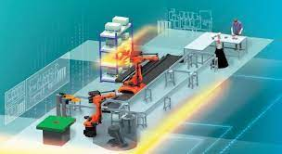
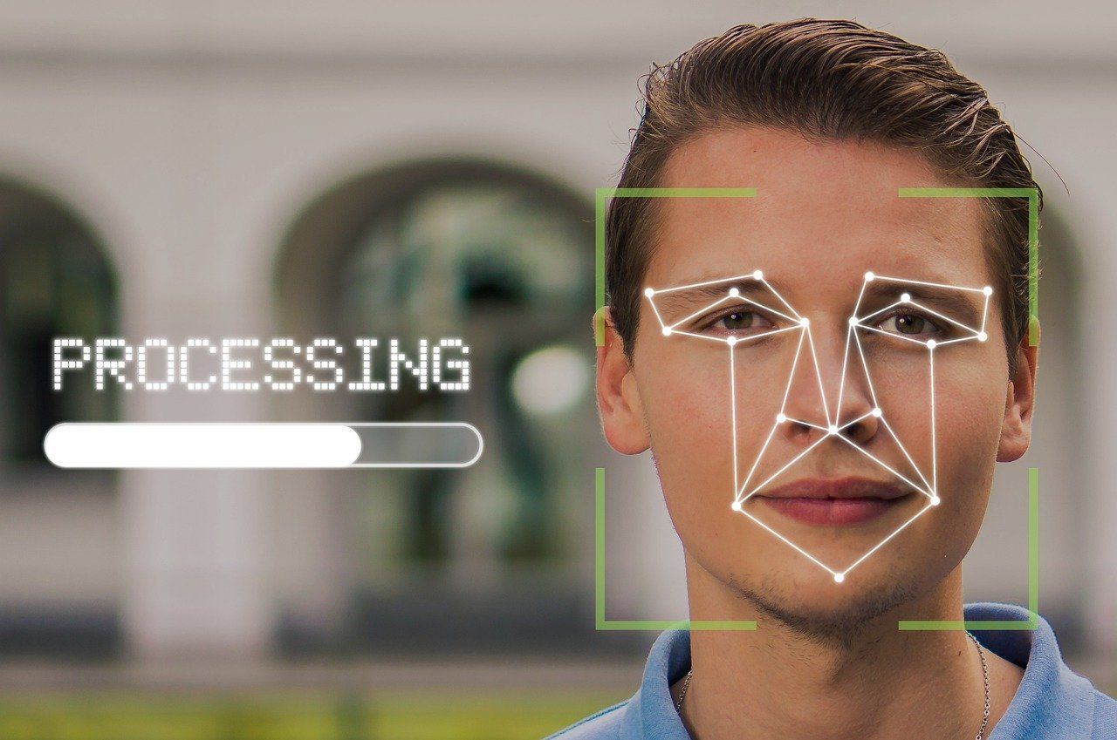
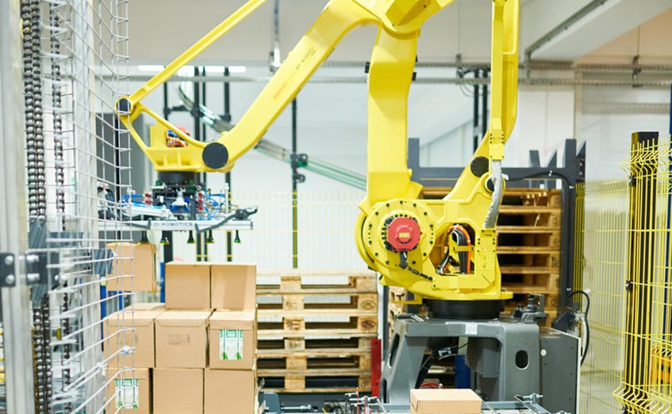
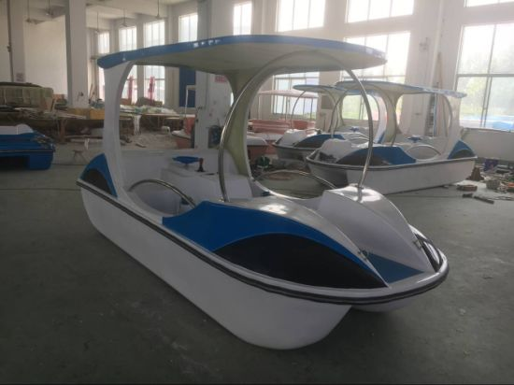
Topic and project idea

Slide 6
No | Call | Title | link | Action | Deadline
1 | HORIZON-CL4-2022-RESILIENCE-01-05 | Technological solutions for tracking raw material flows in complex supply chains (RIA) | https://bit.ly/3d4v5i9 | HORIZON-RIA HORIZON Research and Innovation Action | 30 March 2022
2 | HORIZON-CL4-2022-TWIN-TRANSITION-01-07 | Digital tools to support the engineering of a Circular Economy (Made in Europe Partnership) (RIA) | https://bit.ly/3lpC0qD | HORIZON-RIA HORIZON Research and Innovation Actions
3 | HORIZON-CL4-2022-RESILIENCE-01-21 | Leveraging standardisation in Digital Technologies (CSA) | https://bit.ly/3o95JG7 | HORIZON-CSA HORIZON Coordination and Support Actions
4 | HORIZON-CL4-2022-RESILIENCE-01-26 | 'Innovate to transform' support for SME's sustainability transition (CSA) | https://bit.ly/3lqiJW6 | HORIZON-CSA HORIZON Coordination and Support Actions
5 | HORIZON-CL4-2022-RESILIENCE-01-25 | Optimised Industrial Systems and Lines through digitalisation (IA) | https://bit.ly/3G3Edjh | HORIZON-IA HORIZON Innovation Actions
6 | HORIZON-CL4-2022-TWIN-TRANSITION-01-01 | Rapid reconfigurable production process chains (Made in Europe Partnership) (IA) | https://bit.ly/3DcFH95 | HORIZON-IA HORIZON Innovation Actions
7 | HORIZON-CL4-2022-TWIN-TRANSITION-01-03 | Excellence in distributed control and modular manufacturing (Made in Europe Partnership) (RIA) | https://bit.ly/3odMonj | HORIZON-RIA HORIZON Research and Innovation Actions
8 | HORIZON-CL4-2022-TWIN-TRANSITION-01-04 | Intelligent work piece handling in a full production line (Made in Europe Partnership) (RIA) | https://bit.ly/3DdiSCm | HORIZON-RIA HORIZON Research and Innovation Actions

Slide 7
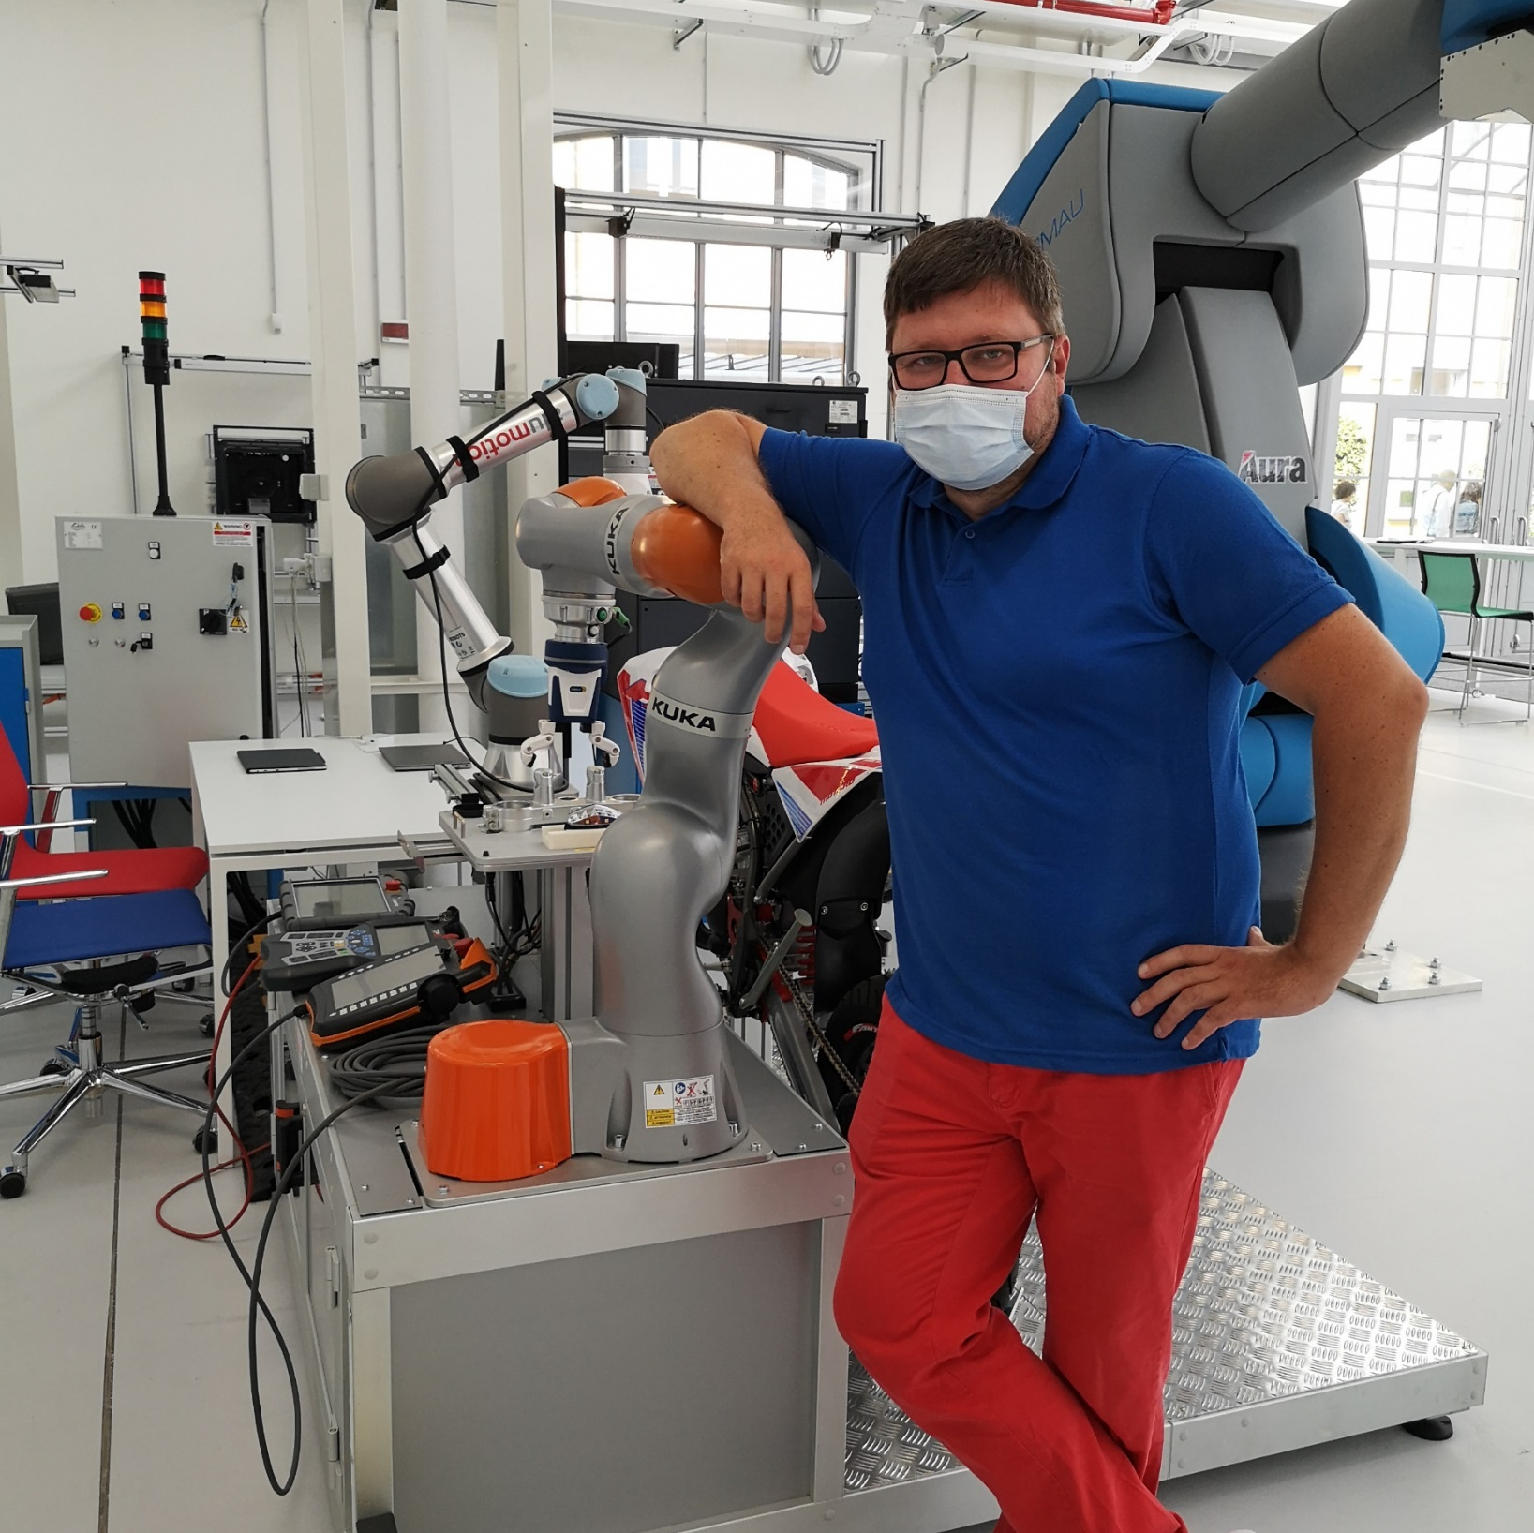
Contact us:
http://intechcentras.lt/
marius.kvedaravicius@intechcentras.lt
https://www.linkedin.com/in/mariuskvedaravicius/

