Slide 1
Thrust – DRONES + ai SYSTEM FOR HIGH QUALITY DATA GATEHRING AT A LARGE SCALE
COMPANY PRESENTATION
Horizon Europe Matchmaking Event
2022-01-21

Slide 2
A start-up developing fixed-wing UAV platform and its integration with advanced analytics

Slide 3
OUR SOLUTION:
Automated diagnostics performed with cutting-edge uavs
COMBINATION OF SENSORS, INCL. LIDAR (25 KG MTOW* / 8 KG PAYLOAD)
SLOWEST FIXED-WING UAV IN THE MARKET (CRUISE AT 43 KM/H FOR HIGH QUALITY DATA)
FAST WHEN NEEDED (MAX SPEED OF 120 KM/H CAN BE USED TO REACH THE INSPECTION SITE)
LONG RANGE (UP TO 300 KM IN ONE MISSION)
GREEN (FUEL CONSUMPTION OF 0,35 L/H)
*MTOW - Maximum take off weight

Slide 4
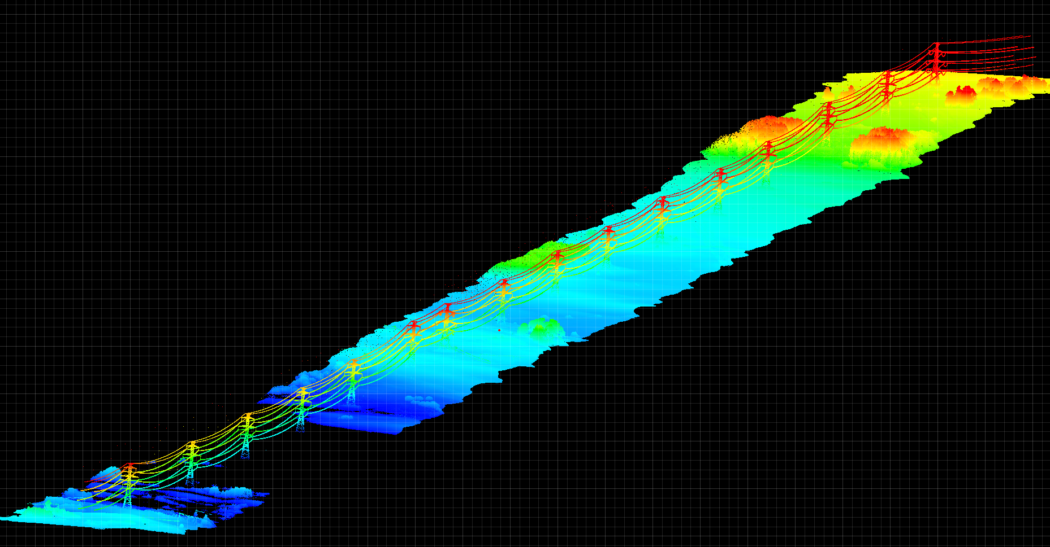
LidAR data analysis foR high voltage power lines (transmission)
Lidar data sample
For electricity transmission grid, LiDAR data is used to calculate curvature of the cable (catenary) to assess the safety (the cables contract and expand due to temperature, cables that hang too low can cause outages and even fatal incidents). Other uses include: identifying dangerous vegetation, unauthorized industrial activities and high-risk objects, measuring geometric deviations, modeling temperature-dependent behavior.

Slide 5
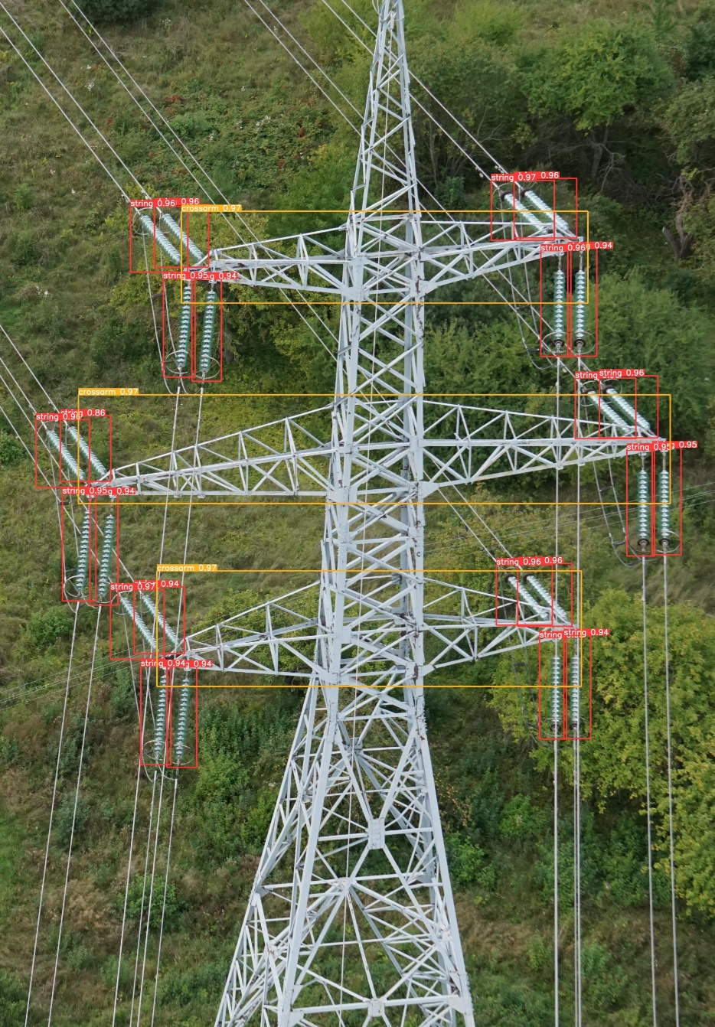
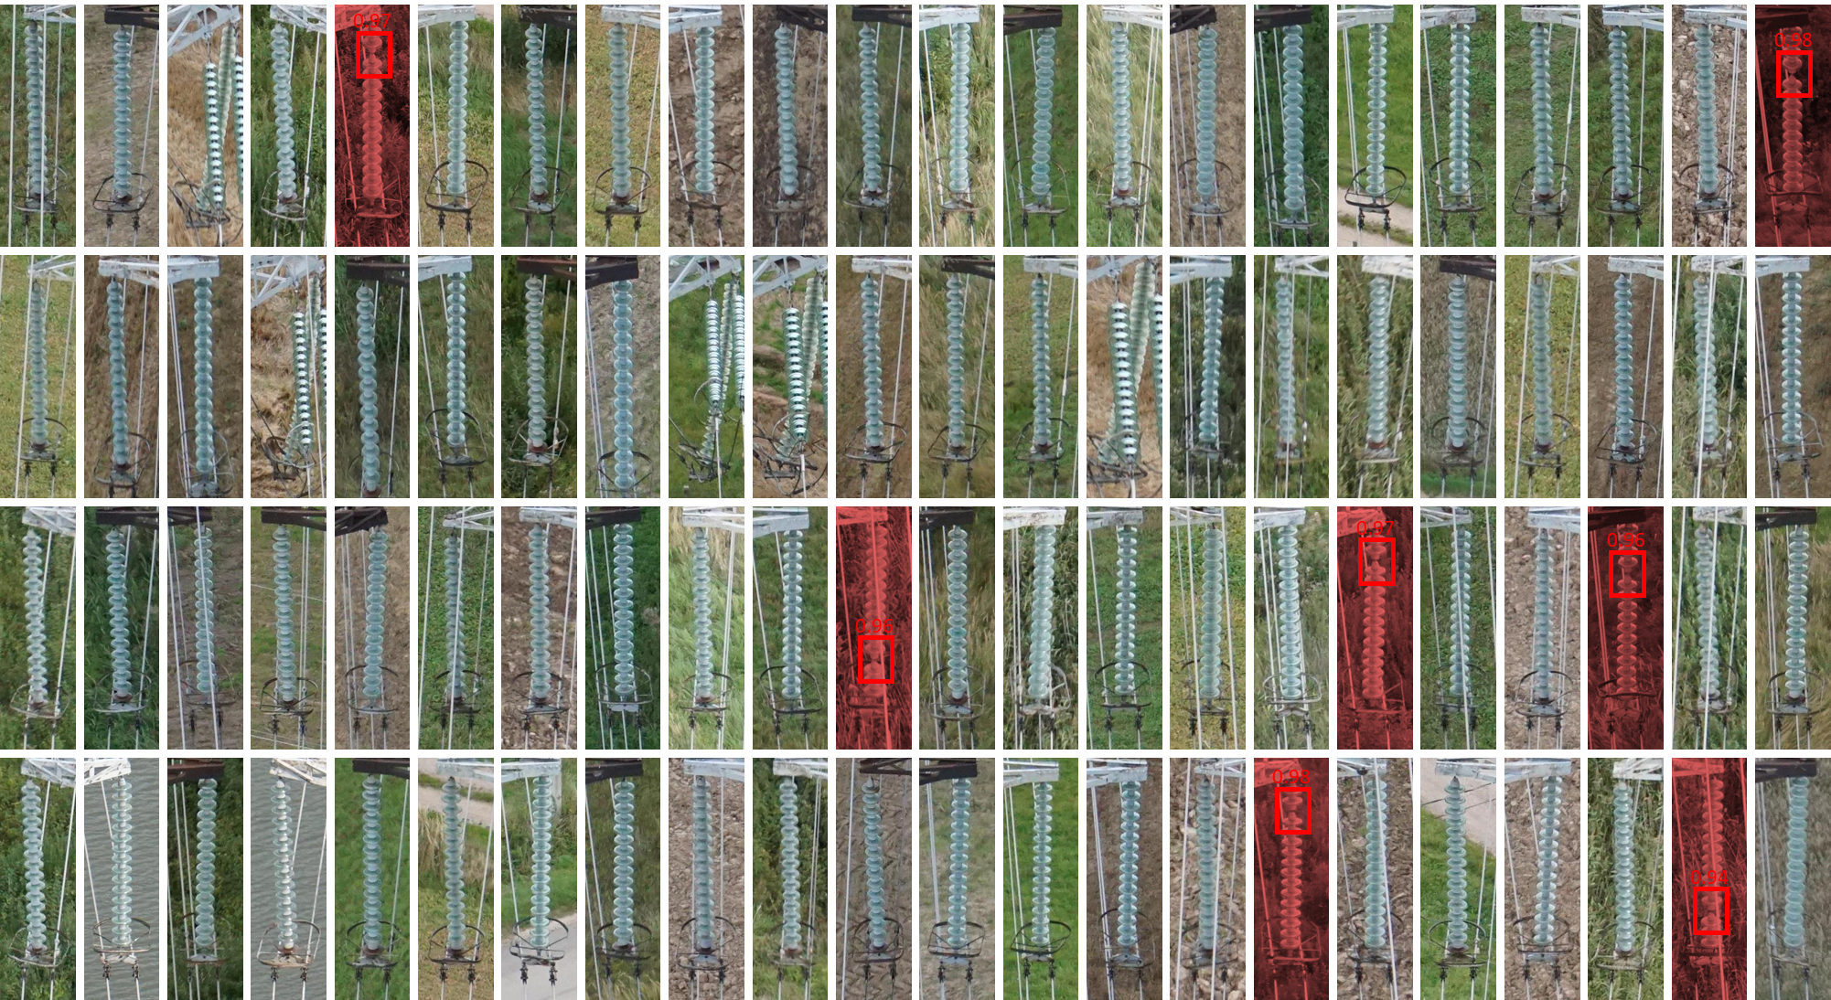
RGB data analysis EXAMPLE foR HIGH voltage POWER lines (TRANSMISSION)
RGB data sample

Slide 6
IN EU 7,2 Million KM OF INFRASTRUCTURE REQUIRE ROUTINE MONITORING, which results in 92,4 million km are driven each year
PROBLEM
1.
Unmanned aerial robotic system development and performance optimization for specific mission parameters (optionally with the training of drone operators and drone maintenance)
2.
AI-based analytics software development for specific purposes (detecting specific objects, automatically performing customized analytics)
3.
High quality data collection services with multisensory capabilities (LiDAR, RGB, IR, multispectral, etc.);
4.
Data collection and analysis using advanced AI/ML analytical tools and reporting the final results
5.
Our team brings together decades of experience in mechatronics, aviation, software development as well as data analytics, preparation of funding applications, business analytics, strategy and project management

Slide 7
We are looking to join consortiums where we can adapt our drone + AI solution to new use cases Our industries of interest: Energy, road inspections, forestry, environmental agriculture, and other (we are always open to new ideas)

Slide 8
GINTAUTAS NEDZVECKAS
Gintautas@thrust.lt
+370 6 95 95 120
www.thrust.lt

