Slide 1


SODIRA CONNECT
Cécile Gloaguen
Networking event on Digital and Emerging Technologies and
Human-centered AI
24 January, 2022

Slide 2
Short introduction of the institution
SODIRA Connect is a company specialized in the field of "Edge Computing" which uses all the power of its technologies to serve the Internet of Things (IoT) and Content Delivery markets worldwide through its innovative products and services.
Its offer includes intelligent gateways that embed innovative software solutions such as caching, prefetching, secured data processing (including pictures, videos etc.) and a software solution suite installed locally or in the cloud to manage a complete network of sensors, intelligent gateways, contents and applications, while preserving the important aspects of security & safety.
In 2021 SODIRA Connect acquired ADVANTEN and completes its product offering and its range of skills.
Advanten specializes in the design and manufacturing of antennas and wireless connectivity solutions for mobile and fixed applications. Our products are intended for civilian, industrial and military applications.
Building on its expertise in the field of radio transmissions, ADVANTEN offers both radio modules and complete end-to-end radio solutions.

Slide 3
Expertise
R&D in RF and antenna design and digital signal processing
Radio design including 6G: complex analog filters, receivers, amplifiers
Complex antennas/ antenna networks design, including 6G
Radio Direction Finders/radars/data link design
Complex algorithmics for position tracking
Complex full radio systems simulations/ optimisation
R&D skills in edge cloud:
Collaborative deep edge computing solutions
Mobile deep edge computing gateways
Integration between deep edge and cloud
R&D skills in cybersecurity:
Edge-based security solutions for IoT
Content caching security implementation
IPS/IDS for IoT applications
R&D skills in Content Caching:
Context-aware/ 6G caching strategies
Intelligent algorithms for cache content placement
Involving content and users related information
Distributed caching algorithms of content delivery (network cost,..)

Slide 4
Project portfolio as technical partner:
  SCENE - mobile IoT platform for smart city applications
  COMBO - fixed and Mobile Convergence
  CAMION - caching for vehicular networks
  CHARISMA - caching for SDN
  5GMEDE - mobile Edge Computing
  Terranova - beyond 5G THz networks
  UAV retina - caching in drone network
  AIRLOC RAPID project (Radio Direction Finder)

Slide 5
Topic and project idea (edit)
All topics regarding
Deep edge computing linked to AI,
Antenna and RF design

Slide 6


Contact details
Jean-Charles POINT
pointjc@sodira-connect.com
06 08 07 24 73
Cécile GLOAGUEN
cecile@sodira-connect.com
02 99 84 13 98
Visit our websites
www.sodira-connect.com
www.advanten.fr

Slide 7
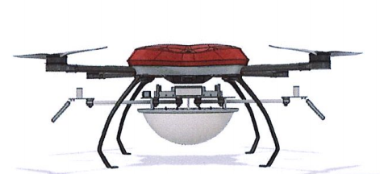
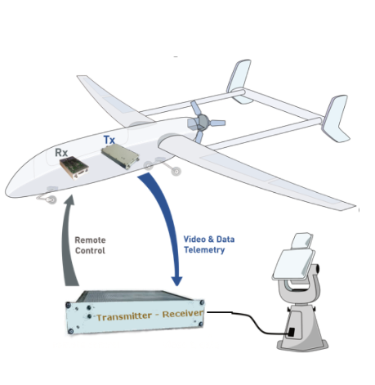
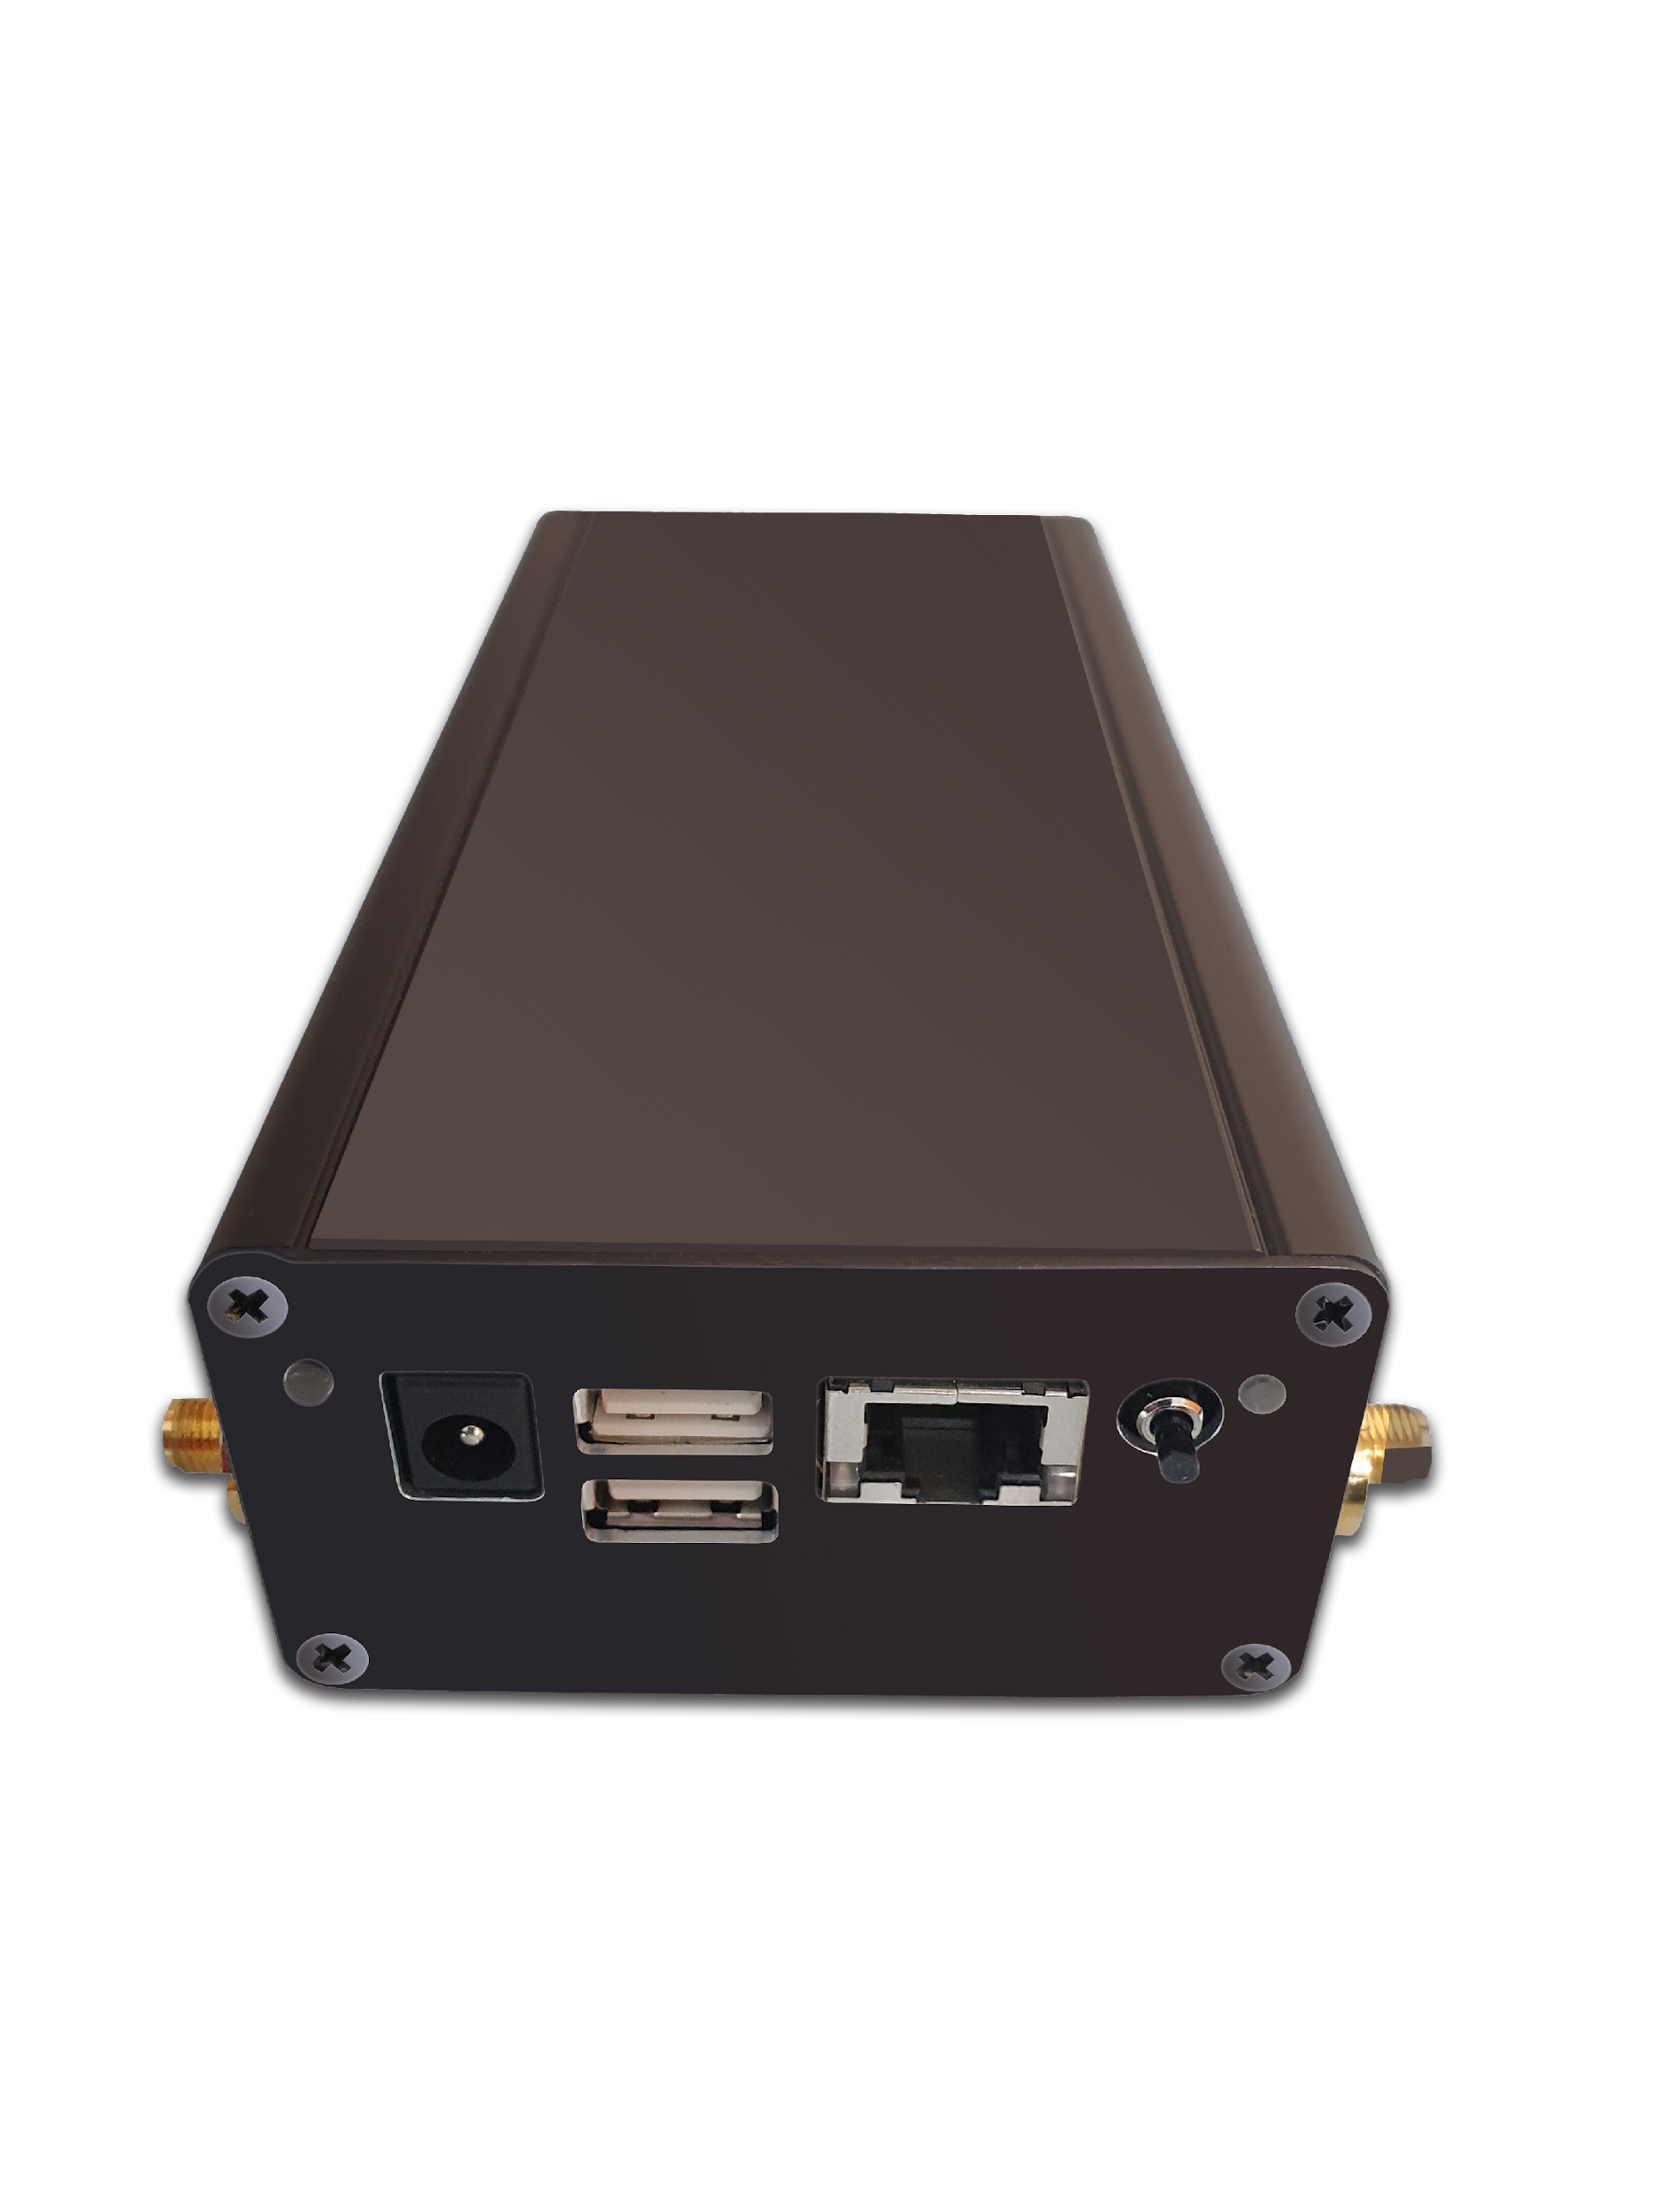

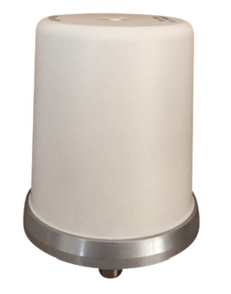
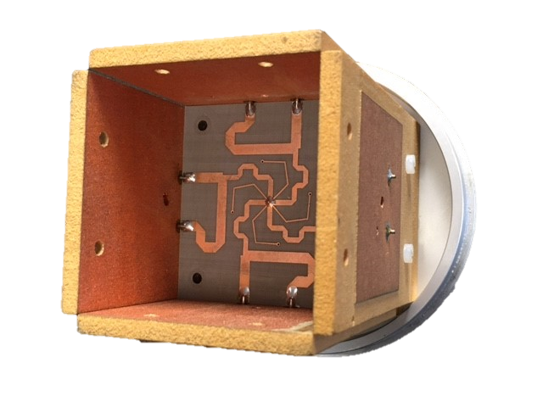
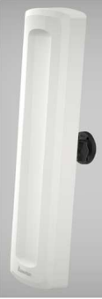
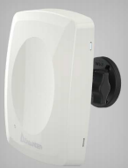
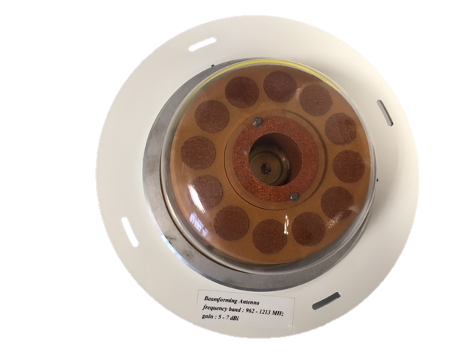
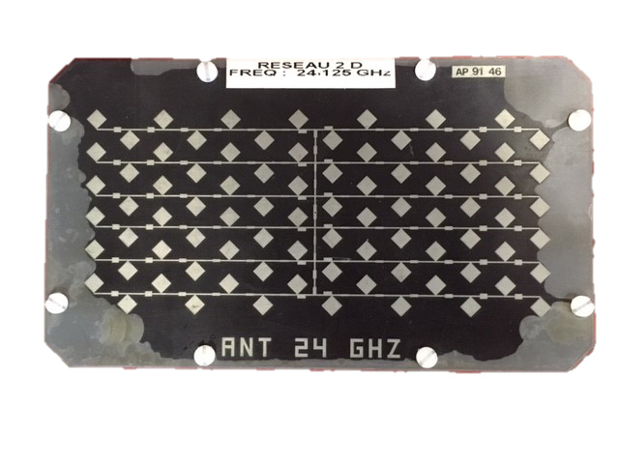
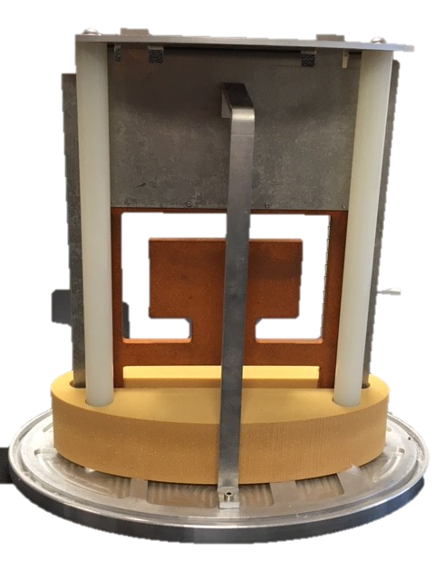

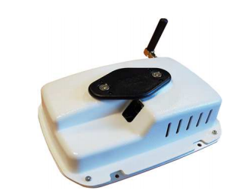










Products and some Key References…
ViewSys Solution
e2Collect Solution
AIRLOC Product
Embedded system & Ground Station
Smart Vision Content Delivery Orchestration Edge/Cloud
Broadband Radio Direction Finder
Antenna products
e2Manager
e2Gateway
High specification antennas, Directional and omnidirectional, Multi bands, Ultra Wideband (UWB) antennas, Sector and Multi Sectors.
Indoor geolocalisation
BLE beacons with configuration by LoRa
NAVICollect Solution
Complete IoT solution with Service Platform
Galop-1 Product LoRa Gateway
NAVIGateway
NAVIManager
References

