Slide 1
Real time data analysis on the Unified AI platform
Zoltan Mathe, PhD
IdomSoft Ltd.
Networking event on Digital and Emerging Technologies and
Human-centred AI
24 January, 2022

Slide 2










IdomSoft Ltd and ICT & IT National Laboratory
ICT & IT National Laboratory
Consortium members
IdomSoft Ltd.
National Security Service
Partners

Slide 3
IdomSoft Ltd.
IdomSoft Ltd. is a 100% indirect state-owned company, a member of the NISZ Group, which plays a leading role in the development, integration, installation and operation of IT systems of national significance, under the supervision of the Ministry of Interior.
Unique experience in:
  the development of high-security IT systems for e-government boards and law enforcement bodies.
  prepared to provide other IT services, e.g. IT management consulting, design and implementation of IT systems, hardware and software selection, operation of IT systems and the provision of related service activities.
  R&D (developing and integrating AI technologies for e-governance and more )
Our Company has played a significant role in the largest IT development projects, affecting and supporting the Hungarian population in various areas of public administration.
IdomSoft Ltd. is developing the data processor of the 12 basic national registers, as well as the entire IT system supporting police activities.

Slide 4
Our Competencies (1)
Research and Development
Text to Speech (TTS) and Speech to Text (STT) solutions optimised to Hungarian language
Natural Language Processing (NLP): chat-bots and complex conversational systems
Image processing: real time video streams and picture analysis (face recognition, face verification, real time face analysis etc.)
Real time data analysis using big data platform: anomaly detection, pattern recognition, improving security of system interoperability (intended to use deep learning in addition to classical machine learning algorithms)
Automated administration based on Deep Learning neural network
Artificial intelligence for IT operations (AIOPs)
Semantic interoperability: defining common interface description language, interface generation

Slide 5
Our Competencies (2)
IT system design and implementation
  New applications: mostly based on micro service architecture in order to provide high availability, reliability and maintainability for maximizing the quality of the services
  Agile development processes: IdomSoft Ltd. makes serious efforts to use agile methodologies for developing new systems
  Quality assurance: unit, regression, integration system and performance testing
  DevOps: automated development lifecycle (CI/CD)
IT operation
  Operating various IT-systems: serious experience and reference
  Cloud technologies: reducing IT operation costs and maximizing service availability, using Kubernetes-based Openshift, Rancher as PaaS
Security
  Secure and trusty administration based on Blockchain technologies
  PKI-based secure communication
  Various integrated key protocols for authorizations

Slide 6
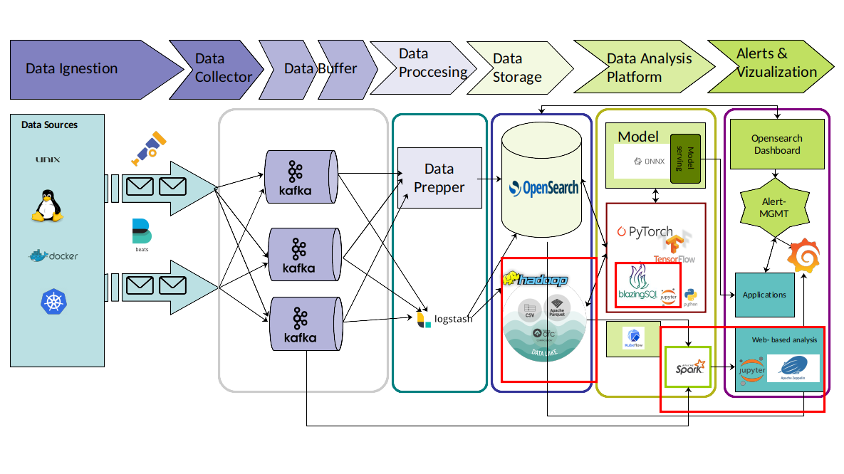
Project idea
Unified AI and data platform, which integrates all steps such as Data Collection, Data processing, Data Storage etc. which are required to analyze huge amount of data using AI technologies
Main characteristics:
  Supports both offline and real time data analysis
  Decentralized (the platform can include different resources Cloud, HPC etc.)
  User friendly: Analysis can be made through web browser and the data analysis will be performed where data is located.
  Integrate a reporting and alarm system with supports various communication protocols
Use cases:
  AI driven decision making
  Monitoring IT systems (AIOps)
  Improving production line
  and more ...

Slide 7
Topics, Project interest
Topics: real time data processing on Data Ocean, data analysis and visualization in distributed systems, data exchange and interoperability, big data, data mining, AI
Projects interest:
  Advanced Computing and Big Data:
    World Leading Data And Computing Technologies 2022 (Horizon CL4-2022-DATA-01)
    Technologies and solutions for data trading, monetizing, exchange and interoperability (AI, Data and Robotics Partnership) (IA)
    Extreme data mining, aggregation and analytics technologies and solutions (RIA)
  Artificial Intelligence and Robotics:
    A Human-centered and ethical development of digital and industrial technologies 2022 (HORIZON-CL4-2022-HUMAN-02)
    Digital and emerging technologies for competitiveness and fit for the green deal (HORIZON-CL4-2022-DIGITAL-EMERGING-02

Slide 8
Contact details
E-mail: international@idomsoft.hu
Mobile: +36 30 947 48 51

