Slide 1
Łukasiewicz-EMAG: potential for cooperation
Mateusz Skowroński
Łukasiewicz Research Network – Institute of Innovative Technologies EMAG
Networking event on Digital and Emerging Technologies and
Human-centred AI
24 January, 2022

Slide 2











Łukasiewicz – EMAG is a member of Łukasiewicz Research Network
Third largest research network in Europe
Around 8 000 employees
28 Institutes
12 cities
350 milion EUR revenue
Smart mobility
Digital transformation
Health
Sustainable economy and energy
4500 scientists

Slide 3

Main areas of activity of Łukasiewicz-EMAG
Cybersecurity
AI, Prediction, Decision support systems
Digital Public Services
IoT, Industry 4.0
Research and certification
Counteracting social exclusion
Availability +
Digital Education Center

Slide 4
Short introduction of the institution
Łukasiewicz Research Network – Institute of Innovative Technologies EMAG is a network institute specializing in applied computer science, technical information technology and information technologies. The Institute deals with, among others broadly understood cybersecurity, artificial intelligence, data analysis (decision support systems), IoT (Industry 4.0, Smart Cities), digital public services and laboratory research. The unit carries out tasks affecting the computerization and IT security of the country.
Participates in creating the National Scheme for Assessing and Certifying the Security and Privacy of IT Products and Systems in accordance with Common Criteria. The Institute is also implementing a project involving the launch of the Cyber ​​Security Center. Strong relationships with the industry, especially mining and energy, allowed to build a strong potential with experience, knowledge, implementation facilities, and a laboratory infrastructure in the field of testing equipment, systems and machines.

Slide 5
AI Expertise
In the area of ​​AI / ML, the institute carries out a number of R&D works and projects related to the following issues: personalization of treatment, analysis of clinical and genetic data, applications of AI / ML in cybersecurity, diagnostics of machines and devices, creation of analytical platforms for processing sensitive data. Examples of key AI / ML projects implemented at the Institute are:
• Integrated Analytical Platform,
• A skeleton system of automatic translation into Polish Sign Language using the mechanism of a virtual human figure,
• Building a dedicated tool to protect users, systems and devices of the Internet of Things, based on machine learning and behavioral analysis,
• Childhood ALL in Poland (CALL-POL) project - national harmonization of diagnosis and treatment of acute lymphoblastic leukemia in children.
Łukasiewicz-EMAG specialists also participate - as experts - in the preparation of challenges and competitions in the field of AI / ML announced on the GovTech platform.
Running/completed projects
ROCD – Reducing risks from Occupational exposure to Coal Dust
CIRAS – Critical Infrastructure Risk Assessment Support
VALUESEC – Mastering the Value Function of Security Measures
OSCAD – Computer-aided business continuity management
Storage-battery locomotive (weight 12t and drive power 40 kW)
Hardware-software platform of the intelligent PLC network for multi-meter applications in systems that measure and settle consumed energy automatically
CRZ (Central Register of Risks) – system for the management of expert knowledge and information on security risks in rail transport
CCMODE – Common Criteria compliant, Modular, Open IT security Development Environment
Increased consumption of energy from renewable sources in the building industry
INDIRES – Information Driven Incident Response
BSHC – a new type of hybrid wireless sensors network for traffic monitoring of vehicles and pedestrians with data transmission and objects localization algorithms

Slide 6
Topic and project idea
We are developing our artificial intelligence competence center. We would like to establish cooperation with similar centers in Europe for example within a project for European Network of AI Excellence Centres: Expanding the European AI lighthouse (RIA)
Expert and decision support systems
Artificial intelligence
Cybersecurity

Slide 7
Łukasiewicz - EMAG is the leader of the AI ​​competence center in the Łukasiewicz Research Network
  PhD students of the Doctoral School of the Silesian University of Technology
  Graduates of the Faculty of Automatic Control, Electronics and Computer Science of the Silesian University of Technology
  Research and teaching staff of the Faculty of Automatic Control, Electronics and Computer Science of the Silesian University of Technology
Team

Slide 8
Competence applied analytical methods
Statistical methods
Standard AI / ML methods and algorithms (full range)
Incremental learning methods (full range)
Team Methods zespołowe (boosting, bagging, stacking,
meta-learning)
Deep learning methods (including CNN, transfer learning,
lifelong learning)

Slide 9
Competence analyzed data
Tabular data
Image
Sound
Logs
Text

Slide 10






Experience
  Analysis of clinical and genomic medical data (e.g. PersonALL, eCALL-POL projects)
  Industrial data analysis
  Machine diagnostics, failure detection, threat detection (Mittal, Tauron)
  Forecasting the demand and sales (AIUT Sp.z o.o., 3Soft, retail)
  Forecasting natural hazards
  Bank data analysis, analysis of debt collection processes
  Detecting abuses in data held by local government administration offices

Slide 11
Offer
Matching mathematical models to measurement data characterizing a given process (model identification)
Analysis and acquisition of knowledge on the method of process control by operators, process control optimization
Application of machine learning methods in cybersecurity systems
Creation of diagnostic models of devices enabling the assessment of the diagnostic condition of the device, detection of failure possibilities, analysis of the causes of failures
Creating forecasting models based on historical data (predicting product quality depending on the set production parameters, predicting the demand for utilities (water, energy, gas), hazard classification)

Slide 12
Offer
Survey data analysis
Other tasks of statistical and exploratory data analysis
Creation of intelligent dialogue systems
Reliability and survival analysis
Detection of causes and relationships between process parameters
Analysis of the use of machines and devices by operators

Slide 13
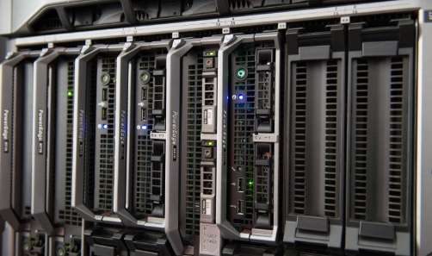
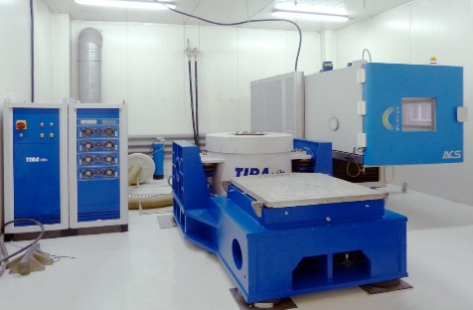
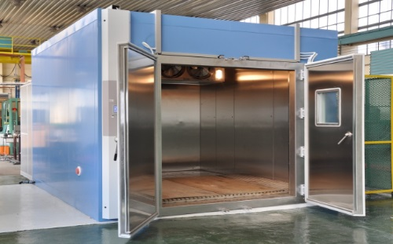
Areas of ŁUKASIEWICZ – EMAG competence
  Cybersecurity laboratory – ITSEF
  IoT + 5G
  Electromagnetic compatibility (EMC) testing laboratory
  Chemical analysis laboratory (solid fuels),
  Calibration Laboratory

Slide 14
Łukasiewicz Research Network – Institute of Innovative Technologies EMAG
Contact details
40-189 Katowice
ul. Leopolda 31
www.emag.lukasiewicz.gov.pl
emag@emag.lukasiewicz.gov.pl
mateusz.skowronski@emag.lukasiewicz.gov.pl

