Slide 1
AI-POWERED GENOMICS 4iG
Imre Szücs
Principal Data Science and Machine Learning Architect
Networking event on Digital and Emerging Technologies and Human-centred AI
24 January, 2022

Slide 2
VISION AND STRATEGY
Thanks to its extensive partner networks in Hungary and abroad, 4iG provides its solutions based on the technologies of global companies as well as its own developments. The company’s acquisition strategy greatly contributes to the profitable operations of the group, the continuous involvement of additional resources and the penetration of new markets.
Holding structure
In addition to IT, 4iG is aiming to build strong market positions in the telecommunications and space industry in Hungary, Central and Eastern Europe and South-Eastern Europe. The link between the three areas is data, therefore the company is investing in sectors such as IT, telecommunication, and aerospace which create the opportunity to build strong synergies. 4iG's investments are aimed at increasing business efficiency.
Telecommunications,
infrastructure
IT System
integrator
Space industry
4iG – PARTNER IN DIGITAL INNOVATION

Slide 3
360-degree IT services
In the focus industries, 4iG is present in numerous fields of business life with its IT expertise, covering a significant part of the Hungarian economy. Thus, besides important entities in the public sector, our clientele includes both Hungarian medium and large enterprises and international corporations. Our industrial expertise is based on understanding the way of business thinking, the processes and specific knowledge of the particular industry. We have gained this expertise at many of our clients by observing sectoral “best practices”, regulations, standards and certifications.
DIGITAL SOLUTIONS
FOR INDUSTRIES
Production,
manufacturing
4iOP products
and solutions
Financial
sector
Agriculture,
food industry
Transportation,
logistics
Energy,
utilities
Pharmaceutical
industry
Healthcare
Public
administration
NGOs, civil
services, charity
Education
Proptech
real estate
management
Construction,
mechanical engineering,
cultural heritage
4iG – PARTNER IN DIGITAL INNOVATION

Slide 4
R&D activities in the HEALTHCARE domain
ESTABLISHMENT OF HEALTHCARE COMPETENCE CENTRE
https://www.4ig.hu/Egeszsegugyikompetenciakozpont
MEDICAL DIAGNOSTICS PROJECT
https://www.4ig.hu/KFprojektek/orvosdiagnosztikai-projekt
AI-POWERED GENOMICS PLATFORM

Slide 5
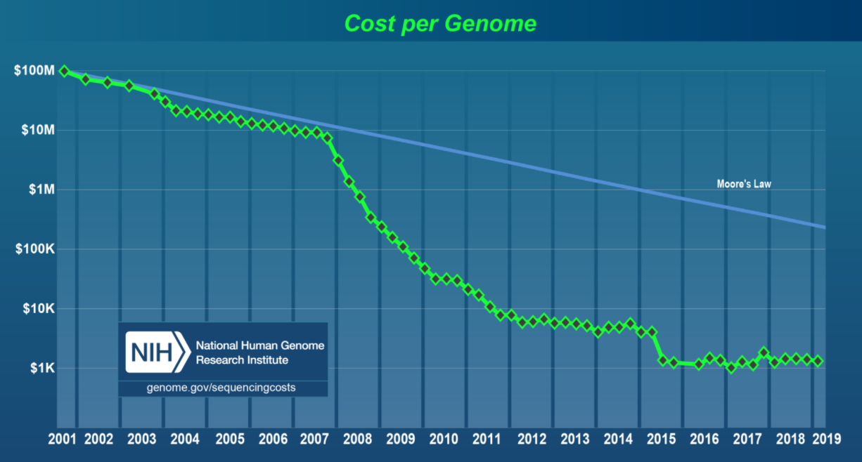
DATA @GENOMICS
The huge drop in the cost of sequencing and the value potential of genomics will increase dramatically the available data.
To manage and analyze tremendous genomics data assets requires special skills and technology.

Slide 6
EMPOWERING THE ECONOMY ON GENOMICS with AI-POWERED GENOMICS PLATFORM
ENTERPRISE-READY
TECHNOLOGY & CAPABILITIES
Data governance
Data privacy and IT Security by design
Genomics workflow management
MLOps for model lifecycle management
CUTTING EDGE MACHINE LEARNING AND ARTIFICIAL INTELLIGENCE
DNA sequence analysis
Read alignment
Variant Calling
Protein structure modelling
…
PRIVACY
SECURITY
MACHINE LEARNING
BIOINFORMATICS
GENOMICS DATA MANAGEMENT

Slide 7
THANKS FOR YOUR ATTENTION!
AI-POWERED GENOMICS
IMRE SZÜCS
Principal Data Science and Machine Learning Architect
Imre.szucs@4ig.hu

