Slide 1
SmartLabs
Budapest University of Technology and Economics

Slide 2
ABOUT US
BME, Budapest University of Technology and Economics, Hungary
Since 1782, 8 faculties, ~21 000 students
Department of Telecommunications and Media Informatics
Since 1949, ~100 employees
Head of department: Dr. Pál Varga
https://www.tmit.bme.hu/
SmartLabs
Since 1978, ~15-20 employees, 2 DSc, 9 PhD, 8 PhD (international) students and
30-40 (international) MSc/BSc students
Head of Laboratory: Dr. Géza Németh
http://smartlab.tmit.bme.hu/
http://lsa.tmit.bme.hu/en

Slide 3
Speech synthesis
Speech and multimodal information systems
Automatic speech recognition
Speech acoustics
Acoustic company image
Multimodal interfaces/media
Speech databases
Human-Computer Interaction (HCI)
Speech quality assessment
Competence fields of the
Speech Communication and
Smart Interactions Laboratories
Human-Robot Interaction (HRI)
Speaker recognition
Mobil user interfaces
Intent/Emotion recognition
Mobile sensor analytics/fusion
Voice diagnosis
Multilingual solutions
Call center automation
Testing of information systems
Statistical methods (Hidden Markov Model, Deep Learning)

Slide 4



























INDUSTRIAL PARTNERS AND SPINOFFS
SoleCall

Slide 5
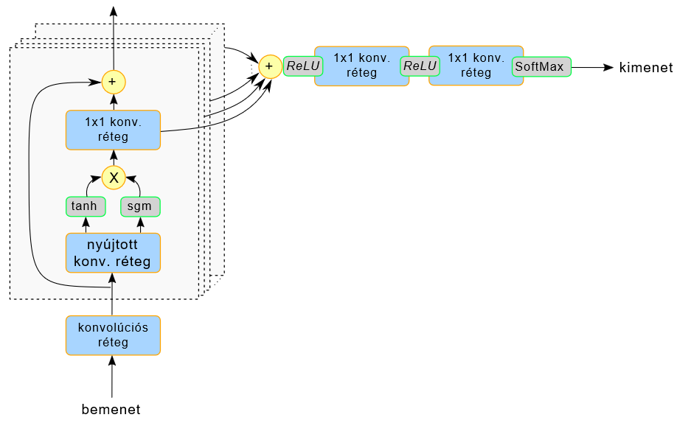
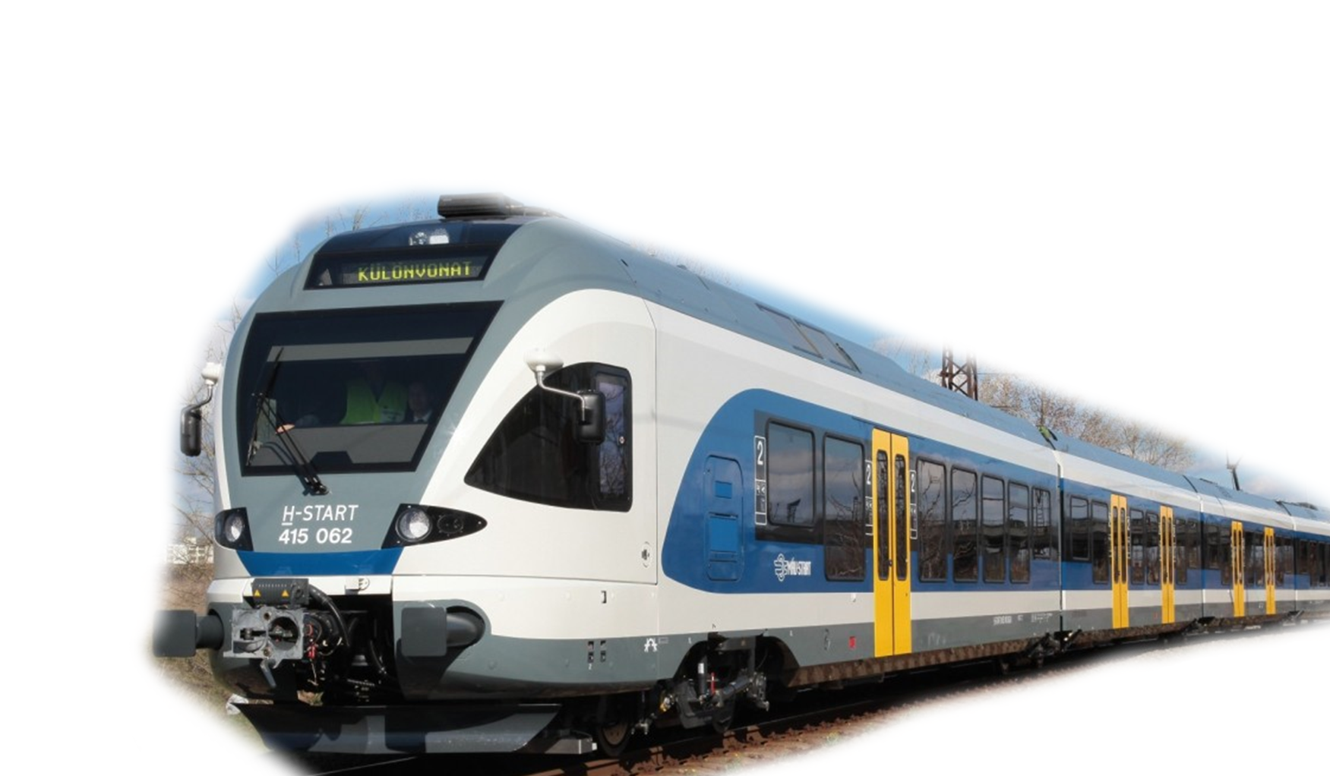
APPLICATIONS – SPEECH SYNTHESIS
AI driven railway announcement system running at more than 100 railway stations in Hungary!
1d 1x1 CONV
1d 1x1 CONV
output
1d 1x1
CONV
Based on NVidia tools:
WaveNet
WaveGlow
Tacotron2
Ongoing research:
Speech rate
CPU inference
Hungarian adaptaion
Interrogative sentences
1d dilated CONV
1d causal
CONV
(Based on DeepMind’s WaveNet)
inputs

Slide 6
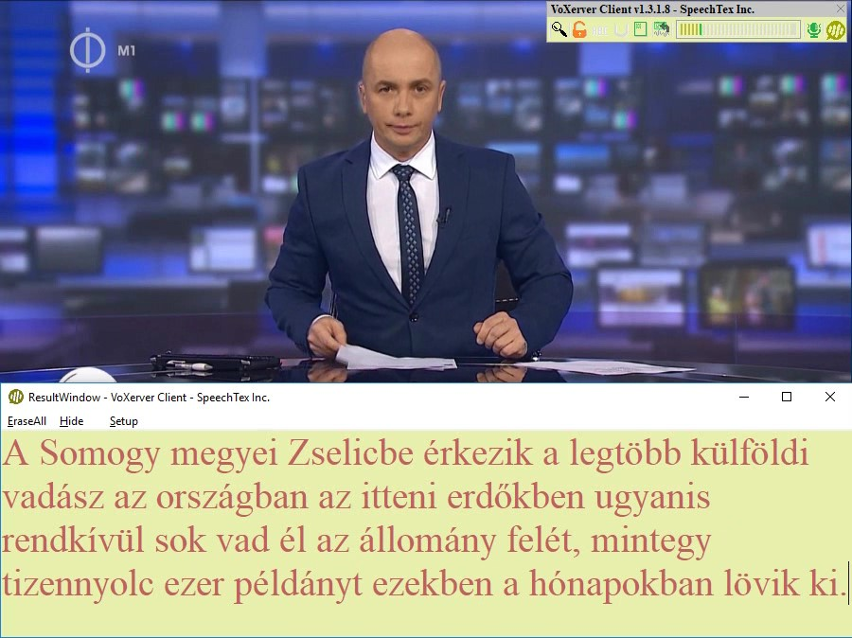
APPLICATIONS – SPEECH RECOGNITION
Realtime
deep learning powered
automatic speech recognition system
Deployed to Hungarian National Television, European Commission,
Banks, etc.

Slide 7



APPLICATIONS – SENSOR DATA ANALYSIS
Sensor data
  Accelerometer
  Orientation
  GPS, WiFi, etc.
Deep Learning based on device
realtime classification
  Behaviour
  Activity
  Motions, gestures
Applications
  Emergency alerts
  Behaviour analysis
  User and user group identification
SoleCall

Slide 8
DEEP LEARNING COLLABORATION
Continental Deep Learning Competence Center Budapest
Joint PhD student
BSc/MSc student topics
Research projects
BSc/MSc student topics
AI Coalition Hungary – International Relations Workgroup Leader
AI4EU European AI On-Demand Platform - National Contact Point

Slide 9
RESEARCH FIELDS
Deep Learning fundamentals
Time series prediction and classification
  multiple timeframes
  weak coherence
  attention mechanism
Deep Reinforcement Learning
  physical architecture search
  neural architecture search
  automated driving
Natural Language Processing
Speech technologies
  text-to-speech synthesis
  automatic speech recognition
  medical applications
  emotion detection
Sensor data analysis
Embedded devices
  model compression
  mixed precision
  smartphone/UAV implementations

Slide 10

email:
nemeth.geza@vik.bme.hu
sztaho.david@vik.bme.hu
THANK YOU

