Slide 1


.1
REGIONAL PROGRAM
BUCHAREST-ILFOV
2021-2027
Simona Curpan

Slide 2

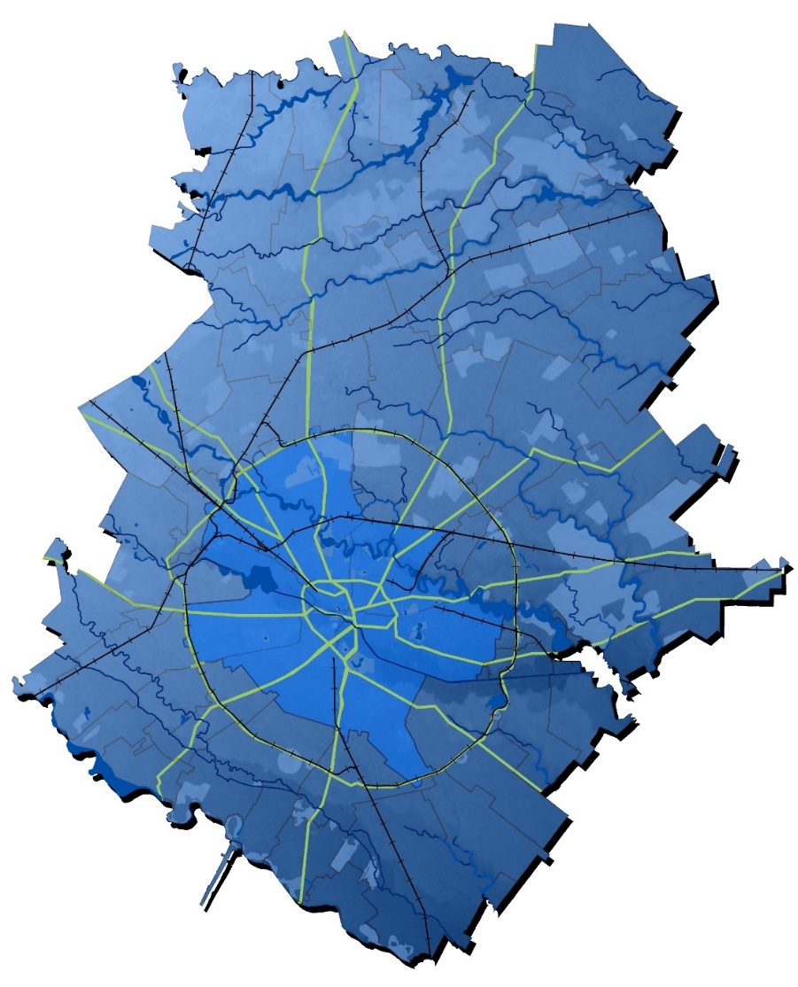
Priority 1 - A competitive region through innovation, digitalization and dynamic enterprises
Priority 2 - A digitalized region
Priority 7 - An attractive and inclusive region
Priority 6 - A region with modern educational infrastructure
Priority 5 - An accessible region
Priority 4 - A region with high mobility
Priority 3 - An environmentally friendly region

Slide 3
Priority 1 - A competitive region through innovation, digitalization and dynamic enterprises – What we support
1.1. the development of an innovative conceptual model - Proof of Concept
1.2. RDI activities in SMEs
1.3. capitalizing on the potential of RDI facilities
1.4. effective collaboration between SMEs and RDI organizations
1.5. innovation clusters for the benefit of SMEs, including by stimulating interregional, international and intersectorial collaboration
1.7. achieving high digital intensity in SMEs
1.8. the advanced digital transformation of SMEs

Slide 4
1.9. Support for sustainable growth and technological modernization of micro-enterprises.
1.10. Support for increasing the competitiveness of SMEs through financial instruments.
1.11. Supporting entrepreneurship by developing business incubators
1.12. Development of skills in SMEs for innovation, technological modernization, industrial transition, circular economy etc.
BUDGET
149.822 million EUR from ERDF (total allocation: 374.555 million EUR)

Slide 5
Priority 4 - A region with high mobility
4.4. Actions to digitize urban public transport systems
Development of intelligent transport systems: public transportation service management, e-ticketing, traffic management, fleet management, passenger information, automatic charging systems, automation of clean public transportation infrastructure elements, data centers etc.
BUDGET
115 million EUR from ERDF (total allocation: 287.5 million EUR)

Slide 6

Discover Bucharest-Ilfov, the region for citizens - 11Stand22368
#EURegionsWeek 2022 / Exhibitors

Slide 7

Thank you!
Bucharest-Ilfov Regional Development Agency
163 Mihai Eminescu street, 2nd sector, Bucharest
Phone /Fax: +40 21.315.96.59; +40 21.315.96.65
E-mail: contact@adrbi.ro
www.adrbi.ro

