Slide 1
TOOLS FOR DIGITALIZATION OF PUBLIC AND MEDICAL SERVICES
Anatolii Petrenko, Prof.,DSc
Igor Sikorsky Kyiv Polytechnic Institute
Networking event on Digital and Emerging Technologies and
Human-centred AI
24 January, 2022

Slide 2

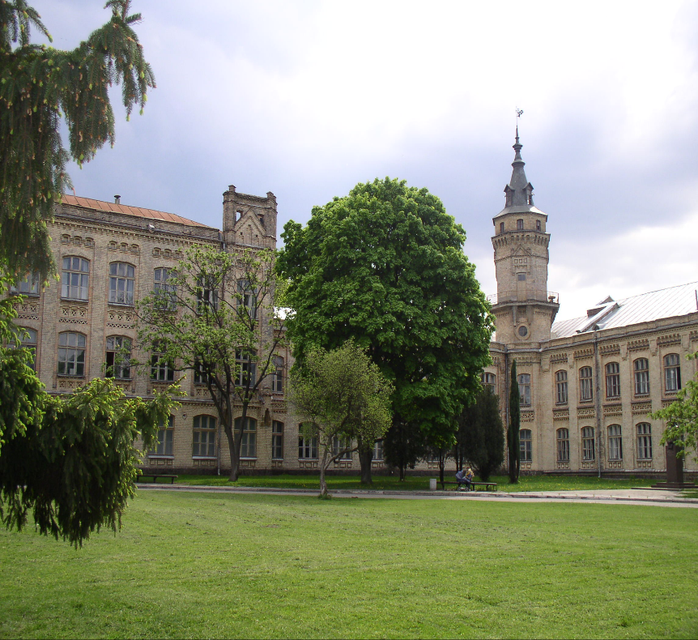
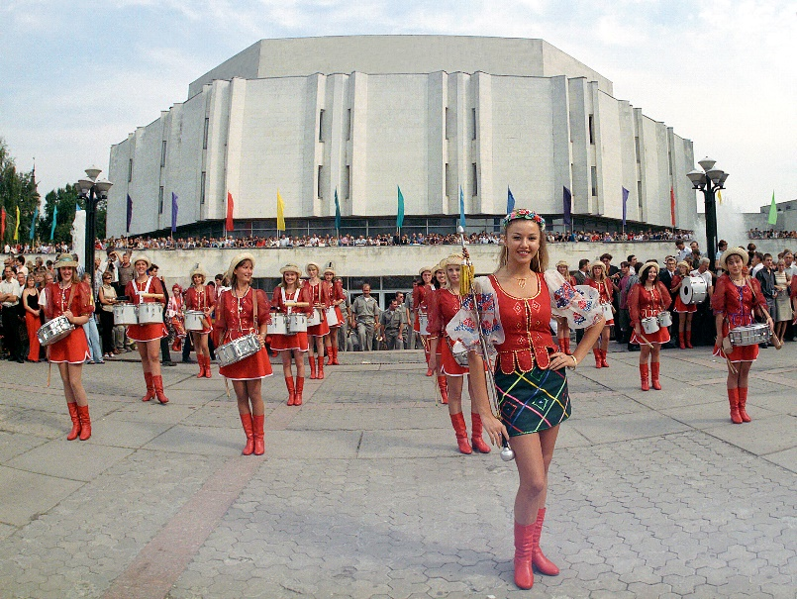
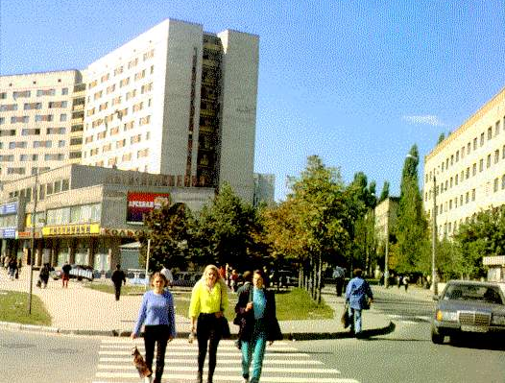
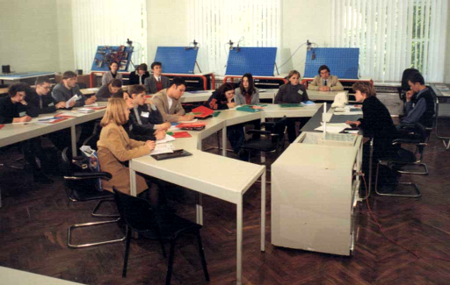
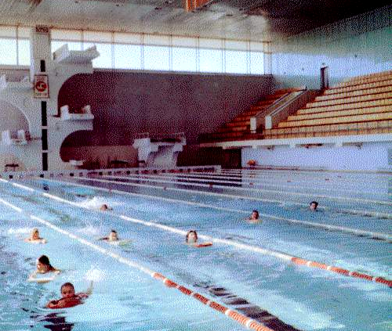
National Technical University “Igor Sikorsky Kyiv Polytechnic Institute”
KPI is one of the oldest and biggest technic universities in Ukraine. It was founded in 1898
2009

Slide 3

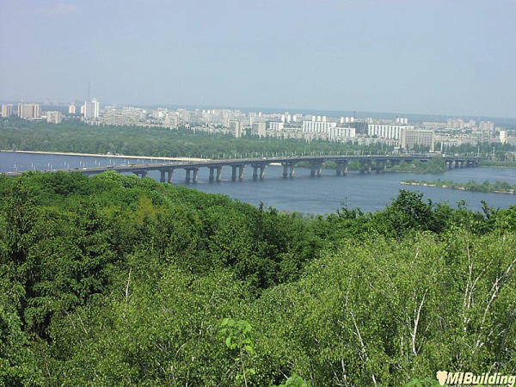
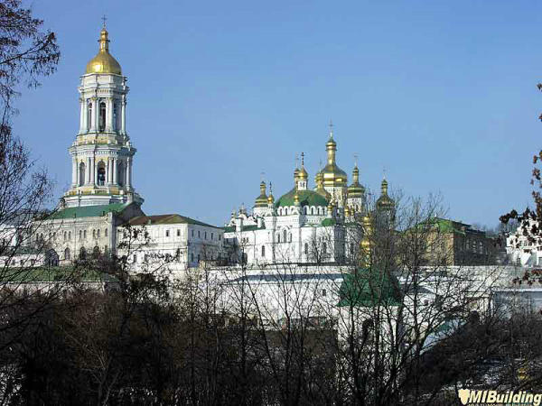

K Y I V
The capital of Ukraine, Kyivhas a population of more than
5 million citizens
Its history goes back to the ancient times of the 5th century
2009

Slide 4

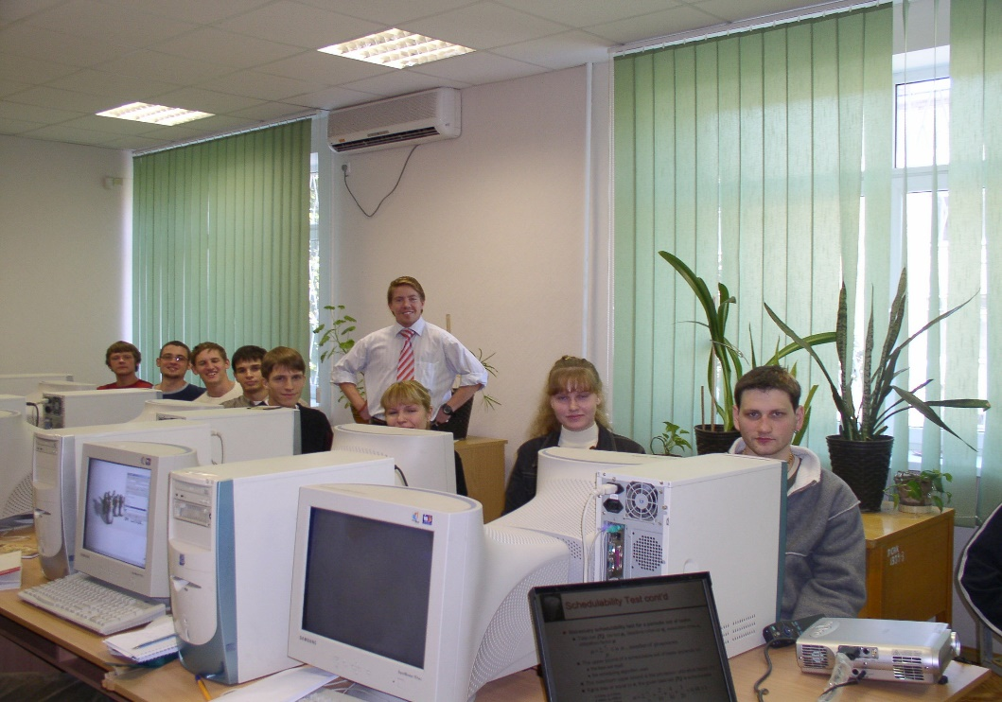
OVERVIEW
Training specialists in 42 specialties, 134 educational programs.
36 000 students
largest producer of engineers in Ukraine
Professors 500
Associate professors 1300
Senior lecturers 500
Assistants 200
2009

Slide 5
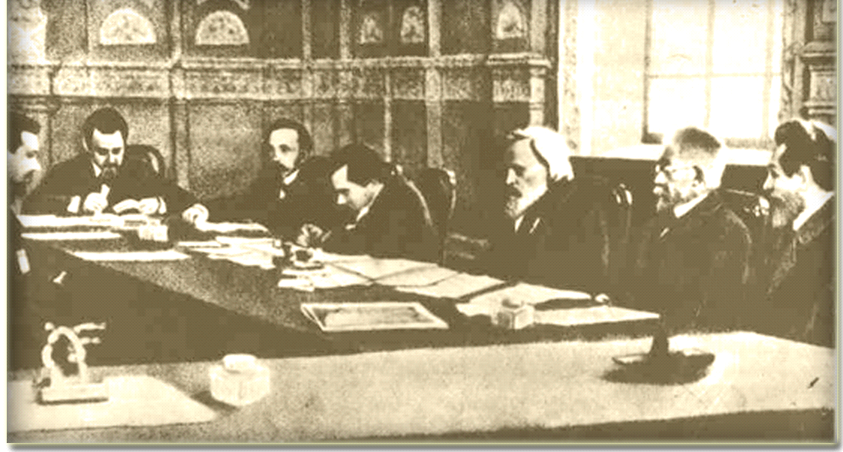
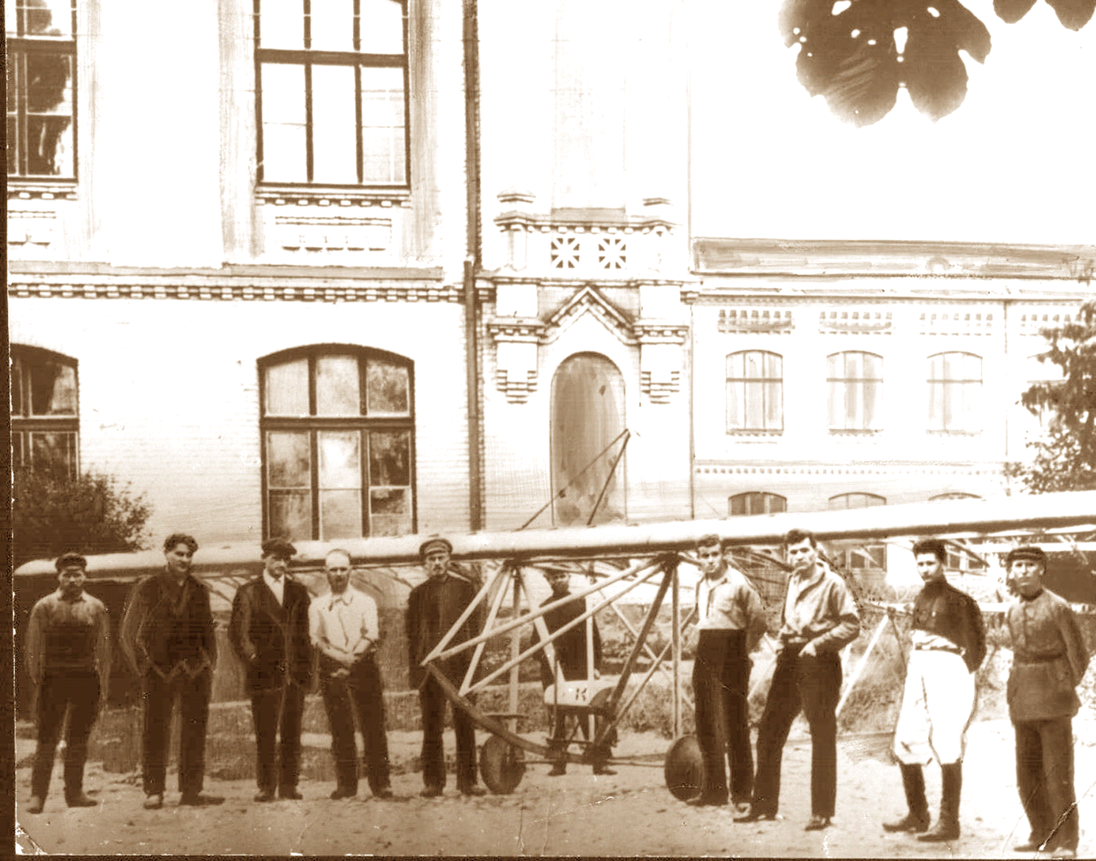
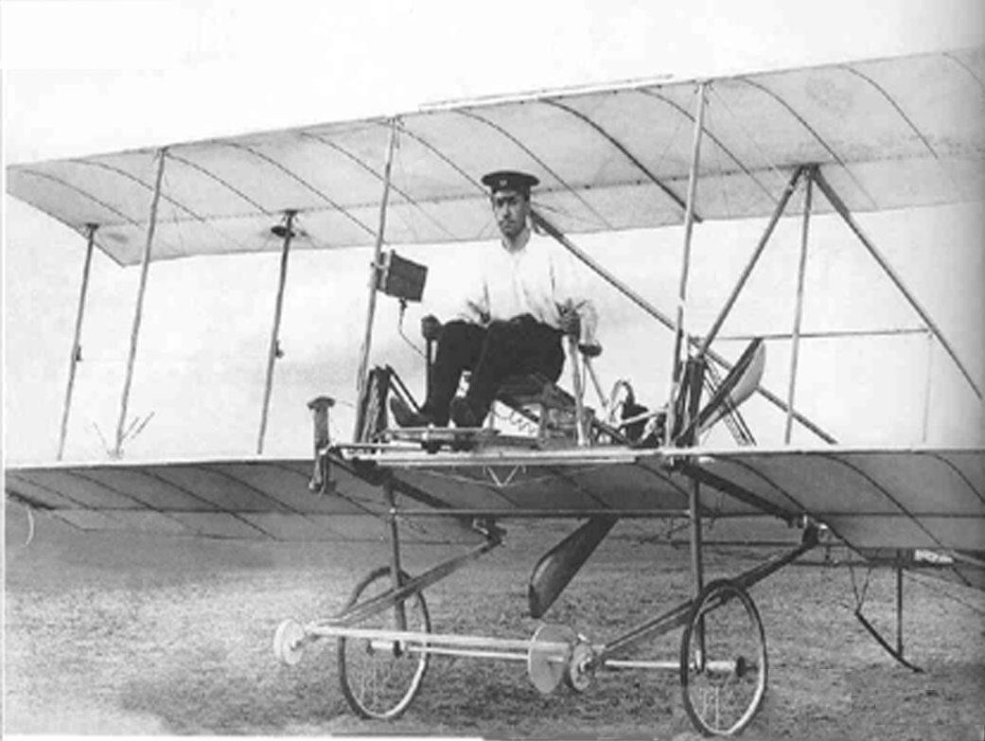
H I S T O R Y
Prof. D.I. MENDELEYEV – Chairman of the first examining board in KPI, 1903
S. KOROLEV – the student of KPI, the member of university air -club
The student I. SIKORSKY in the plane of his own design
2009

Slide 6
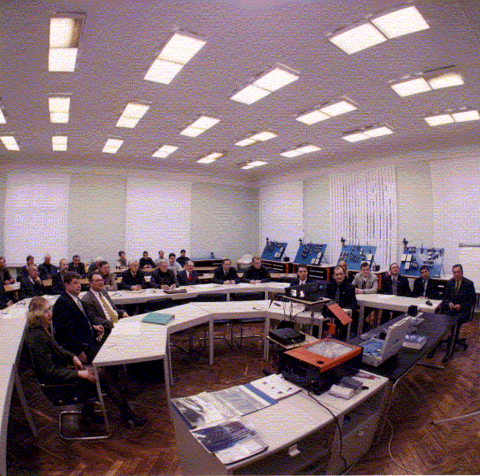
Institute of Applied System Analysis
Research areas:
1. Distributed and parallel systems
2. Cloud Computing (IaaS, PaaS, SaaS, DaaS)
3. Grid and Mobile Computing
4. Service-oriented computing (SOC)
5. Semantic Web Services and Performance
6. Sensing and Sensor Networks
7. Agents and Multi-agent Systems
8. Smart Healthcare and Medical Diagnosis
9. Augmented and Virtual Reality
10. Blockchain and Serverless Computing
2006

Slide 7
Expertise
EXPERTISE

Slide 8
EXPERTISE
№ | 1 | 2 | 3
Call Identifier | H2020-SC1-2016-2017 | H2020-INFRADEV-2019-2 | FP7-PEOPLE-2010- IRSES
Topic | SC1-PM-18-201 (Personalised Medicine) | INFRADEV-03-2018-2019 | Marie Curie Action "International Research Staff Exchange Scheme" (IRSES)
Proposal title | Patient-generated interoperable data systems (PGIDS) for supporting Big Data in eHealth | Strengthening ERA: LifeWatch ENGAGE | Developing Multidomain MEMS Models for Educational Purposes
Proposal ID | 727323 (internal reference number: SEP-210339393) | 871159 (internal reference number: SEP-210584667) | 269295
Proposal Acronym | CrossMed | LW ENGAGE | EduMEMS
Type of action | RIA | RIA | RIA
Data of submission | 16/02/2016 at 05:48:00 | 2019-03-20 at 6:24:05 | 2011-06-01
Participants | Sweden, Netherlands, Ukraine, United Kingdom, Poland, Austria, Italy, Estonia, Greece, Canada | Spain, Belgium, Greece, Italy, Netherlands, Portugal, Slovenia, Ukraine. | France, Belgium, Poland, Ukraine

Slide 9
HORIZON-CL4-2022-DIGITAL-EMERGING-01-03: Advanced multi-sensing systems (RIA)
We propose: 1) a unified approach to modular designing multi-sensing systems for Mobile Health Monitoring, Diagnosis and Anticipating based on the use of interchangeable components-services; 2) modification of the centralized form of services interaction ("orchestration") so as to exclude low-level details of the description of interaction scenarios, but to keep the rules of interaction of services in the knowledge base. This provides moving to the level of "metaprogramming" when the user can build an application from ready-made building blocks (services) relatively easily (easier than traditional writing of program codes), promoting dynamic integration of services from different developers (suppliers) into a single service environment; 3) usage of the knowledge base which has been built on the ontology of the subject area with the use of semantic descriptions of services and semantic methods of their discovery in a rapidly growing size of cloud registers of such services;

Slide 10
HORIZON-CL4-2022-DIGITAL-EMERGING-01-03: Advanced multi-sensing systems (RIA)
We propose: 4) ways of compensating certain shortcomings and inconveniences of using simple portable body sensors and providing rich contextual information in a real application through Deep Learning methods, in particular, the use of the latest convolutional neural networks (CNN) to support the necessary diagnostic procedures; 5) a dynamic mechanism of distribution of calculations between cloud and fog networks taking into account features and capacities of different types of nodes of a computing environment that allows increasing autonomy of a final platform, and also to reduce outgoing traffic and loading on a cloud resulting in reducing significantly overall energy consumption; 6) a mechanism for temporarily storing dynamic data from body sensors in case of loss of network connection, which is based on the calculation of a moving average and allows not to lose this data, but to obtain their average values during the absence of communication with a more detailed description of the latest data.

Slide 11
Contact details
+380 67-597-2077
tolja.petrenko@gmail.com
Please insert your contact details here

