Slide 1

Extended Operator 4.0
Bring back the human worker into the center of the semi-automated systems
Dr. Tamás RUPPERT
University of Pannonia, Hungary
Networking event on Digital and Emerging Technologies and
Human-centred AI
24 January, 2022

Slide 2
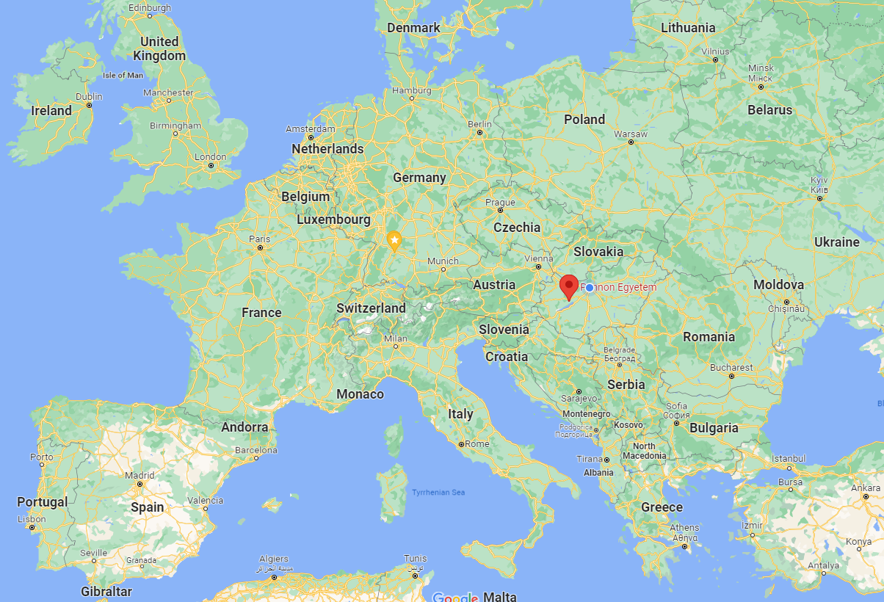
University of Pannonia
University of Pannonia situated in Central-Transdanubia, Hungary, close to Lake Balaton
Acts as Educational Institution, Resarch Institution, R&D Institution
5 Faculties: Business and Economics, Engineering, Modern Philology & Social Sciences, Information Technology, Business Adminstration
Campuses in 4 locations (Veszprém, Kőszeg, Nagykanizsa, Zalaegerszeg)
Landscaped campus
Wide international opportuinties for students & Scholarship opportunities
University of Pannonia has several implemented projects under Erasmus+, H2020, Interreg, Visegrand Fund, Life and Eureka programmes
Project specialization depend on the role of the involved research group or Faculty
Renewing environment, up-to-date infrastructure and technical facilities
Internationally renowned professors, well-trained instructors, acknowledged professionals of business sector
Extensive cooperation with industrial companies and service providers in the teaching process and technology transfer

Slide 3
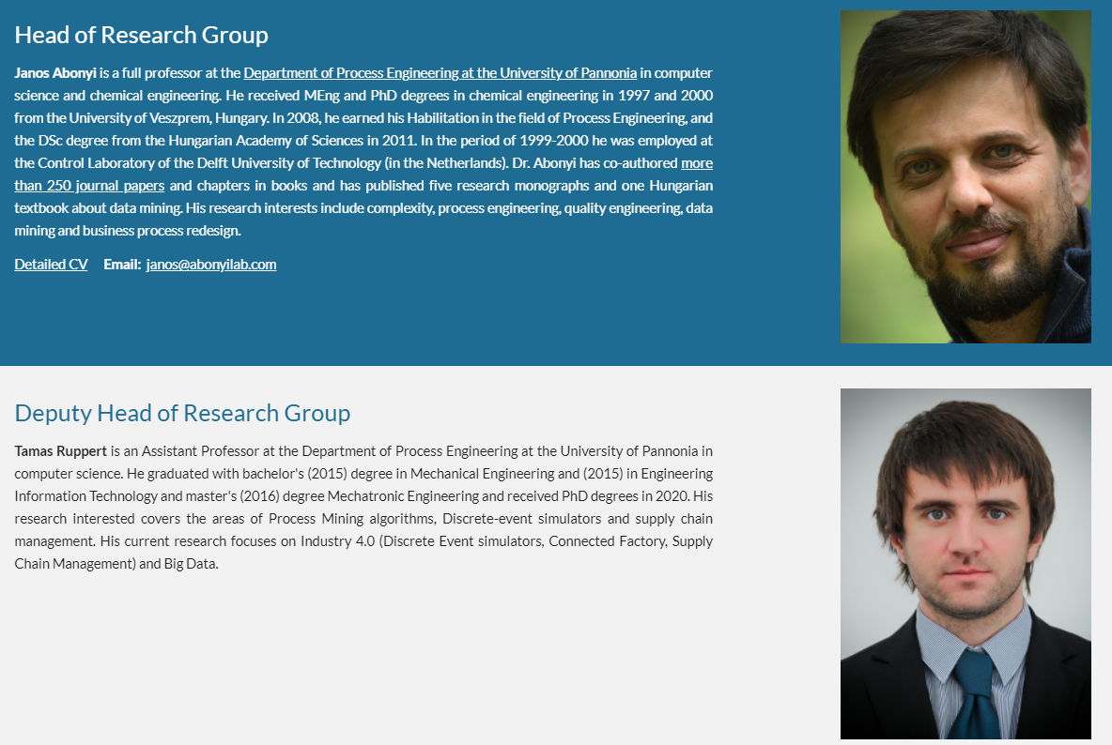

Slide 4
Main pillars of the extended Operator 4.0
Brownfield Industry 4.0
Sensor development
State estimation, data-sensor-, and information fusion
Operator 4.0
Monitoring of workers
Dynamic work instructions
Data-based model discovery
Human-Digital Twin
Process Mining based Digital Twin
Predict human activity Collaborative HCI
Ontology-based representation
Predictive analysics

Slide 5
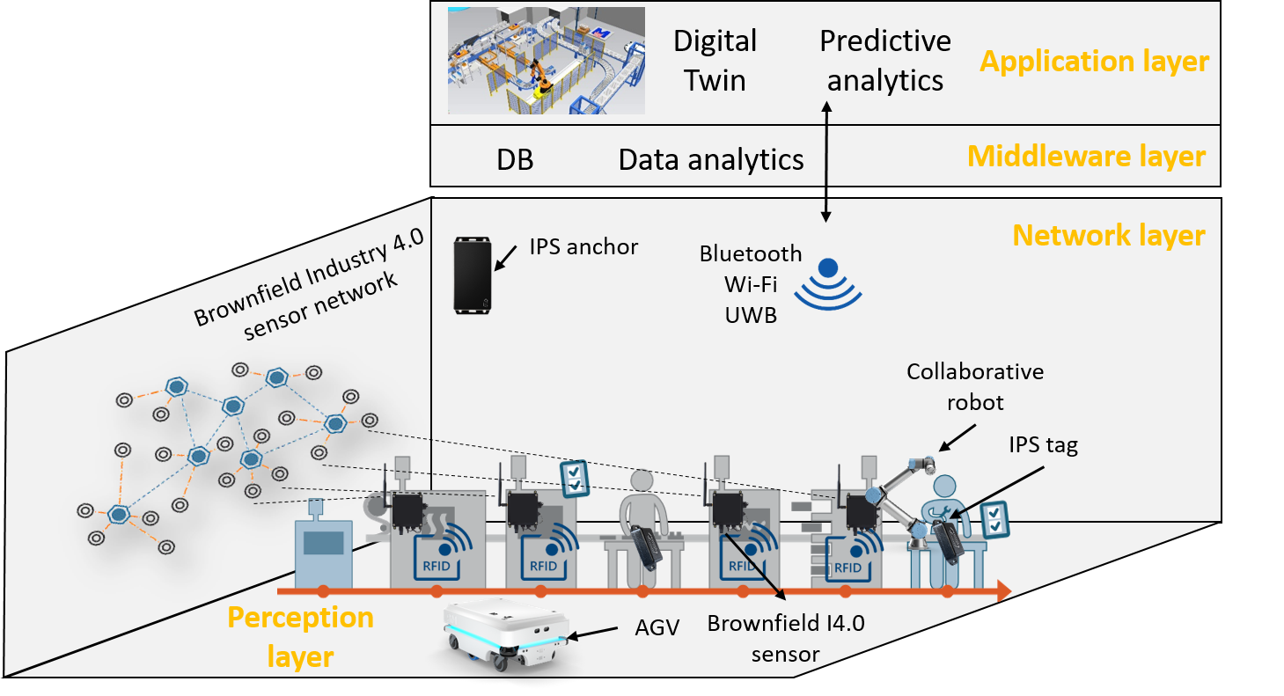
Cooperation and collaboration
Introduction of the Intelligent Collaborative Space concept

Slide 6

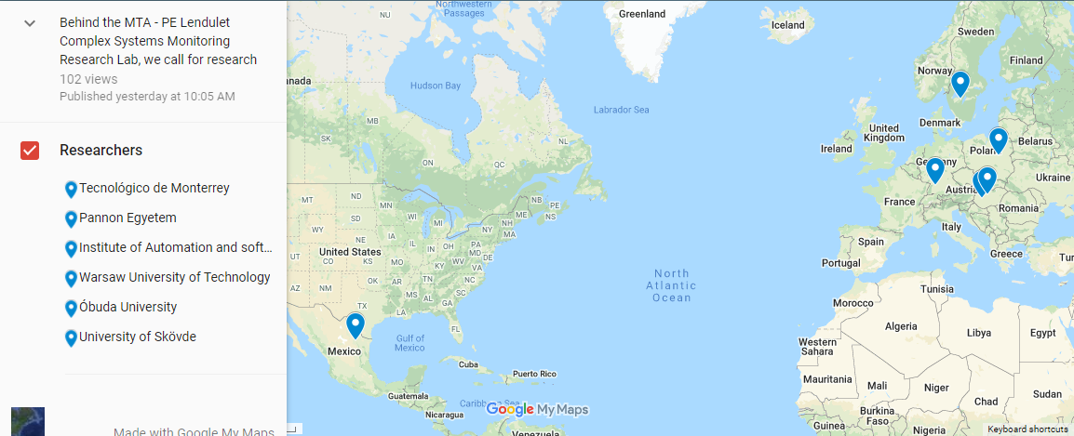
Operator 4.0 community
Dr. Tamás RUPPERT
ruppert@abonyilab.com
abonyilab.com
Call for collaboration to apply a proposal for HORIZON-CL4-2022-HUMAN-01-01: AI for human empowerment (AI, Data and Robotics Partnership) (RIA) call
operator4.com/call-for-collaboration

