Slide 1
HUMAN-ROBOT INTERACTIONS: A SOCIAL ROBOTICS PROJECT AT THE UNIVESITY OF DEBRECEN
Csilla Csukonyi PhD
University of Debrecen,
Institute of Psychology
Networking event on Digital and Emerging Technologies and
Human-centred AI
24 January, 2022

Slide 2
Digital Interaction Research Group
The Digital Interactions Research Group coordinates individual research at our Institute in the following areas:
Psychological aspects of Human-Robot interactions,
Individual differences in human interactions with different robots,
Special attitudes toward Humanoid (Nao) robots.
Application possibilities of human-robot interactions at the workplace,
Development and promotion of ethical (social, emotional needs and respect for human values) human-robot relationships,
Human-to-Human interactions via computers and other digital channels,
E-sports, gamification, home office and online workgroups,
Leadership characteristics of online workgroups.

Slide 3
Expertise of Digital Interactions Research Group at the UD
The effect of cooperation: Behavioural experiments about how shared, common work with robots changes subjects’ attitudes toward Robots/AI
Question of freedom and autonomy: How subjects would react when a robot asks them a favour/shows some level of human characteristics?
Keywords: Humanoid Robots, Cooperation, Social Interaction, Robot Anxiety
Running project: Neurotech Erasmus+ Network WP6
Introducing robot anxiety to Hungarian scientific/psychological literature (Psychiatria Hungarica, 2019), which does exist among employees.
Developing and adopting Robot Attitude measurements (2020). NARS measures the negative attitudes towards robots, RAS Robot anxiety scale and MDRAS complex, multidimensional attitude scale revealing general attitudes toward robots connected to the perceived control and/or autonomy of Robot/AI.

Slide 4
Human-Robot Interaction Project
  On the basis of Human-Robot behavioural experiments developing:
  A complex, multidimensional and ethical measurement, protocol and training to reveal robot anxiety, attitude and planned behaviour toward HRI (Human-Robot Interaction) in different levels and areas of workplaces.

Slide 5
Contact details:
csukonyi.csilla@arts.unideb.hu

Slide 6
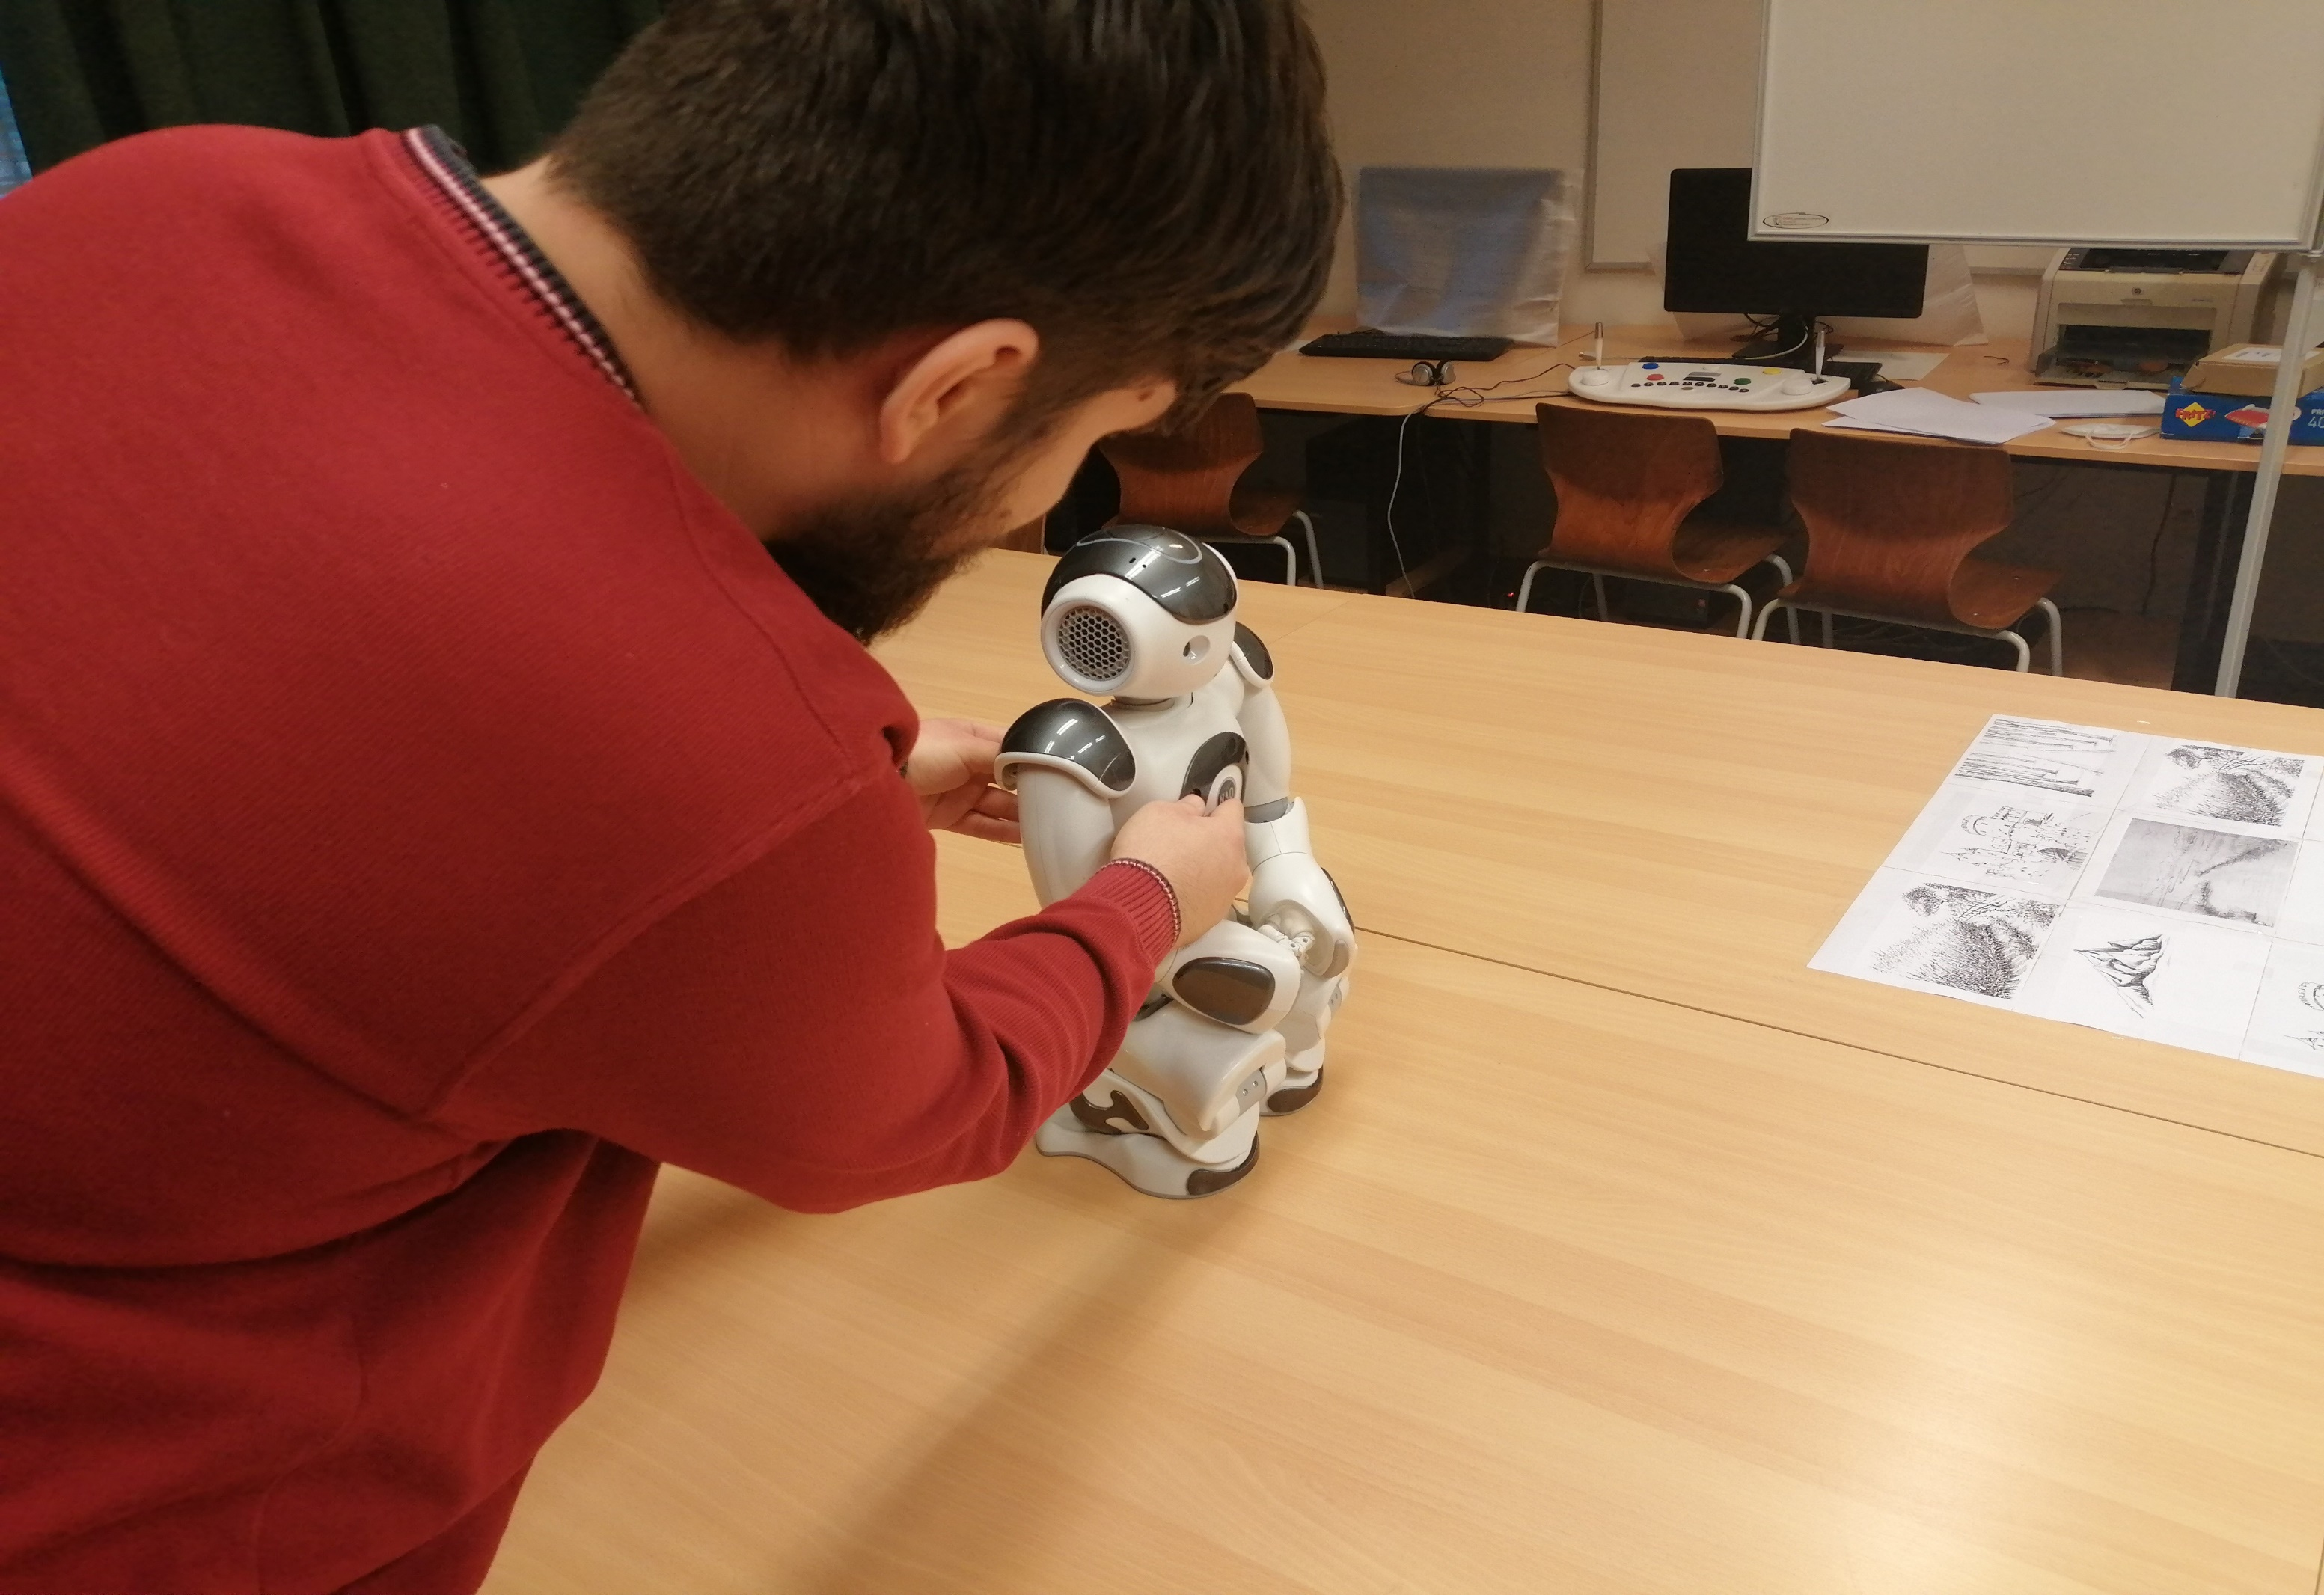

Slide 7
