Slide 1
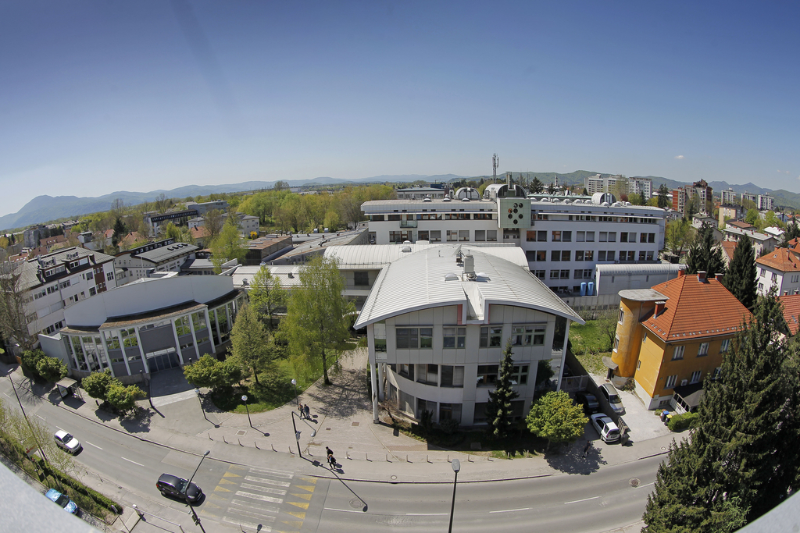
Nanostructured materials, sensors, fuel cells, testing of materials and development of cyber security systems
Dr. Gregor Dolanc, Prof. Dr. Janez Dolinšek
Jožef Stefan Institute, Ljubljana, Slovenia
Leading research institution for natural sciences in Slovenia
Founded in 1949
Broad spectrum of basic and applied research
Staff of more than 950 working in 27 research departments and several centres

Slide 2
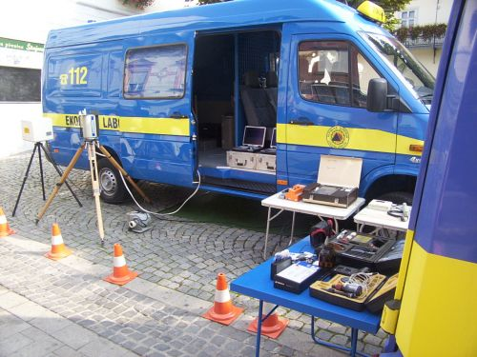
Defence research:
Interdisciplinary research:
Physics
Chemistry
Life sciences
Advanced materials
Computational science
Information and communication technologies
Nuclear research
Energy
Collaboration with NATO
project E-SiCure - Engineering Silicon Carbide for Enhanced Border and Ports Security (2016-2019)
project Atmospheric Pressure Plasma Jet for Neutralisation of CBW (2013-2017)
Collaboration with Republic of Slovenia’s Ministry of Defence
Ecological laboratory with mobile unit (ELME), ongoing collaboration
project "KeraPro" (2007-2010)
project "Unos" (2007-2010)

Slide 3
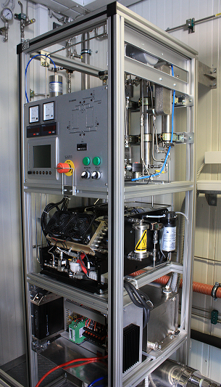
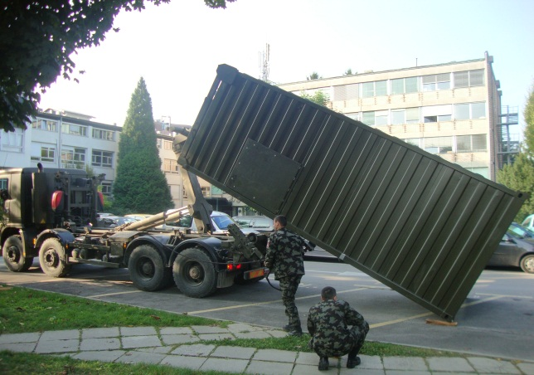
Department of Systems and Control
Fuel cell technology for mobile and stationary applications
Transportable dwelling container with in-built fuel cell cogeneration system (CHP) for electric power and heat supply for a basic military unit
Electric power 7 kW, thermal power 8 kW
Automatic operation and remote supervision
Financed by Slovenian Ministry of Defense, and companies Inea and Domel
Developed by JSI in colaboration with companies Inea and Domel

Slide 4
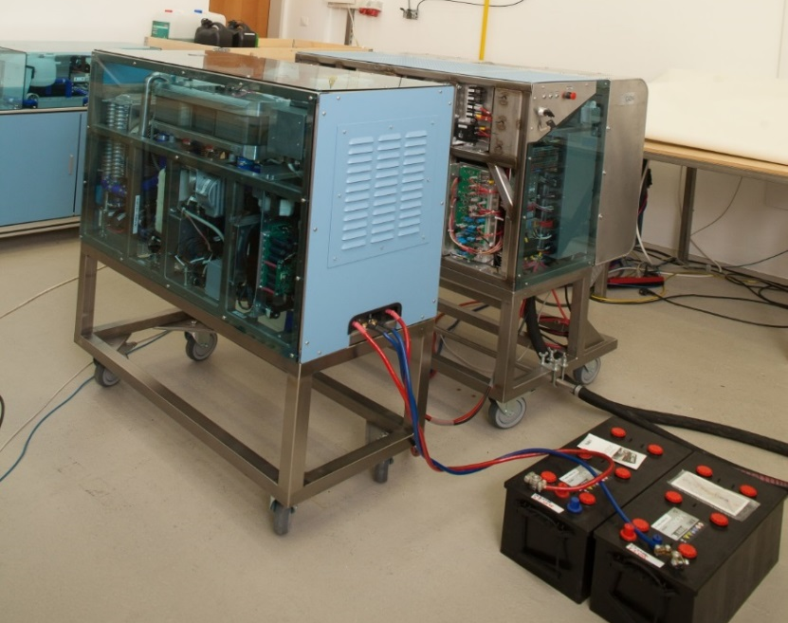
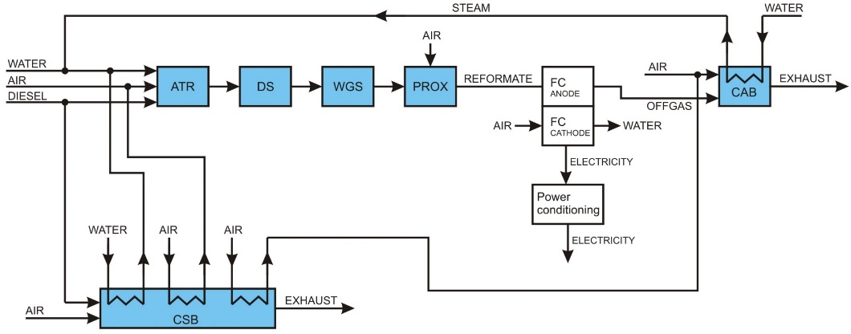
Fuel cell technology for mobile and stationary applications
Diesel fuel cell auxiliary power units for mobile and stationary applications (remote and off-grid areas)
System based on diesel fuel reforming and reformate fuel cells
TRL 6 prototype, 5 kW electric power
Low noise emissions, clean exhaust (no soot, no particles, no odor)
Developed within international project FP7 – FCGEN

Slide 5




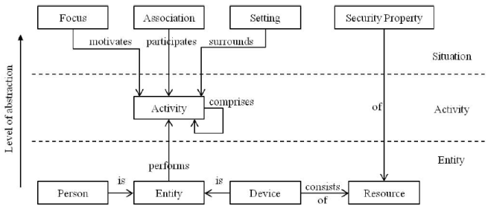
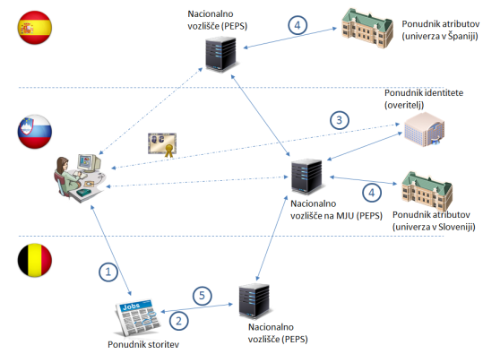
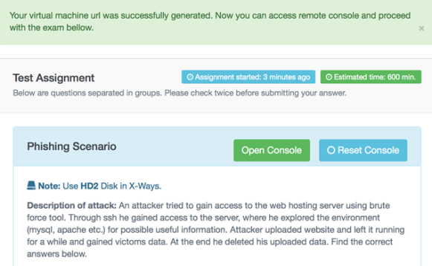
Laboratory for Open Systems and Networks
Areas of R&D activities
  Cyber security and defence
  Common operational view
Current specific areas:
Data fusion, anomaly detection, operational view support
  Security provisioning in critical domains, risk reduction
Security in ubiquitous systems
  Advanced context aware security mechanisms for cyber defence
IoT and cloud security
  Security and privacy provision mechanisms
Building blocks for secure cross-border services
  eID-based security services
Security economics
Optimal investment into security technologies
Cyber security education and training
  Courses, cloud-based environment, serious games

Slide 6



Cyber security and defence
Members of the EU Network of Centres of Excellence in Cybercrime (SENTER)
  Cybercrime research, education and training, awareness raising
  Open source intelligence (OSINT), digital forensics
DEFENDER
  Defending European Critical Energy Infrastructure. Combined cyber-physical threats
COURAGE
  EU research agenda and roadmap for the fight against cybercrime and cyberterrorism
SERENITY
  Adaptable security service and mechanisms for security and dependability provision in Ambient Intelligence Systems
DIADEM
  Distributed firewall
Flex4Grid
  Secure cryptographic IoT backend database system

Slide 7
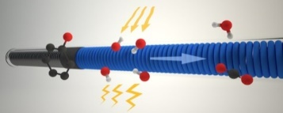
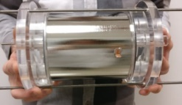
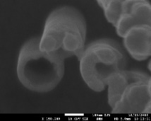
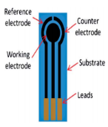
Department for nanostructured materials
Water purification
Our innovative water purification reactors are based on the process of photocatalysis or photoelectrocatalysis.
The active part of reactors is made of photocatalytically active film of titania nanotubes that is firmly bound to metal substrate. Our water purification systems consist of custom made reactors of different sizes that are easily interconnected in order to treat desired volumes of water. Our water purification systems enable:
providing clean drinking water
treating waste waters
Biochemical warfare agents detection
Portable electrochemical sensors for numerous biochemical analytes based on modified screen printed electrodes are developed. The receptor elements are based on nanostructured materials, such as complex hybrid nanoparticles (NPs), nanowires (NWs) and nanotubes (NTs). Transition metals (Ni, Co and their redox couples) are combined with noble metals like Pt or Au, which are known to exhibit electrocatalytic effects. The synthesized nanostructures are further immobilized with specific enzymes that increase the sensor sensitivity.

Slide 8

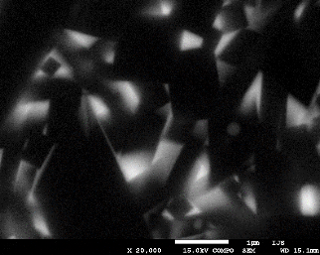
Department for nanostructured materials
Lightweight armour plates
Hard-to-sinter carbide-based ceramic plates that are main constituents of outer tactical vests will be consolidated in our SPS (Spark Plasma Sintering) facility, where the powder precursors will be subjected to axial pressure and pulsed-electric current, which enables extremely high heating rates, short sintering times and lowered sintering temperatures. Besides advanced sintering approach precursor powder mixtures will be prepared using polymer precursor route aimed at fabrication of high-performance SiC-infiltrated B₄C-based composites with increased homogeneity.

Slide 9
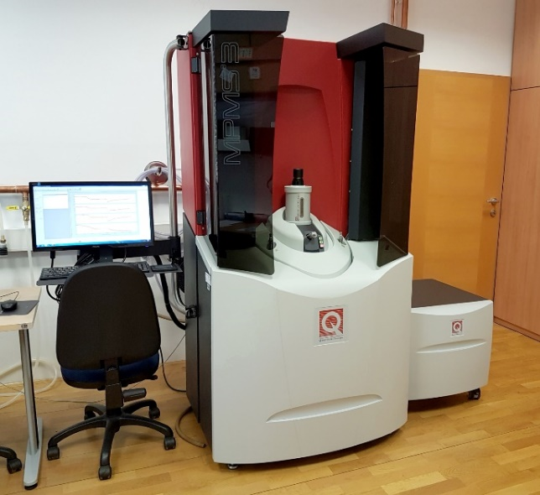
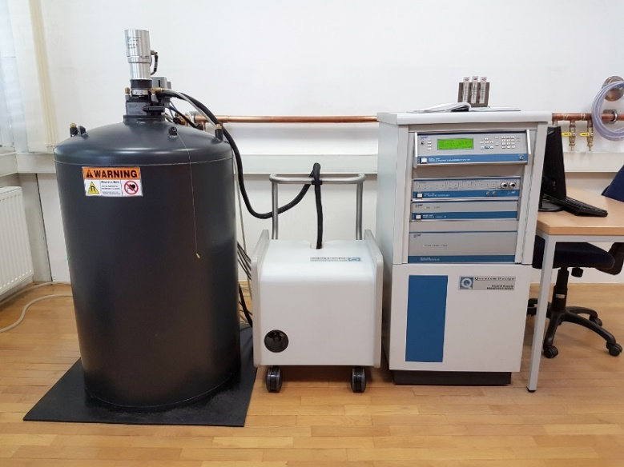
Laboratory for electrical, thermal and magnetic testing of materials
SQUID Magnetometer QD-MPMS3
Electrical and thermal properties
QD-PPMS 9T
Magnetic fields from -7 T to + 7 T
Temperature range from 1,8 K to 1000 K
Hydrostatic pressure up to 1,3 GPa
DC or AC (sinusoidal) magnetic field
Types of measurements:
Magnetization as a function of temperature
Hysteresis curves
Orientation-dependent magnetic properties
Magnetic properties of ferromagnetic materials
Magnetic fields from -9 T to + 9 T
Temperature range from 0,35 K to 400 K
Types of measurements:
Electrical resistivity
Magnetoresistance
Specific heat
Hall coefficient
Thermal conductivity
Thermoelectric power (figure of merit ZT)

Slide 10
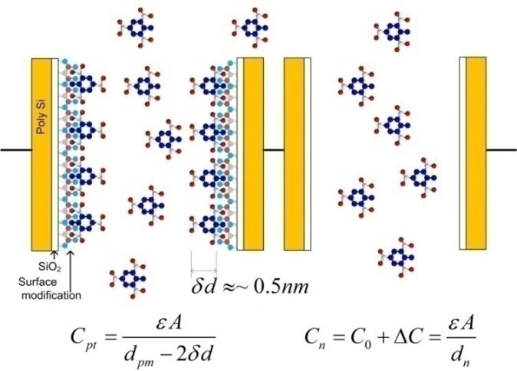
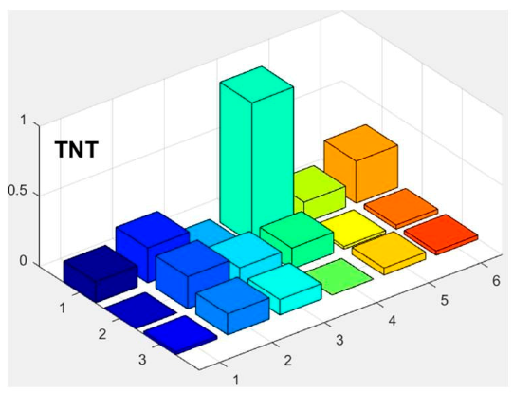
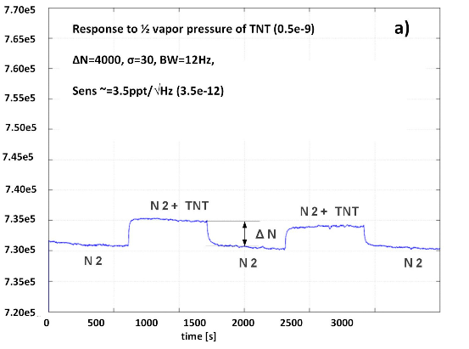
Detection of vapour traces of illicit and hazardous chemicals in air
(„Artificial nose“)
Detection limit:
1 molecule of TNT in 10¹² molecules of air
or
1 molecule of RDX in 10¹³ molecules of air
Multiple sensors with different modification layers + artificial inteligence → Chemical selectivity
Currently up to 16 different sensors

Slide 11
Contacts (by topic):
Jožef Stefan Institute, Ljubljana, Slovenia
Systems and Control:
Dr. Gregor Dolanc: gregor.dolanc@ijs.si
Laboratory for Open Systems and Networks:
Dr. Dušan Gabrijelčič: Dusan.Gabrijelcic@ijs.si
• Nanostructured materials:
Prof. dr. Spomenka Kobe: Spomenka.Kobe@ijs.si
• Condensed matter physics:
Prof. dr. Janez Dolinšek: Jani.Dolinsek@ijs.si
„Artificial nose“:
Prof. dr. Igor Muševič: Igor.Musevic@ijs.si

