Slide 1
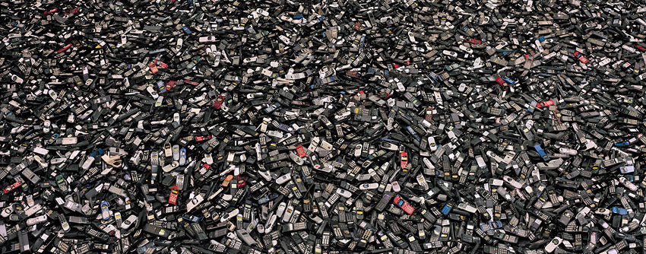
advanced materials & technologies for a circular economy
Jan Meneve
VITO Vision on Technology
Belgium
SBRA MAT4CE - 29 March 2017

Slide 2
CONTENT
VITO in a nutshell
Driven by the Sustainable Development Goals
Inspired by the Circular Economy
Feeding & closing material and product loops
Shorter closing of loops by circular business models
Conclusions

Slide 3







VITO in numbers
772 employees
24 nationalities
More than 400 patents worldwide
HQ in Mol, Belgium. Offices in Ostend, Berchem, Ghent, Genk
Subsidiary in China
250 scientific
articles in 2015
1902 research projects
147 mio € turnover in 2015
More than 500 research partners
3
SBRA MAT4CE - 29 March 2017

Slide 4


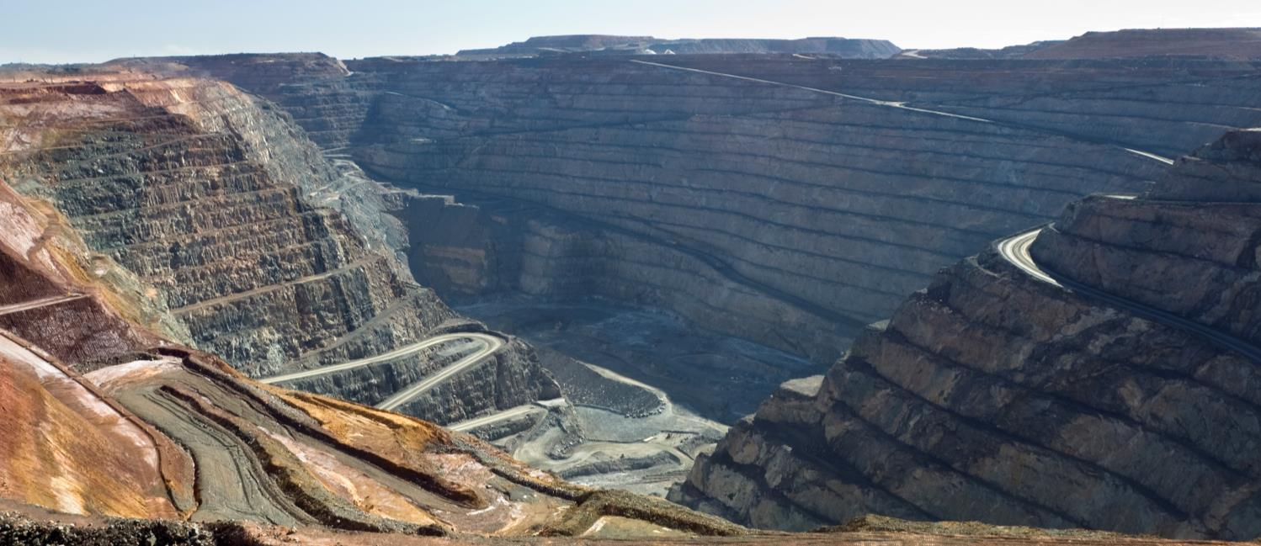
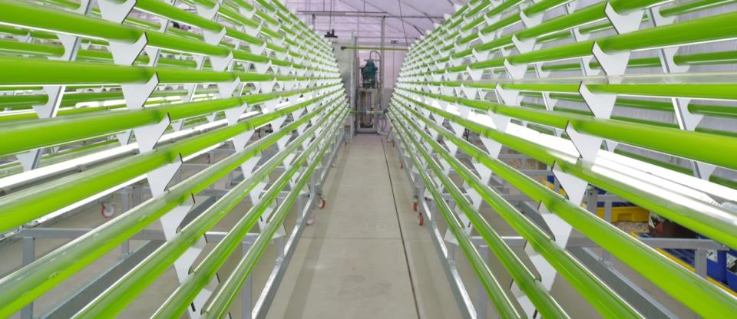


VITO: areas of expertise
Energy
Materials
Chemistry
Health
Land use
4
SBRA MAT4CE - 29 March 2017

Slide 5

Sustainable materials
Raw materials are crucial for our society but are increasingly critical
Sustainable management of materials, closed material cycles,
new circular business concepts and supporting policy frameworks
are required in the transition towards a circular economy
5
SBRA MAT4CE - 29 March 2017

Slide 6

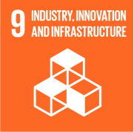
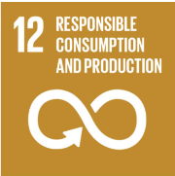
Driven by Sustainable Development Goals
Linking SDG 9 and SDG 12
SDG9 : build resilient infrastructure, promote sustainable industrialization and foster innovation.
  9.4: upgrade infrastructure and retrofit industries to make them sustainable, with increased resource-use efficiency and greater adoption of clean and environmentally sound technologies and industrial processes, with all countries taking action in accordance with their respective capabilities.
SDG 12 : ensure sustainable consumption and production patterns.
  material footprint
  domestic materials consumption
  food loss
  recycling rates
  hazardous waste production
  sustainable public procurement actions.

Slide 7
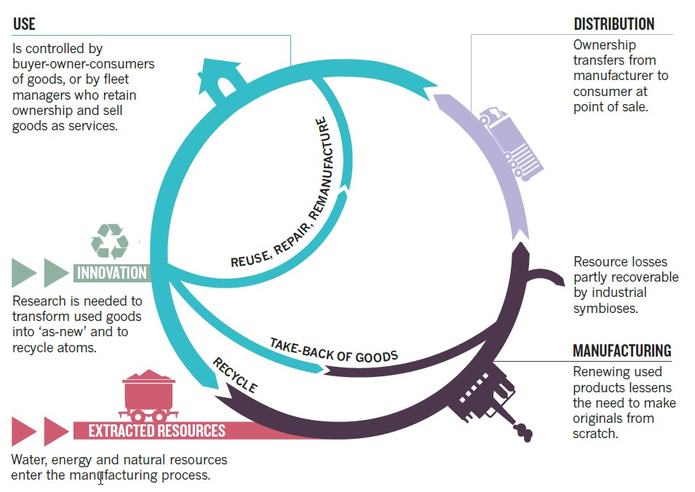
inspired by the circular economy
NATURE comment, The circular economy, by Walter R. Stahel, 23 March 2016
Functionality (value) of products and materials should be maintained
at the highest level possible at all times

Slide 8
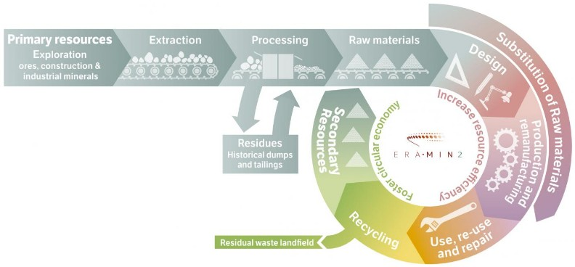
A viable and expanding circular economy
responsible and sustainable mining and recycling are key for
feeding and closing cascaded material and product loops
in a viable and expanding circular economy
“mining ?”
“Recycling is least preferred option”
“Recycling supports the linear economy by providing resources to it”

Slide 9
Feeding and closing material loops
Key role of advanced materials & technologies
Sustainable mining
Resource efficiency - do more with less
Substitution
Resource recovery & waste re-/upcycling
Safe sinks for (toxic) residues
Notes:
Circular economy takes a product perspective and looks at multiple loops. It focusses on ‘inner circles’ (3R) and sees recycling as the ultimate option.

Slide 10

sustainable mining
H2020 MetGROW+ project
http://metgrowplus.eu/
To develop new metallurgical unit operations for metal extraction, with a focus on economically important (Ni, Co, Zn, Cu, Fe) and critical metals (In, Ga, Ge, Cr, Sb and Co).
A metallurgical toolbox is being developed for the zero waste exploitation of
complex, low grade ores and industrial residues, including novel bio- & solvometallurgy
and plasma-pyro technologies,

Slide 11

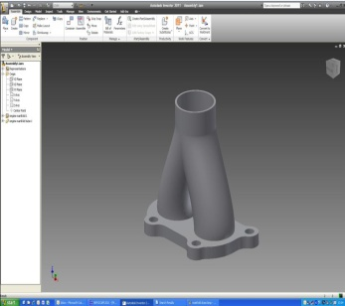
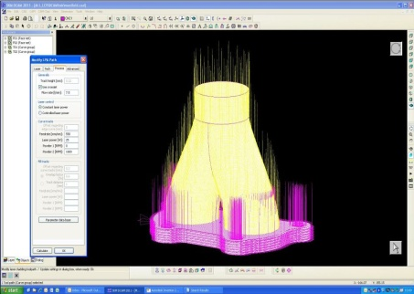
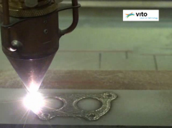
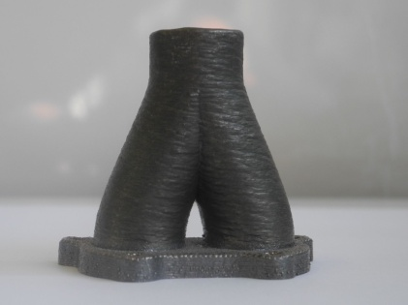
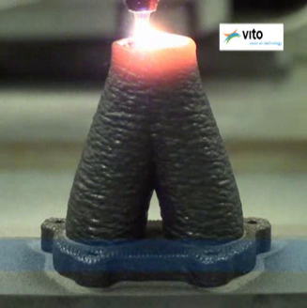
resource efficiency
Laser additive manufacturing
VITO, 2012, YouTube
CAD-design DCAM slicing and tool path generation Additive process
Final component

Slide 12
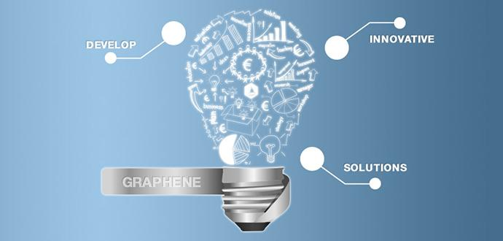
Substitution
The EC Graphene flagship
http://graphene-flagship.eu/

Slide 13

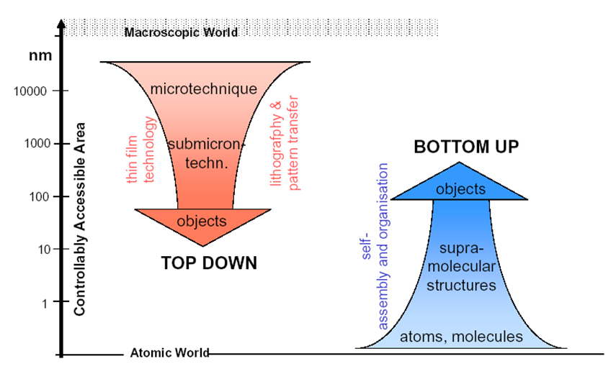
Substitution
Multi scale modelling
EuMaT SRA, 2014

Slide 14
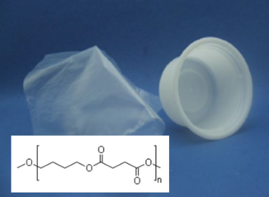
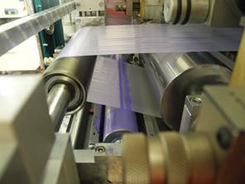

Substitution
Plasma surface engineering enabled bioplastics for food packaging
VITO, 2014

Slide 15
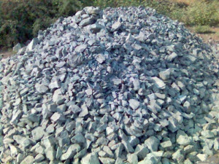
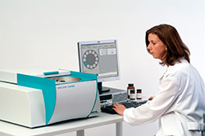
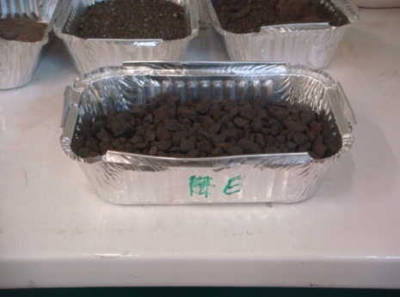
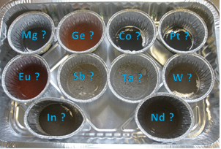
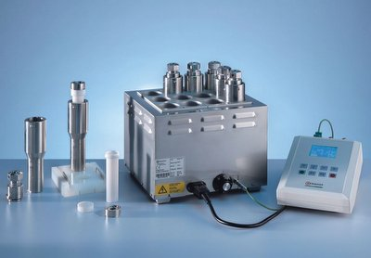
resource recovery
Element speciation in waste streams
VITO, 2014

Slide 16
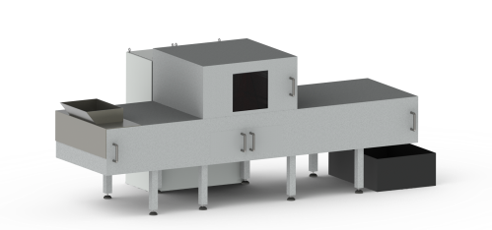

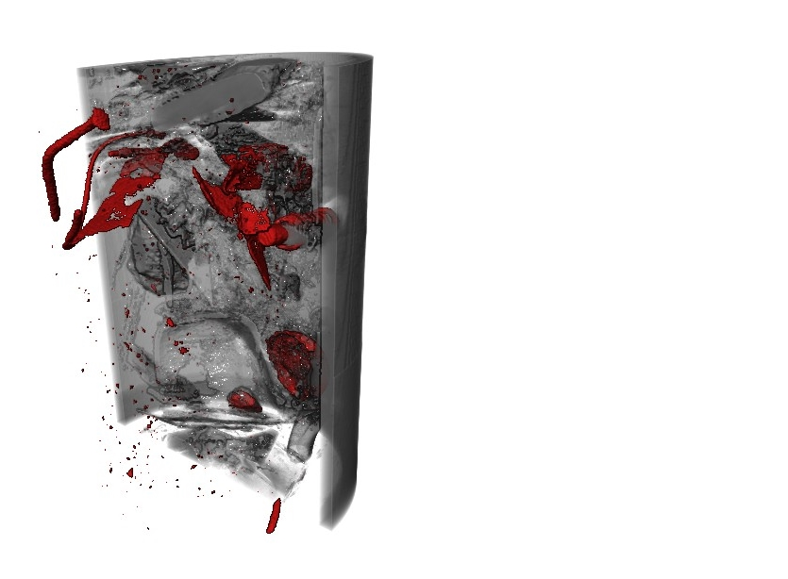
resource recovery
Sorting of waste streams
VITO, 2016
Dual Energy X-Ray
3D Laser Triangulation
Online Data Processing
Quality Management
X₁
X₂
Laser
Density
Material
Shape
Size
Mass
Composition in wt%

Slide 17
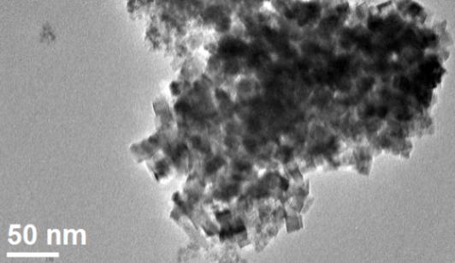
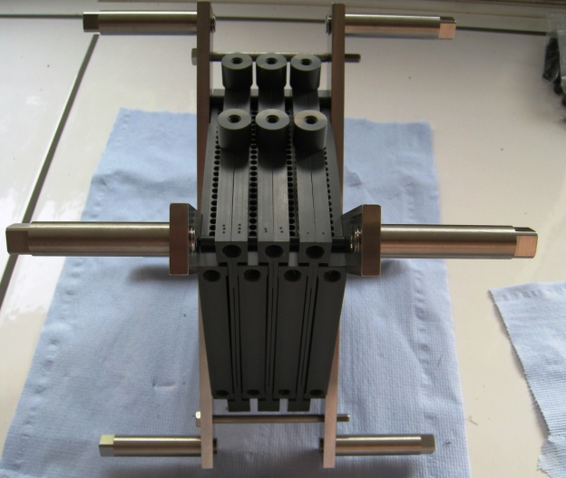
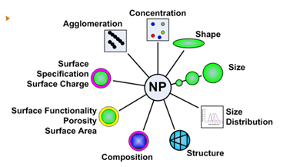
resource recovery
Electro-crystallization recovery of Rare Earths from aqueous waste stream
VITO, 2015
Patented VITO process

Slide 18
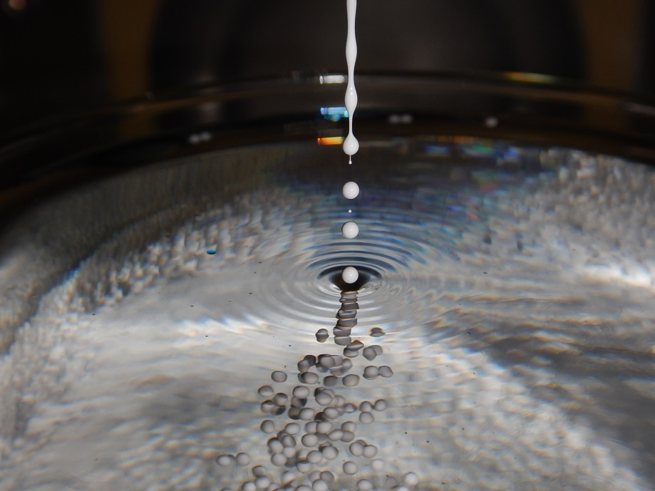
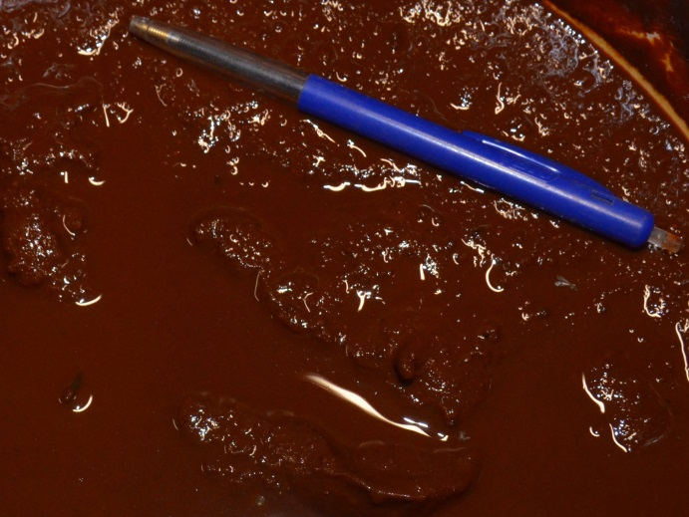
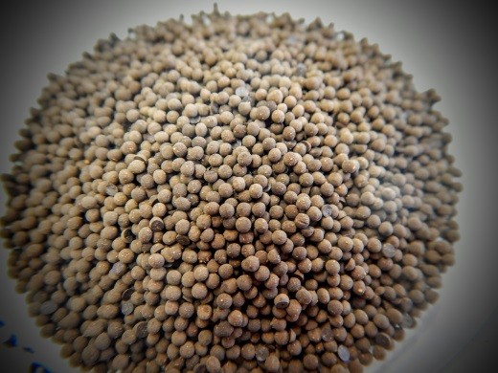
resource recovery & waste recycling
Phosphate sorbents from waste iron sludge
VITO, 2015

Slide 19
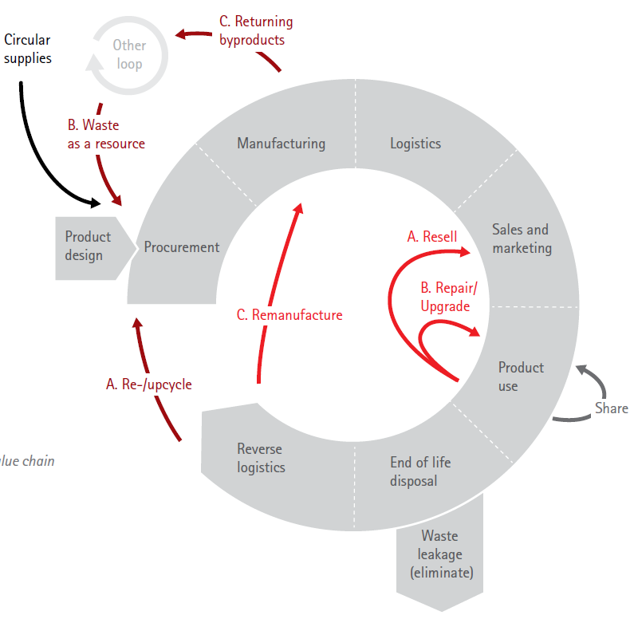
an effective circular economy
Shorter product loop closure by new business models
product life extension by repair, re-use, upgrading, remanufacture
shared use/access/ownership
product as a service
The effective Circular Economy is about more than feeding and closing material and product loops
Accenture Strategy
Circular Advantage
Accenture 2014

Slide 20
the iot enabled circular economy
Circular business models enabled by the Internet of Things
Internet of things [Wikipedia]: the inter-networking of physical devices, vehicles (also referred to as "connected devices" and "smart devices"), buildings, and other items - embedded with electronics, software, sensors, actuators, and network connectivity that enable these objects to collect and exchange data
Software (the internet) & hardware (the things)
The things most often enabled by advanced material & nanotech

Slide 21
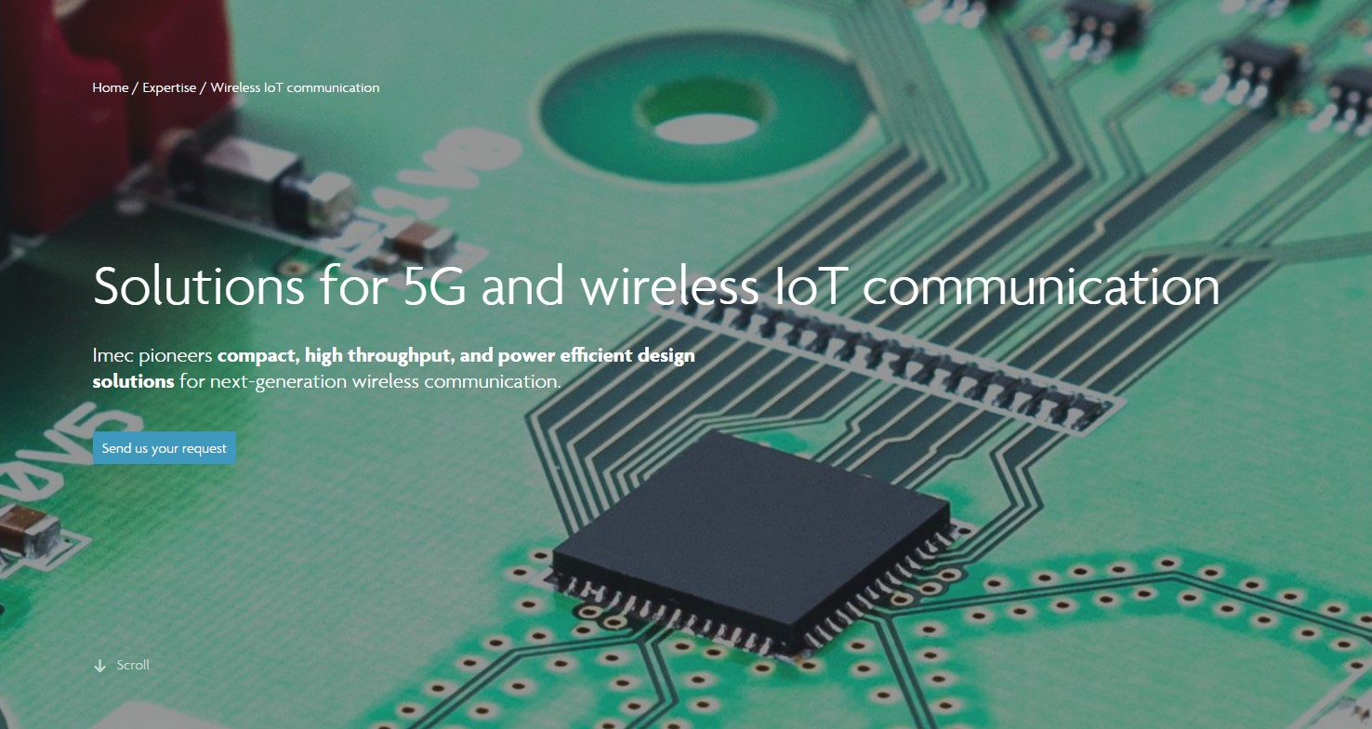
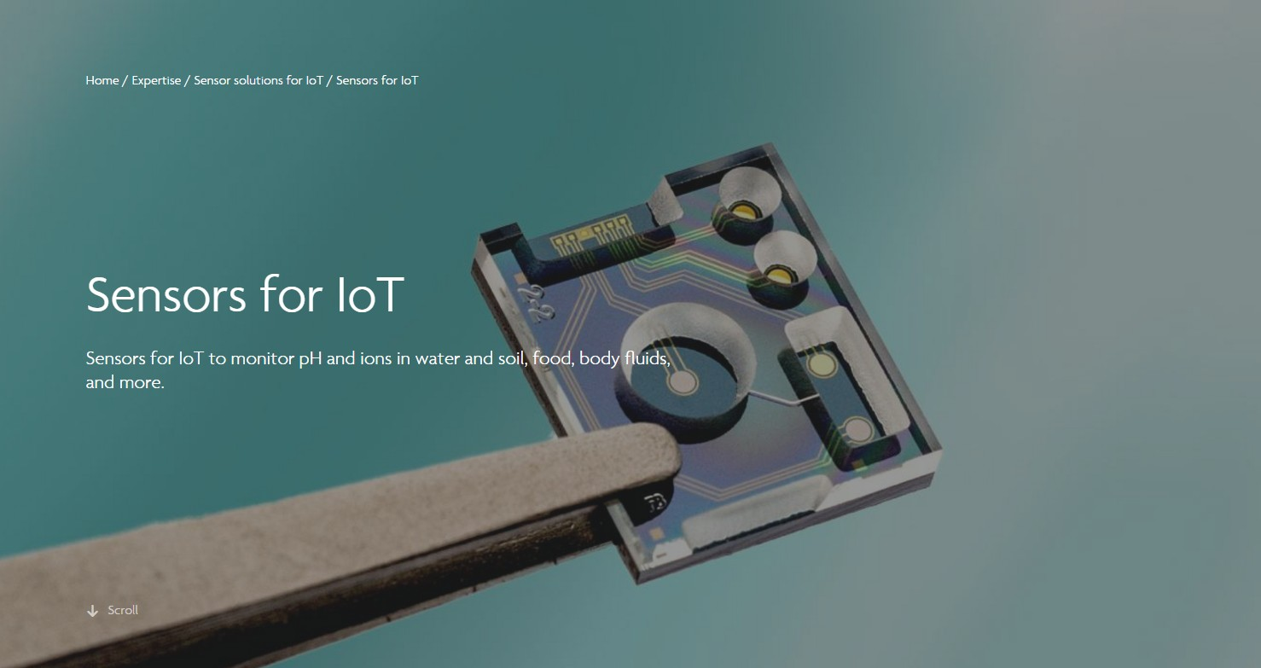
iot enabled by advanced materials & nanotech
IMEC
http://www.imec-int.com/en/home

Slide 22
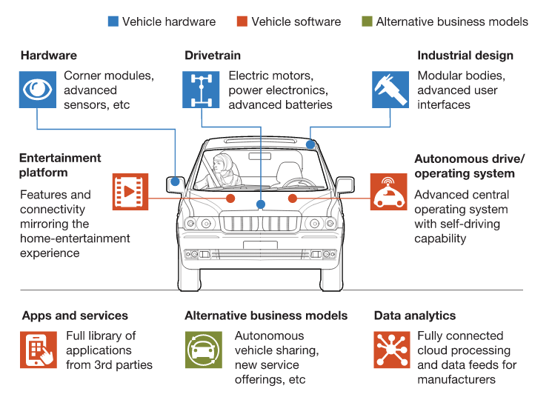

the IOT enabled circular economy
Circular business models enabled by the Internet of Things
E.g. (autonomous) car sharing platform: cars will become
computers on wheels enabling mobile app based sharing, remote monitoring & management of assets, safety and regulatory compliance.
McKinsey&Company
How the convergence of automotive and tech will create
a new ecosystem
November 2016

Slide 23
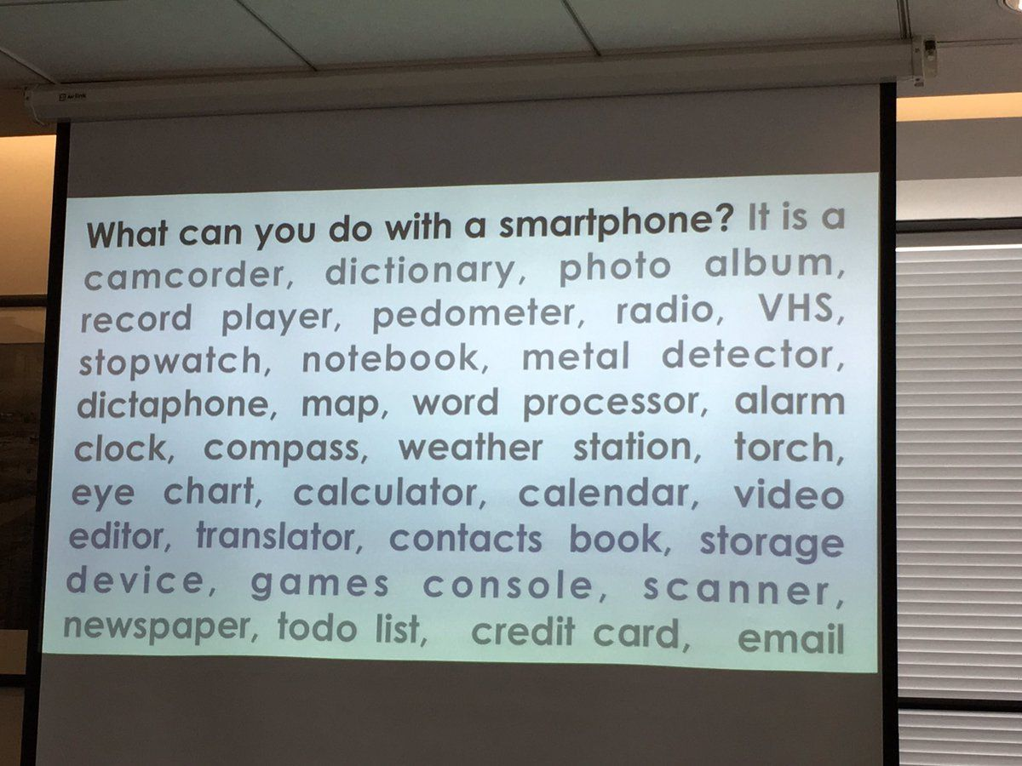
the IOT enabled circular economy
Nanotech and the IoT for dematerialisation

Slide 24

the IOT enabled circular economy
IoT enabling an even more resource effective manufacturing & processing IND 4.0
INDUSTRY 4.0 summit
Manchester
4-5 April, 2017

Slide 25
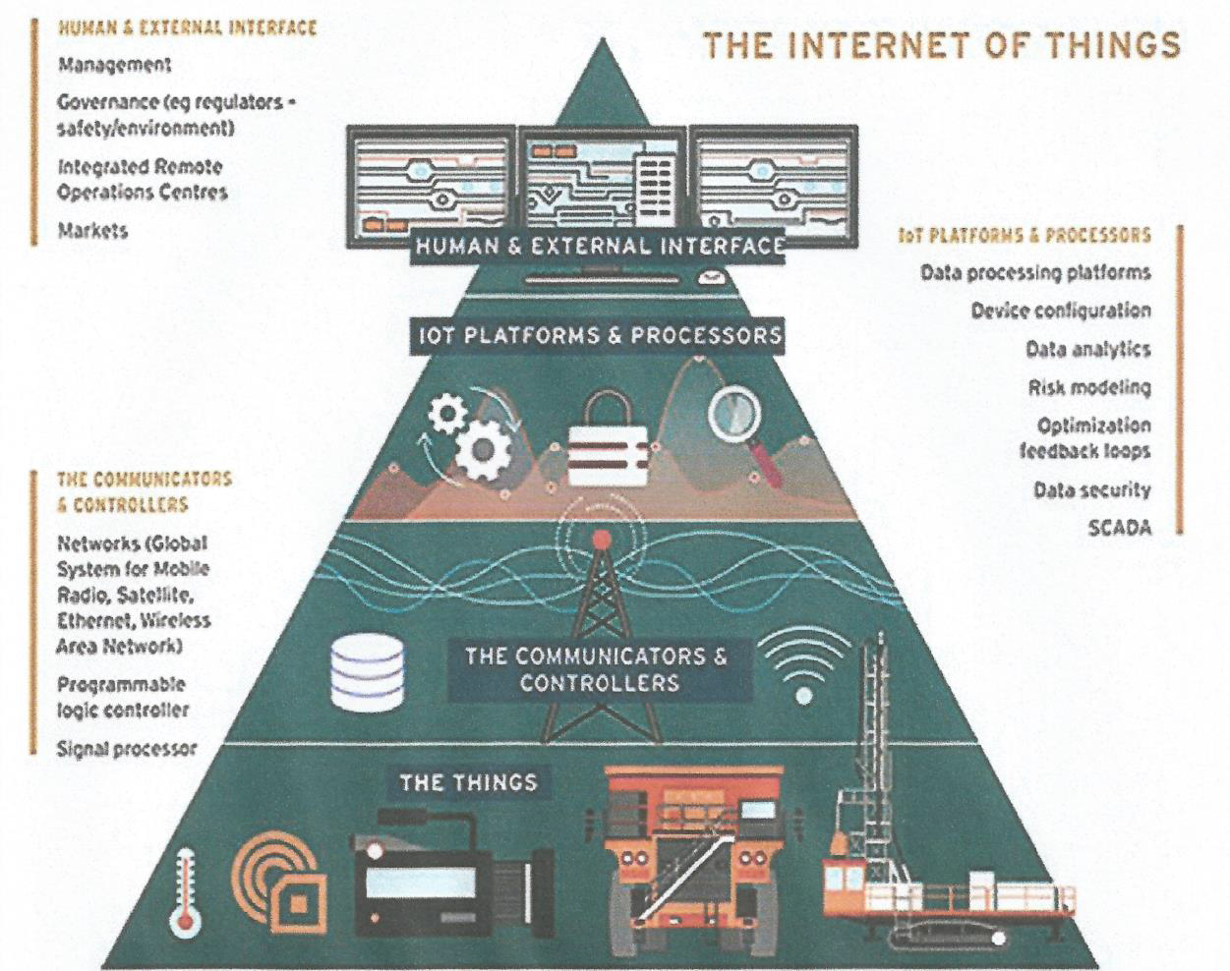
the IOT enabled circular economy
IoT enabling the sustainable mine
Henryk Karaś
Is the 4th Industrial Revolution in the EU industry a chance for the RM sector ?
VERAM Stakeholder Forum; 19th October 2016; Antwerp, Belgium

Slide 26
Conclusions
Circular economy needs systems thinking
Advanced materials & technologies are key in closing material and product cycles
The Internet of Things & related nanotech are essential for enabling circular business models
IND 4.0 and related IoT, AI, robotics, big data is in turn rendering manufacturing and processing, ànd mining even more sustainable
Vast, exciting and relatively unexplored field for RR&D&I

Slide 27
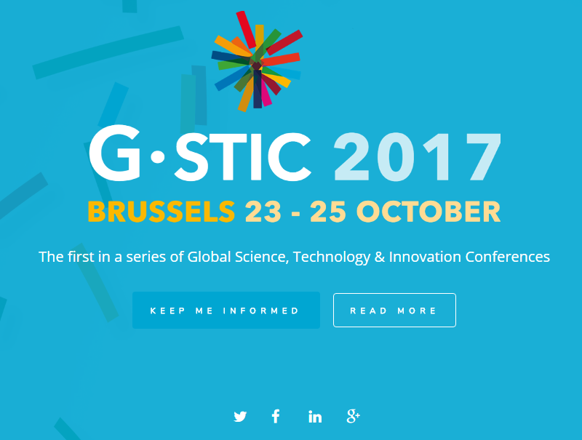
Global Science, Technology and innovation Conferences
www.gstic.org

Slide 28
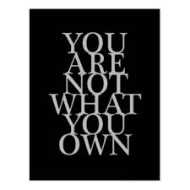

contact
Thank you for your attention
Jan Meneve
Research Programme Manager
jan.meneve@vito.be
Notes:
self-evident truth in the context of a CE

