Slide 1
Ultra Low Power ADC for IN-VITRO Micro-electrodes Array READOUT CHAIN
William BONTEMS: Phd student in TIMA
Daniel DZAHINI : dzahini@univ-grenoble-alpes.fr ; professor + senior designer
Tima laboratory / grenoble / France
TIMA: 70 permanent people + 50 phd students working in different aspects of electronics

Slide 2
The dream to communicate with our brain via electronics sensors
One might hear about NEURALINK Company of Elon MUSK futur tests
NEUROTECH consortium in Grenoble (France)
We present here a collaboration project for very low power Microelectrodes:
TIMA Lab. France => Ultra low power specific Analog to Digital Converters (ADC)
ETH Zürich, 4058 Basel, Switzerland: =>In Vitro Multi-Functional Microelectrode

Slide 3
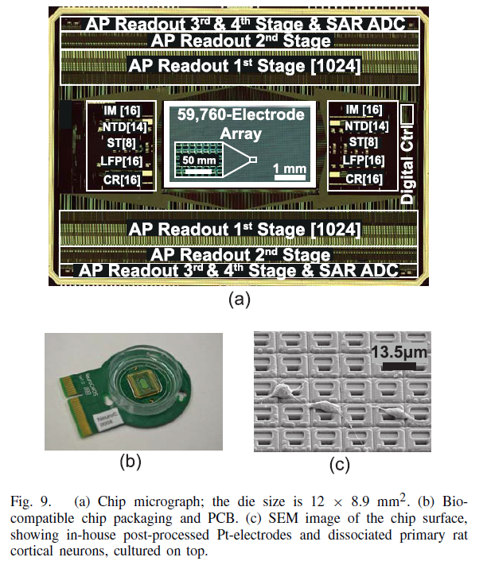
Published by Andreas Hierlemann et. Al ETH Zürich Switzerland IEEE Journal of Solid-State Circuits, vol. 52, no. 6, June 2017; p.1576
Bloc diagram: AP=Active Photo sensor
Chip micrograph

Slide 4
Ultra low power MEA (Micro electrode Array)
Power dissipation and noise are the key limitations for in-vitro applications
The number read-out of channels must increase in the near future
Power will limit the life time of embedded device
Power will damage the signal to read
Power may heat the neurons
Our present research presents a gain of 20 for the SAR ADC power; 2 is due too process scaling (180n->65n), but 10 is due to design innovation.

Slide 5
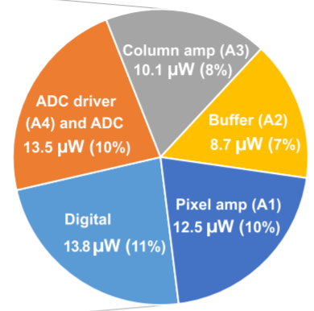
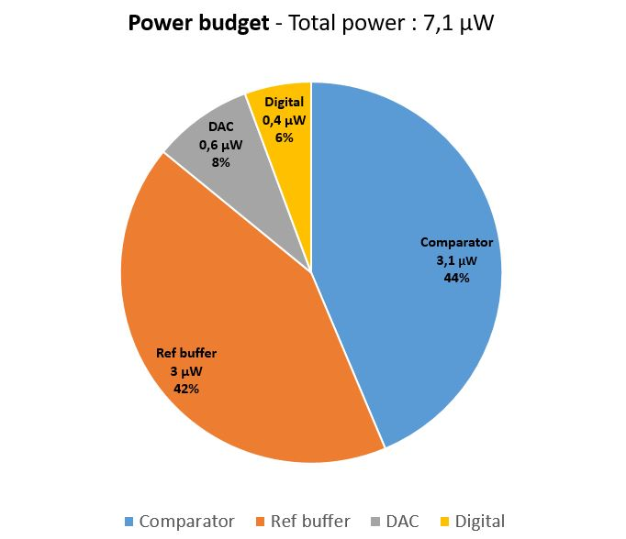
New Figure of merit in SAR ADC power scaling: from 180nm to 65nm
We target to reduce significantly the power (more than factor 20 for the ADC)
Using a new methodology of SAR ADC
New ADC design going on in TIMA Lab.
15bits, 7.1µW
10bits; @11.6KSps
180nm
65nm
IEEE JOURNAL OF SOLID-STATE CIRCUITS, VOL. 56, NO. 8, AUGUST 2021

Slide 6
Contact details
Daniel Dzahini: dzahini@univ-alpes-grenoble.fr
University Grenoble Alpes
TIMA Laboratory
tima.univ-grenoble-alpes.fr
Tel. +33 674 6468 47

