Slide 1
Cybersecurity Research in NGNs
Michał Pilc
Poznań Supercomputing and Networking Center
Networking event on Digital and Emerging Technologies and
Human-centred AI
24 January, 2022

Slide 2

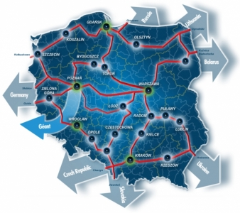
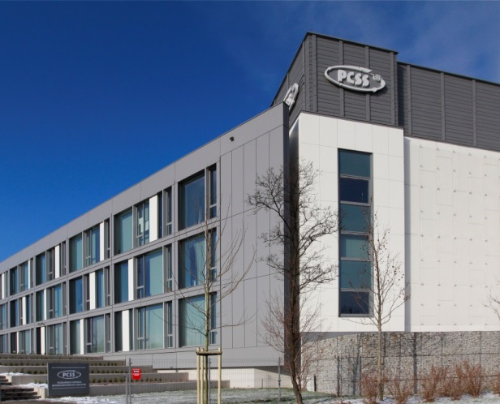
Description of the institution
Poznań Supercomputing & Networking Center
  R&D center affiliated by Polish Academy of Sciences
  400+ people
Operator of PIONIER (Polish NREN) and POZMAN networks
European and Polish R&D Projects
  170 EU funded projects (5PR – H2020), 19 coordinating – as of 01.2022
R&D together with science, industry, finance, public administration
Main areas of interest
  New generation networks (NGN)
  New data processing architectures
  Internet of Things services
  Security of systems and networks
Head quarter: Polish Optical Internet Research Center (CBPIO)

Slide 3
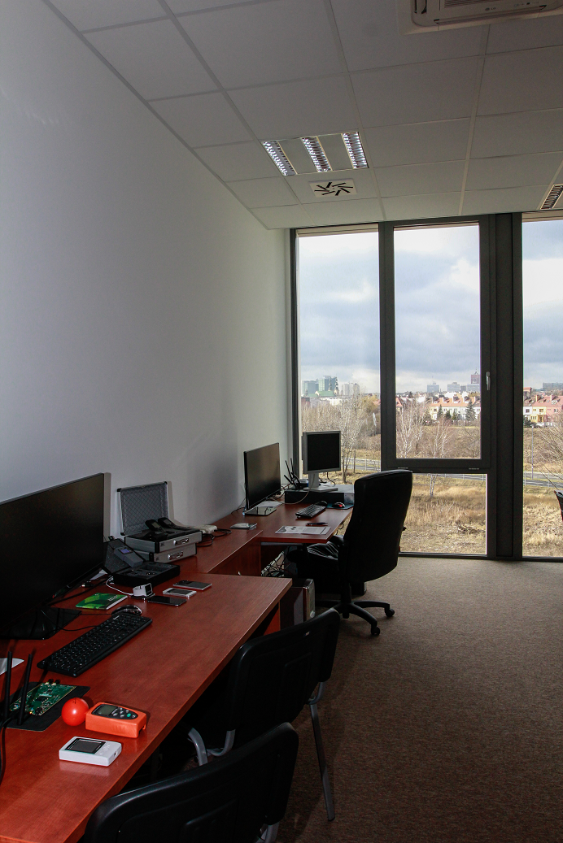
Cybersecurity Department
Main areas of activity
  Protection of IT infrastructure in PIONIER, POZMAN (PIONIER CERT)
  Security tasks in R&D projects
  Internal and external cybersecurity audits
Current and past research projects
  PROTECTIVE (http://protective-h2020.eu/)
  symbIoTe (http://symbiote-h2020.eu/)
  GN4-2 (https://www.geant.org/Projects/GEANT_Project_GN4)
  MEDICS (NCBiR national project)
Current leading research topics
  Advanced threat detection modules for ICT, SCADA and IoT
    Complex Event Processing, Anomaly detection
    Machine learning, AI, behawioral analytics
  Threat intelligence sharing
  Security architecture in future ICT systems (5G, 6G, Internet of Everything)

Slide 4
Area of interest
Industry 4.0, IT/OT integration, smart factories
Protection of Critical infrastructure (energy, gas, telecommunication)
ICT in healthcare sector
Partners sought
SMEs
End users (pilots)
Software houses
Law enforcement authorities
Academia

Slide 5
Contact details
Michał Pilc
PSNC
Cybersecurity Department
Tel. +48 61 8582066
E-mail: mpilc@man.poznan.pl
Web http://www.psnc.pl

