Slide 1

Slovenian Railways – SŽ Group
and the South East Europe Strategic Alliance for Rail Innovation
(SEESARI)
Dr. Peter Verlič
Transport & Logistics Conference 2016
Brussels, 3rd March 2016

Slide 2
Slovenian Railway Sector
GOVERNMENT
AKOS – AGENCY FOR COMMUNICATION NETWORKS AND SERVICES OF THE REPUBLIC OF SLOVENIA
RAILWAY SECTOR
MINISTRY OF
INFRASTRUCTURE
SLOVENSKE ŽELEZNICE
(SLOVENIAN
RAILWAYS HOLDING)
OTHER RAILWAY OPERATORS
ažp – Public Agency of the Republic of Slovenia for Railway Transport
INFRASTRUCTURE AGENCY
Transport, Energy and Spatial Planning Inspectorate of the Republic of Slovenia (IRSPEP)
Road Transport, Rail Transport, Cableways and Ski Slope Inspection Service
POTNIŠKI PROMET
(PASSENGER TRANSPORT)
DRI INVESTMENT MANAGEMENT LTD, COMPANY FOR INFRASTRUCTURE DEVELOPMENT
TOVORNI PROMET
(FREIGHT TRANSPORT)
INFRASTRUKTURA
(INFRASTRUCTURE)
OTHER COMPANIES
TRANSPORT DIRECTORATE
Sector for Railways
AKOS – Regulatory body
Decision-making in administrative matters, monitoring of competition on the market of rail passenger and freight services
AŽP
Safety, certification, assessing and licensing authority
Allocation authority
Authority for infrastructure charging
DRI
Consultancy and engineering services in rail infrastructure, supervision of track (re)construction works, procedures relating to land acquisition in construction of new rail lines
SŽ-Passenger
Operator of public service obligations (PSOs) in rail passenger transport
SŽ-Cargo
National rail freight operator
SŽ-Infrastructure
Management of public rail infrastructure in Slovenia
Rail infrastructure management and maintenance
Rail traffic operation
Ministry of Infrastructure
Infrastructure Development and Investment
Transport policy of the Republic of Slovenia
Transport legislation
IRSPEP
Supervision and inspection of the railway
system

Slide 3
Structure of SŽ Group
Skupina Slovenske železnice – SŽ Group
Revenues: 557,189
Employees: 8,069
Slovenske železnice, d. o. o.
Revenues: 33,313
Employees: 461
SŽ-Tovorni promet, d.o.o.
(Freight Transport)
SŽ-Potniški promet, d.o.o.
(Passenger Transport)
SŽ-Infrastruktura,
d.o.o.
(Infrastructure)
SŽ-VIT, d.o.o.
(Traction and Technical Services)
SŽ-ŽGP, d.d.
(Railway Construction Company)
SŽ-ŽIP, d.o.o.
(Railway Company for Disabled Persons)
Prometni institut, d.o.o.
(Institute of Traffic and Transport)
SŽ-Železniška tiskarna, d .d.
(Rail Printing House)
Fersped, d.o.o.
(Forwarding company)
100% 100% 100% 100% 79.82% 100% 100% 64.28% 100%
R: 206,194
Em: 1,301
R: 85,151
Em: 622
R: 164,466
Em: 2,385
R: 102,473
Em: 2,105
R: 81,950
Em: 334
R: 25,959
Em: 716
R: 1,671
Em: 26
R: 500
Em: 13
R: 19,436
Em: 77
Legend:
Note:
The parent company Slovenske železnice, d.o.o., also holds shares in the following associated companies: Adria Kombi, d.o.o., 26.0%, Terme Olimia, d.d., 23.87%.
Parent company
Subsidiaries in the Slovenske železnice Group with corresponding participating interests (full consolidation)
R: Operating revenue January – December 2014 (EUR thousand)
Em: Employee – 31. December 2014

Slide 4
Key Facts of SŽ Group 2014
Slovenian Railways
mio EUR 2014
Operating revenues | 557,189
Transport revenues Freight transport Passenger transport | 196,708 159,983 36,725
Revenues from public services Passenger transport Infrastructure | 146,332 41,380 104,952
Other operating revenues | 214,149
Operating expenses | 533,024
2014
Goods (mio tonnes) | 18.8
Passengers (mio) | 14.8
Employees (31 December) | 8,069

Slide 5
SŽ Group – Mission, Vision & Goals
Mission
Mission
Providing transport and logistics services in freight and passenger transport
Managing public rail infrastructure and traffic management
Providing quality and efficient services to economy and promoting the mobility of
population in a safe, reliable and environmentally-friendly manner
Becoming an important regional transport operator and provider of integrated
logistics services in Central and South-East Europe
Becoming a key provider of passenger services in Slovenian integrated public transport
Managing and maintaining modern, reliable and safe public rail infrastructure
Vision
Vision
Our goals for the target region for freight and passenger services in Central and South-East Europe:
Increasing the rail freight market share on Corridor V and X
Becoming the biggest provider of passenger services in Slovenian integrated public transport
Providing efficient and reliable management of public rail infrastructure
Developing and expanding freight and passenger terminals
Becoming the leading constructing and engineering company in the area of rail infrastructure
Developing efficient supporting services within the SŽ Group
Goals
Goals

Slide 6
SŽ Group – Strategic Pillars
SŽ Group
STRATEGIC ACTIVITIES
LOGISTICS & MOBILITY
JŽI / IJPP
MANAGEMENT
CONSTRUCTION
Freight transport
Rail cargo
Logistics
Passenger transport
Rail
Bus
Traction and technical wagon services
Management of Public Rail Infrastructure – JŽI
Management of Integrated Public Passenger Transport System – IJPP
Construction and renewals
Rail infrastructure
Civil engineering works
Building works
Construction planning
GROUP FUNCTIONS & SERVICES
Business support functions
Real estate management
Building maintenance, cleaning services and security
Research and development

Slide 7
SŽ Group – Regional Operator on the Crossroad of European Corridors
Baltic-Adriatic Corridor RFC 5
Mediterranean Corridor RFC 6
Alpine-Western Balkan Corridor

Slide 8
Key Facts of SŽ Rail Network
Line length:
Total 1,207 km
Double-track 330 km
Single-track 877 km
Electrified (3kV DC) 503 km
Corridor RFC 6 365 km
Corridor RFC 5 337 km
Number of:
Rail Freight Stations 105
Rail Passenger Stations 115
Railroad Crossings 888
double track
single track

Slide 9
Planned Increases of Line Capacity (in %)
Track sections where the increase of capacity is necessary:
up to 20%
20% - 40%
more than 40%
adequate capacity

Slide 10
Ongoing Major Rail Investments
Reconstruction, electrification and upgrading of the Pragersko-Hodoš line to enable performance at speeds of up to 160 km/h – investment 465.5 mio € (EU funds 231 mio €) – 2016
Modernization of the existing single-track rail line Divača-Koper – investment 110 mio € (EU funds 68 mio €) – 2015
  Implementation GSM-R System on Slovenian rail network – investment 145 mio € (EU funds 100 mio €) – 2015
  ERTMS/ETCS project on RFC 6 – investment 47.5 mio € (EU funds 23 mio €) – 2015
  Upgrading on line Zidani most-Šentilj on section Dolga Gora-Poljčane and Slovenska Bistrica-Pragersko to D4 axel load – investment 54 mio € (EU funds 27 mio €) – 2015

Slide 11
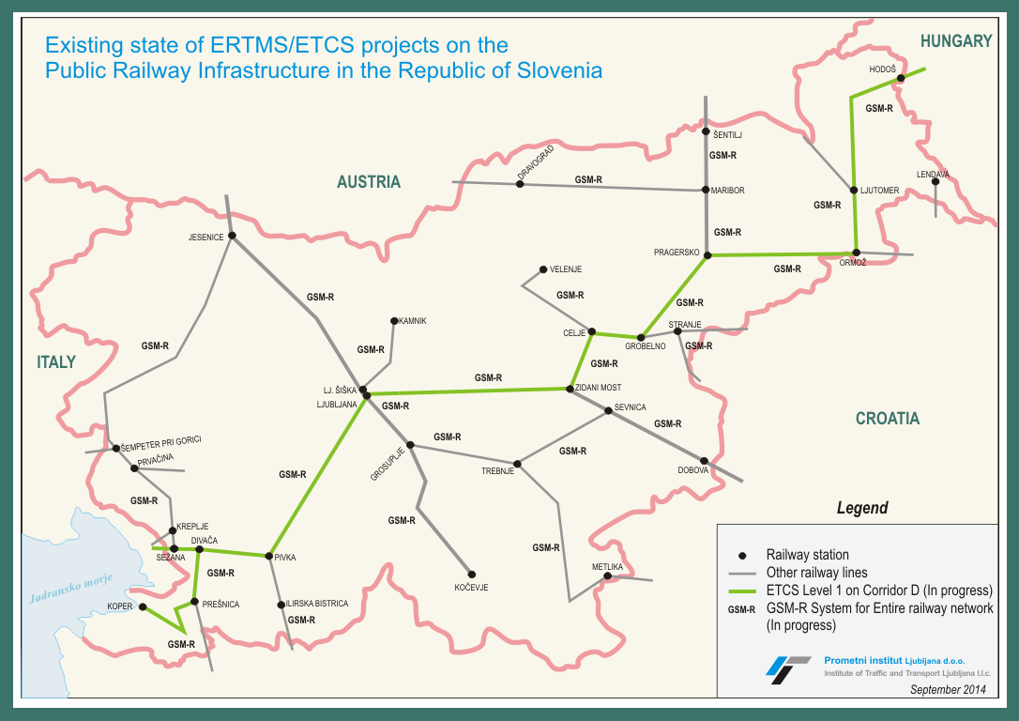
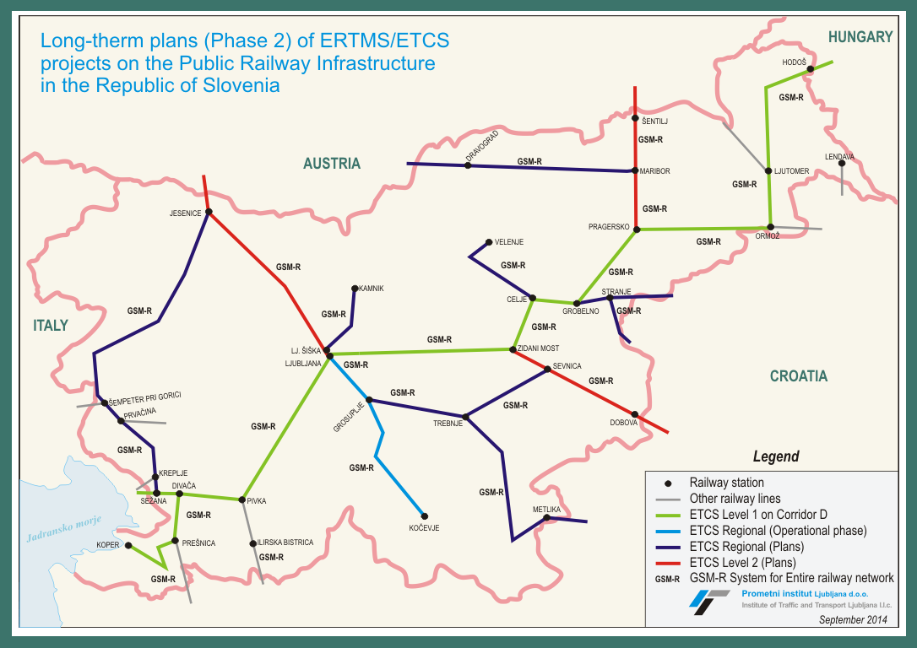
Current situation
Future plans

Slide 12
Planned Major Rail Investments in the Long Run
Construction of a new second track (27 km) on the Divača-Koper line by 2020; upgrading of the Divača-Ljubljana line
Upgrading of all major lines to D4 category by 2018, Zidani Most-Celje, Poljčane-Slovenska Bistrica and Pragersko node
  Infrastructure upgrades to facilitate interoperability on rail freight corridors (ETCS, double-track lines, remote control traffic management system…)
  Construction of a second track (16.5 km) on the Maribor-Šentilj line
  Construction of a second track (71 km) on the Ljubljana-Jesenice line
  Reconstruction of the Ljubljana Traffic Node; upgrading of the switch yard Ljubljana-Zalog
  Modernization and expansion of the Ljubljana Intermodal Terminal

Slide 13
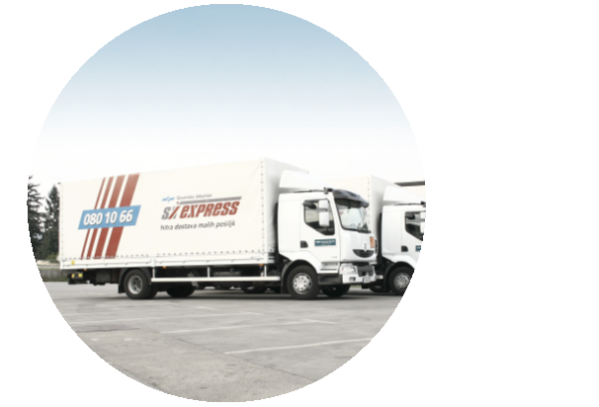
Primary Activities of SŽ-Cargo
Transport of goods and provision of transport-related services
Conventional transport
Combined transport
SŽ-Express
single wagons, wagons group,
complete trains
transport of units (semi-trailers,
swap bodies or containers),
ROLA transport, container terminal
services
door-to-door parcel
service, warehousing
and distribution
74%
25.9%
0.1%

Slide 14
Key Facts of SŽ-Cargo
2014
KEY FIGURES
Goods | mio | 18.8
Work performed | mio NTKM | 4,277
Total revenues | mio EUR | 206.8
Wagons |  | 2,819
Locomotives |  | 140
D-loc |  | 70
E-loc |  | 70
Employees |  | 1,301
1999
2000
2001
2002
2003
2004
2005
2006
2007
2008
2009
2010
2011
2012
2013
2014
KEY MARKETS
Austria 6.9 mio tonnes Italy 2.4 mio tonnes
Hungary 2.0 mio tonnes Slovakia 0.9 mio tonnes
Germany 0.9 mio tonnes Check Republic 0.7 mio tonnes
SEE 2.7 mio tonnes
Fleet modernization in period 2016-2020:
- 15 new locomotives and 400 freight waggons (115 mio EUR)
- ERTMS installations, renewal of 160 waggons

Slide 15
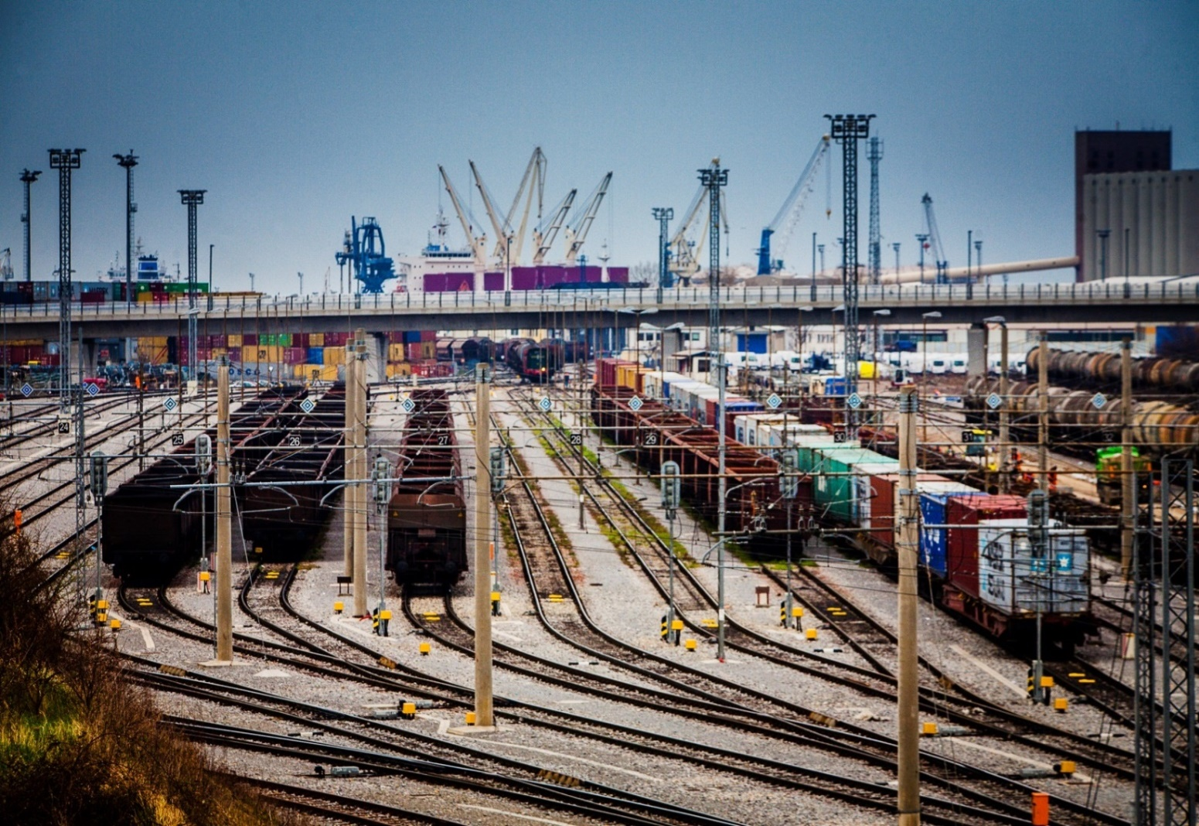
Role of Port of Koper
Port transit in total SŽ transport volume (in %)
2007
47%
51%
2008
52%
2009
55%
2010
2011
58%
60%
2012
57%
2013
Port of Koper is an important source of goods for SŽ-Cargo
57% of all goods were transported in transit to and from Port of Koper (2013)

Slide 16
Key Facts of SŽ-Passenger
KEY MARKETS
Domestic market 14.1 mio passengers
  - commuters 7.6 mio passengers
Croatia 168,671 passengers
Austria 139,411 passengers
Germany 85,810 passengers
2014
KEY FIGURES
Passengers | mio | 14.8
Work performed | mio PKM | 697
Total revenues | mio EUR | 85.5
Wagons |  | 99
Locomotives EMU, DMU |  | 120
Employees |  | 622
14.1 mio
168 671

Slide 17
Market Situation of SŽ-Passenger
Market segments
Passengers in domestic railway transport constituted 95% of all passengers transported; international transport generated 21% of all transport revenues.
Nearly 50% of passengers in domestic transport are commuters, mostly school-age children and students.
22% of passengers in international traffic travel to destinations abroad. The rest either travels to Slovenia or via Slovenia to other destinations – the main transport markets include Croatia, Austria and Germany.

Slide 18
Strategic Plan of SŽ-Passenger
Integrated public transport in Slovenia (national project – Ministry of Infrastructure)
Purchasing new motor units with co-financing from EU funds (Cohesion policy 2014-2020)
Renovation of ticketing system with introduction of new sales channels (NFC, mobile apps)
Development of new products in cooperation with partners (tourist trains, displays on trains and stations, Wi-Fi on trains)
Fleet modernization with 25 new passenger units by 2020 (20 electric and 5 diesel units – 142 mio EUR)

Slide 19


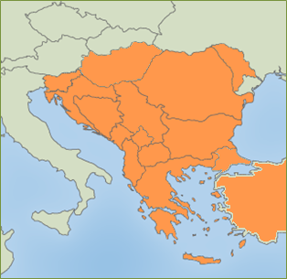
SEESARI - SOUTH EAST EUROPE STRATEGIC ALLIANCE FOR RAIL INNOVATION
Very strong economic potential as the strategic commercial node between Europe and Asia or/and the Middle East in collaboration with Turkey
More than 45.000 km of railway network (UIC Statistics)
147 million tons of goods (railways) (UIC Statistics)
352 million railway passengerss (UIC Statistics)
only 2% of the total freight between Europe and Turkey is carried by rail (The economist 2010)
19

Slide 20
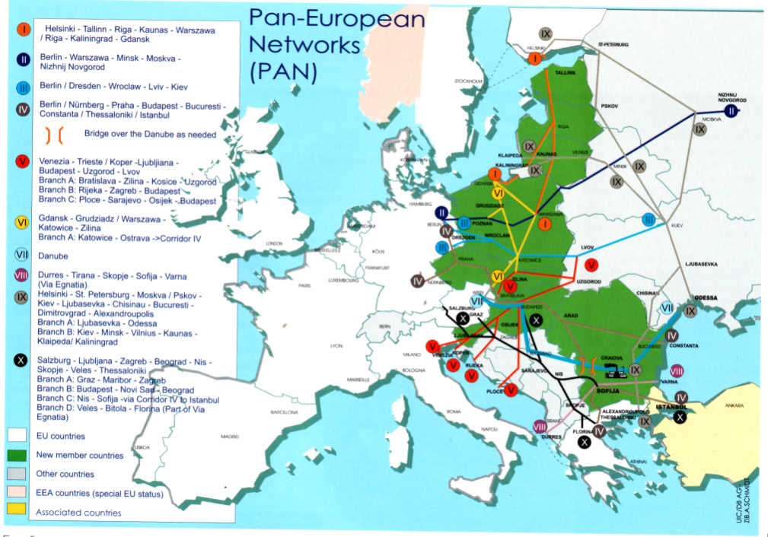
Huge Rail Investments in SEE Countries needed
→ One single “Future European Railway System”
CHALLENGE 2050
EU TEN – T Corridors
Pan European Corridors
Extension of the main EU TEN –T Railway Corridors to SEE
NB: South Eastern Europe – Blank!

Slide 21
SEESARI - South East Europe Alliance for Railway Innovation
History: previous events and presentations:
presented in Belgrade in October 2014 at the SEE conference in Belgrade
1st preparatory meeting in Ljubljana in April 2015
2nd preparatory meeting in Belgrade in July 2015
Presentation at UIC (RICG) in Paris in 1st half of 2015
Presentation at international rail conference (Railway Pro) in Bucharest in October 2015
Presentation at International railway congress in Sarajevo in October 2015
Presentation at international railway conference in Belgrade („Železnička infrastruktura u regionu“) in October 2015
Kick-off meeting in Belgrade on 27th of January 2016

Slide 22
SEESARI - South East Europe Alliance for Railway Innovation
Vision: to be an important player in development or railway system in South East Europe
The main goals of the Alliance are:
clustering of interested stakeholders for identifying the innovative ideas/solutions/projects for railway development and transport
bring new ideas and soluitions into reality
support the development of rail in South East Europe and support its contribution to the wider European railway system and more sustainable transport.

Slide 23
THE PARTNERSHIP
The main SEESARI stakeholders:
transport operators
infrastructure managers
manufacturers and suppliers of technical equipment
financial institutions
research institutions
assotiations and interest groups connected with (rail) transport
national and regional authorities
other institutions and administrations from a wide range of interested stakeholders
=> work in close collaboration to identify, develop and implement innovative solutions for the Future European Railway System and in thus doing, support the economic growth of the South East Europe Area.

Slide 24
SEESARI - MAIN PRIORITIES:
HIGH SPEED RAIL NETWORK
INTERGATION OF PASSENGER TRANSPORT
REGIONAL RAILWAY NETWORK
RAILWAY ROLLING STOCK
INTEROPETABILITY AND TECHNICAL STANDARDS
H/UMAN RESOURCES
COOPERATION IN FREIGHT TRANSPORT

Slide 25
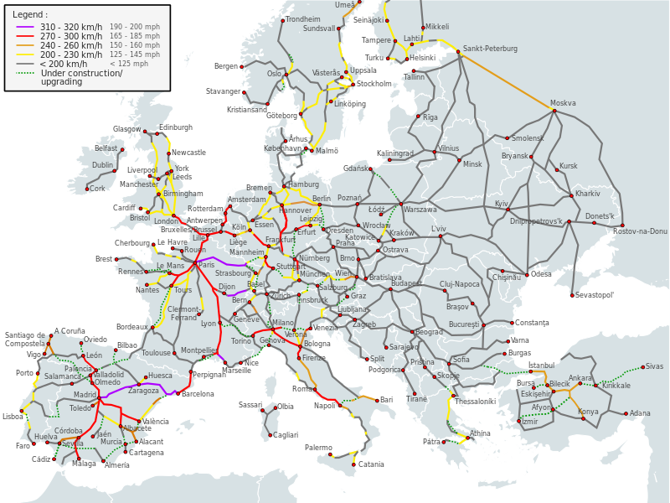
DEVELOPMENT OF THE HIGH SPEED RAIL NETWORK IN SEE

Slide 26
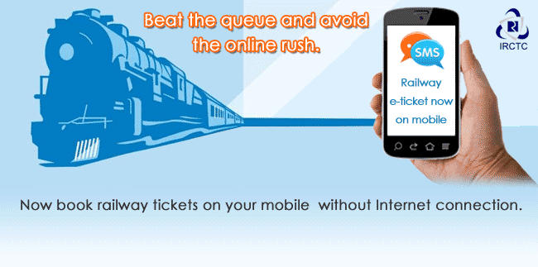
INTEGRATION OF PASSENGER TRANSPORT (IT, TICKETING)
Good opportunity to integrate the Ticketing systems and IT solutions in rail passenger transport
MAIN GOALS:
Better competitiveness of rail transport
More passengers
Integrated rail passenger transport

Slide 27
REVITALISATION OF REGIONAL RAILWAY LINES
Why regional lines?
  big potential (infrastructure already exists)
  low density lines
  less developed and neglected areas
Goals?
  Improved signalling and safety devices (ERTMS regional)
  Sustainable transport and logistics services
  Innovative passenger services
  New generation of rail vehicles (intermodality)
  Integrated smart services model for regional railway network

Slide 28
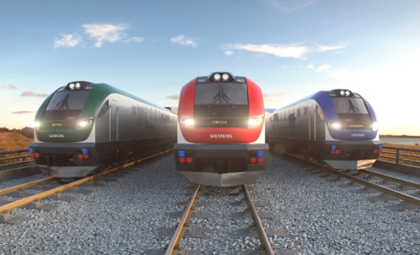
JOINT PROCUREMENT OF RAILWAY ROLLING STOCK
Lower prices – more attractive offers from suppliers. Quite significant for small companies.
Administrative cost savings – The total administrative work for the involved in preparing and carrying out one rather than several tenders can be substantially reduced.
Skills and expertise – pooling of different skills and expertise. Smaller authorities in particular can benefit from the capacities of staff in larger authorities.

Slide 29

INTEROPERABILITY AND UNIFICATION OF TECHNICAL STANDARDS
Interoperability in TSIs – a fundamental component of the future rail system as the transport backbone of Europe.
Development of a set of harmonised operating processes in the form of International Rail Standards (IRS).
Interoperability ensures trains cross state and operational borders without delay or operational
constraint.

Slide 30
HUMAN RESOURCES (SOCIAL COMPONENT, STAFF REORGANIZATION)
Positive working conditions and the protection of health and safety of rail workers high-quality services.
The availability of a skilled and highly motivated labour force in the sector
efficient and competitive transport services.
Optimization and reorganization of railway staff more added value.
Offering best education and training opportunities for young professionals.

Slide 31
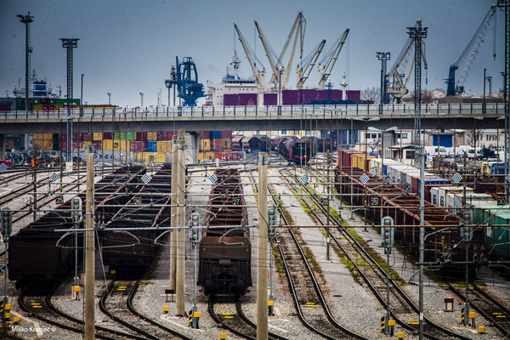
FREIGHT TRANSPORT DEVELOPMENT AND INTERMODALITY
Rail freight to reduce Europe’s dependence on imported fuels, due to its high energy efficiency and major reliance on electric energy.
Rail freight can support Europe’s competitiveness.
A demand for removing technical and administrative bottlenecks through achieving a Single European Railway Area through rail infrastructure
investments.

Slide 32
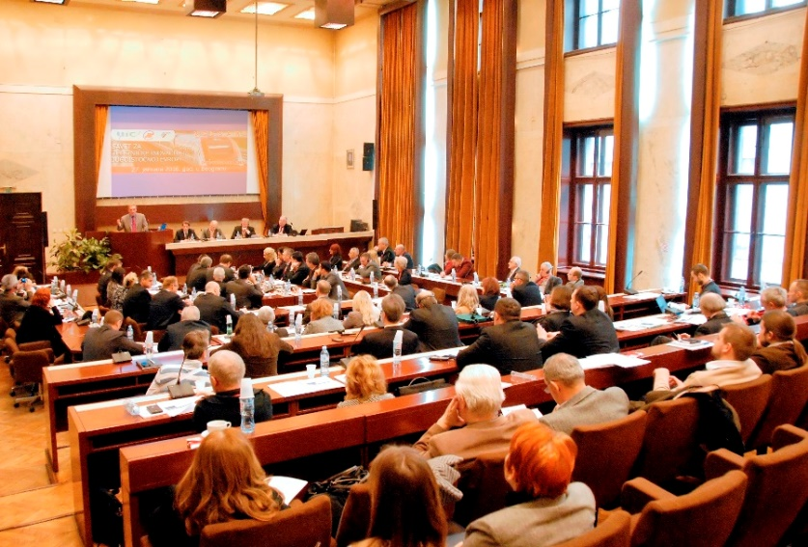
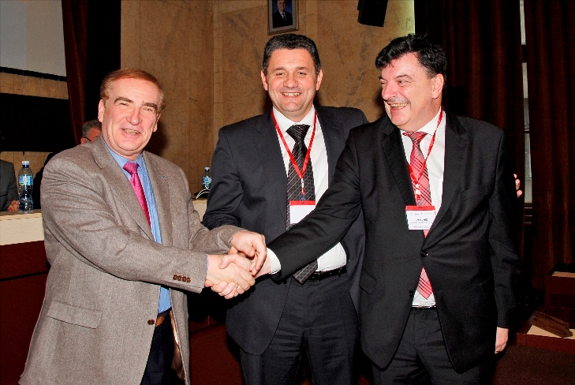
KICK-OFF MEETING IN BELGRADE
Took place on 27th January 2016
70 participants from 14 countries
Opened by the Vice-Prime minister and Minister of Transport and Infrastructure of Serbia
Presented vision, strategy, action plan and Declaration of intent (establishment)
Selected Chairman of SEESARI
Signed Memorandum of establishment (Declaration of intent)

Slide 33
→ NEXT STEPS
1st Steering Commetee in 1st half of 2016
Set up organizational structure of SEESARI
Regional/country visits, visiting EIB, EC…
- Promotion and communication: website, brochure
- Finalize and confirm strategy and action plan and prepare a first set of project proposals and financial scenarios for the suggested activities
- Searching for funding opportunities from a range of sector and institutional sources (close watch on possible funding mechanisms such as SHIFT2RAIL, CEF, Horizon 2020, EFSI)
All interested are invited to sign the Declaration to join the initiative!
=> For more info please contact: info@seesari.org

Slide 34
Thank you for your attention.
Peter Verlič, D.Sc
Prometni institut Ljubljana d.o.o.
Kolodvorska 11, SI-1000 Ljubljana
Tel.: +38612914623, +38612914626
Fax.:+38612319277
www.prometni-institut.si
www.slo-zeleznice.si

