Slide 1
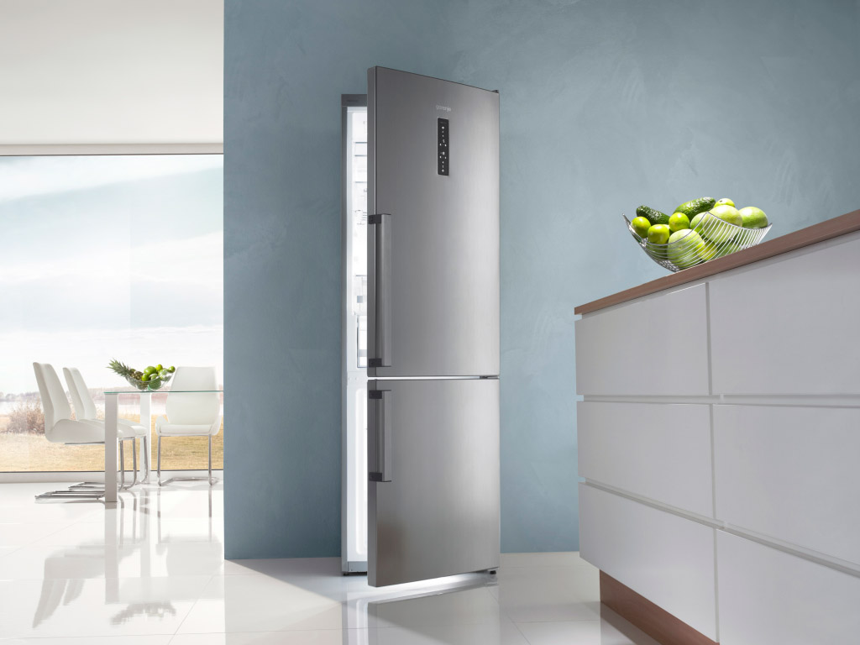


Nano materials and industrial production of Gorenje large domestic appliances
Dr. Aleš Mihelič & Boštjan Bavec
Brussels, March 2017

Slide 2
One of Leading European
Manufacturers of Products for Home
CORE BUSINESS
Products and
services for home
(MDA, SDA, HVAC,
kitchen furniture)
R&D COMPETENCE CENTRES
Slovenia
Czech Republic
Sweden
Netherlands
NUMBER OF
EMPLOYEES
10,796
Gorenje
Group
OWN
PRODUCTION
Slovenia
Serbia
Czech Republic
CONSOLIDATED
REVENUE
EUR 1.257 billion
GLOBAL
PRESENCE
90 Countries
Worldwide,
mostly in Europe (92%),
also in USA, Australia,
Near and Far East
EXPORT
95%
of sales
MDA (major domestic appliances)
SDA (small domestic appliances)
HVAC (heating, ventilation, air conditioning)

Slide 3
Most Important Markets:
Germany, Russia and the Netherlands
GERMANY
RUSSIA
THE NETHERLANDS
SERBIA
SLOVENIA
CZECH REPUBLIC
CROATIA
DENMARK
AUSTRALIJA
USA
UKRAINE
BIH
AUSTRIA
POLAND
BELGIUM
HUNGARY
FINLAND
NORWAY
RUMANIA
SLOVAKIA
SWEDEN
BULGARIA
GREAT BRITAIN
FRANCE
MONTENEGRO

Slide 4
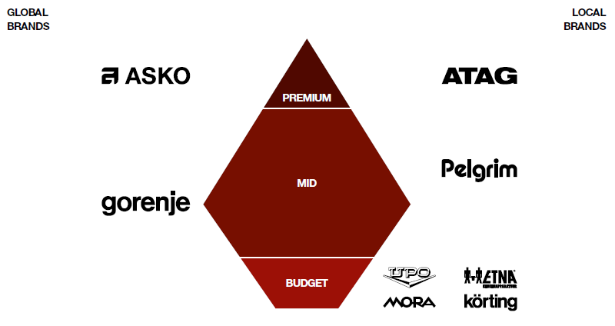
Gorenje Group Brand Portfolio
Implementing a multi-brand strategy with attention on the upper-mid and premium price segment.

Slide 5
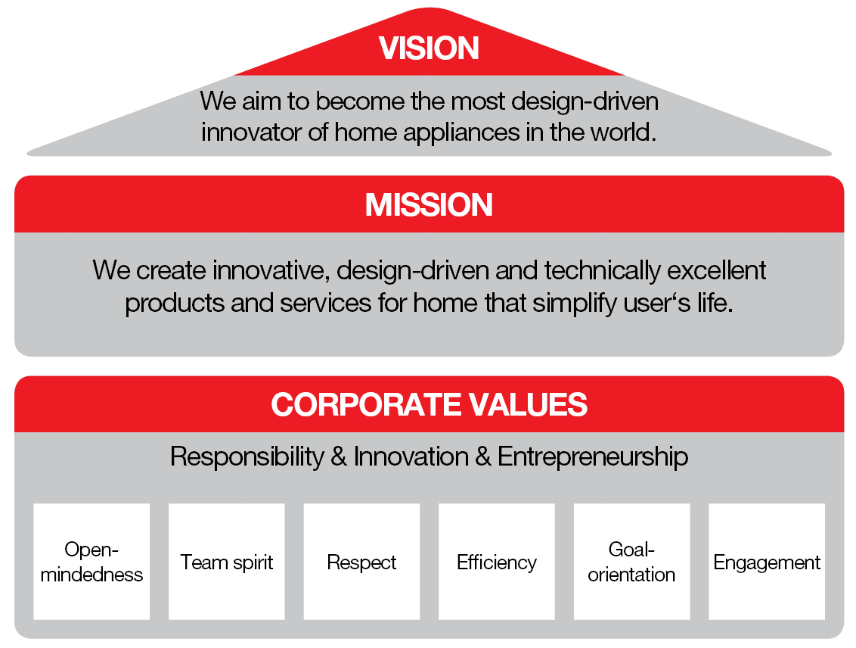
Vision, Mission, Corporate Values

Slide 6
Material which are used nowadays in regular Gorenje production
- Different quality of steel (decarburized steel, low alloyed different quality of stainless steel)
- Enamels (white, black, gray…)
- Glass
- Plastic
- Rubber
- Wire
- Different surface protecting coatings

Slide 7
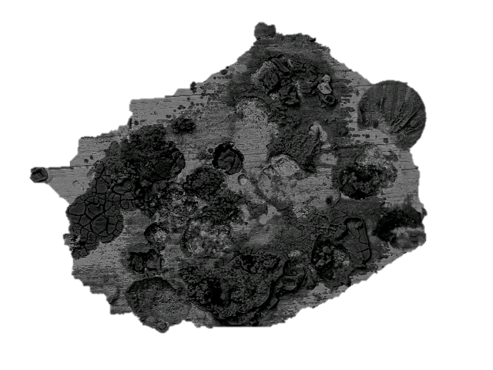
The main shortcomings of regular materials are
Corrosion
Appearance of bacteria if
costumer don’t clean it regularly
Hard to clean oil from enamels
Glass can have fog appearance
Scratches on surface
Lose off color shine
Energy losses

Slide 8
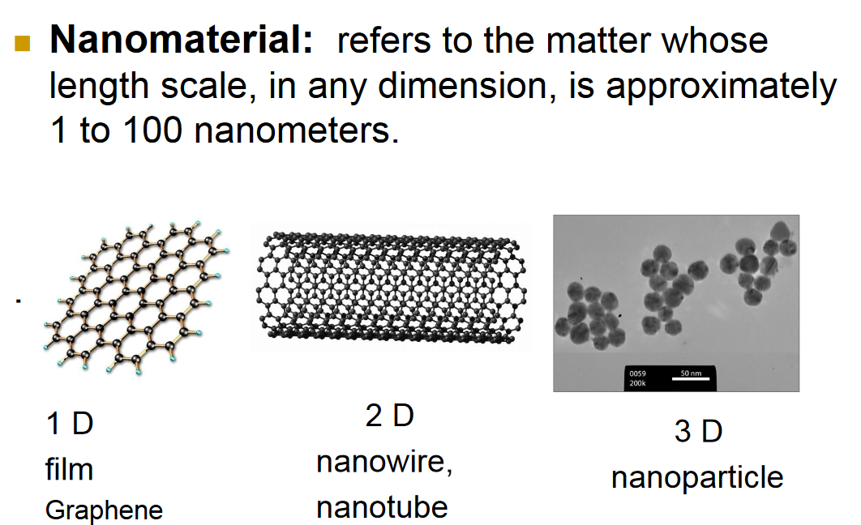
WHAT ARE NANOMATERIAL

Slide 9
Which material are used for nanomaterial now days
• Carbon black
• Silica fumes
• Clay
• Metal/alloys
• Ceramics
Used in tires and other rubber products, fillers,
pigments, synthetic bone, polishing slurries,
pharma additives, sun

Slide 10
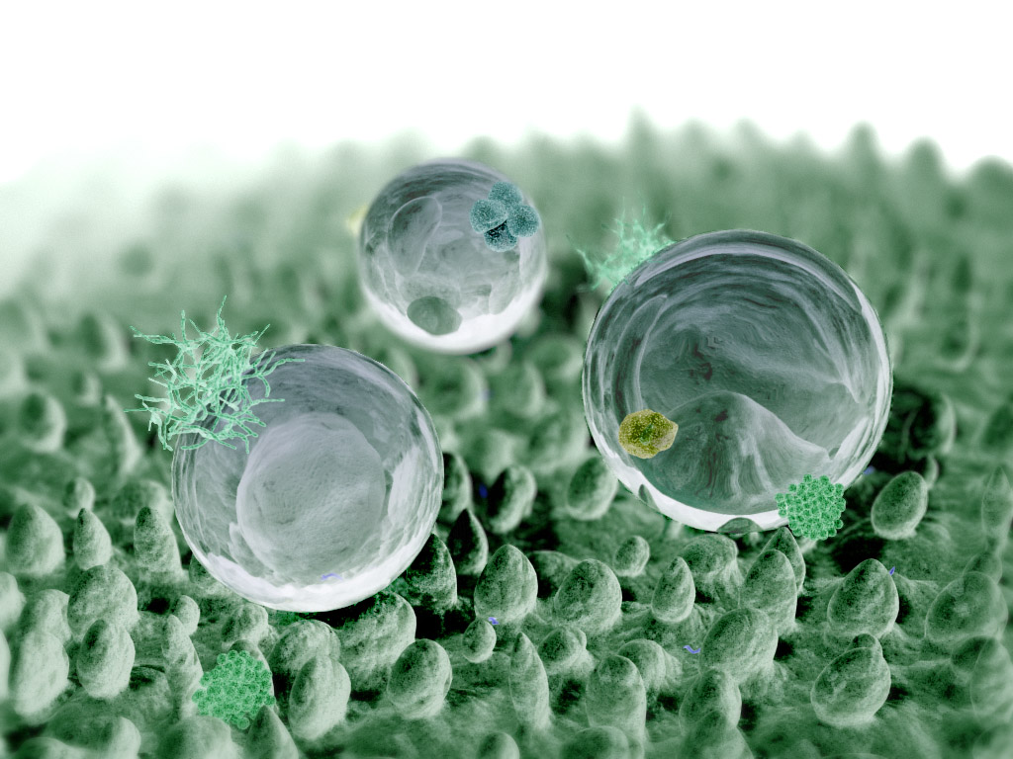
Main advantages why to use nano material in home appliance
Nano material allow to achieve amazing things;
antibacterial protection
self-cleaning effect
surfaces can make them water- and residue-repellent
resistant to ultraviolet or infrared light
good corrosion protection
different color visibly
anti wear protection and scratch-resistant
antifog
energy reflection
10

Slide 11
Where would be most visible advantage with build in nanomaterials
Less energy consumptions we could achieve higher energy level A+++…
Anti/Less bacteria
Less material in appliances (lower weight)
More resistant to scratch (we would be able to sell coking appliance without enamels
Oleofobic materials - almost no need to clean
Feel like metal plastic
Innovative displays
…

Slide 12
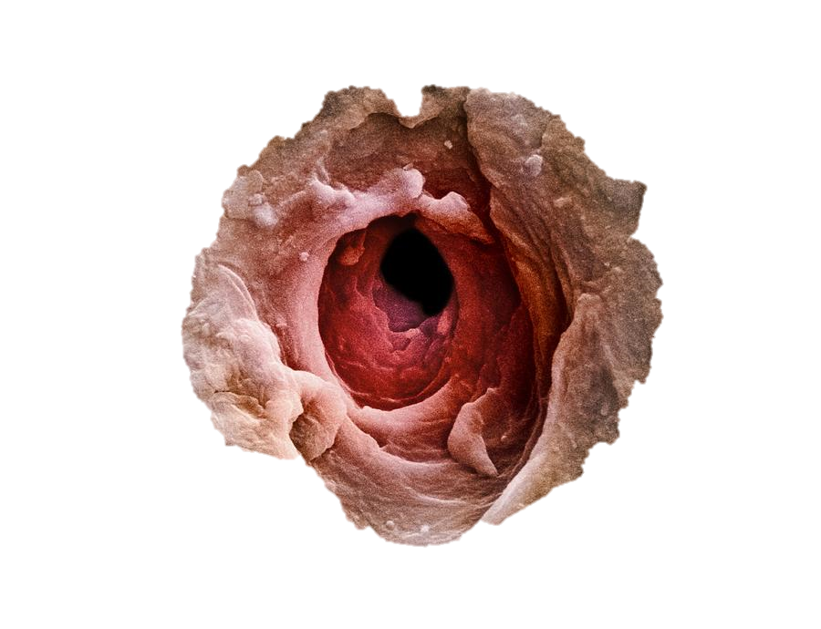
The main problems in implementing nano-technology in production
Liability for product during whole lifetime
Workers working environment
Difficult to recycle
Legislation barriers
One sweat pore

Slide 13
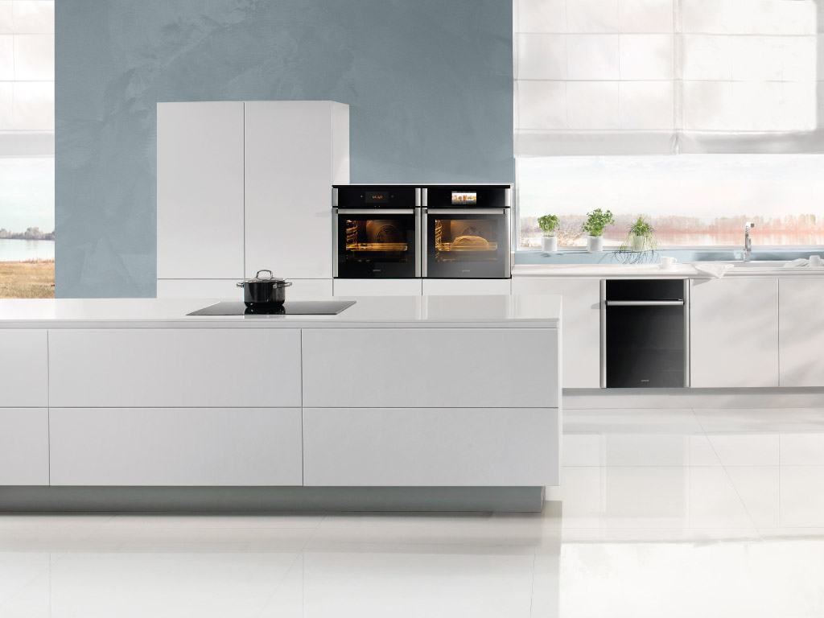
Thank you for your attention

