Slide 1



REGIONS AND CITIES FOR CIRCULAR ECONOMY
EUROPEAN WEEK OF REGIONS AND CITIES
BRUSSELS - 12 OCTOBER 2016
Janez Potočnik
Co-Chair UNEP International Resource Panel (IRP)
SYSTEMIQ

Slide 2
WORLD
IN WHICH WE LIVE

Slide 3


20th CENTURY
THE GREAT ACCELERATION
Growth of population by a factor 3.7
Annual extraction of construction materials grew by a factor of 34, ores and minerals by a factor of 27, fossil fuels by a factor of 12, biomass by a factor of 3.6
Total material extraction grew by a factor of 8
GHG emissions grew by a factor of 13
Globalisation

Slide 4

21th CENTURY
FACTS WE CAN NOT IGNORE
Population growth (2050 – 9.7 billion)
Per capita consumption growth (McKinsey estimates 3 billion consumers moving from low to middle class consumption till 2030)

Slide 5
21th CENTURY
FACTS WE CAN NOT IGNORE
Poverty and social inequality (Oxfam Report: 62 people own the same as half of the world and the richest 1% is more wealthy than the rest of the world)
60% of ecosystems already degraded or used unsustainably
Increasing evidence of the climate change threat

Slide 6
GLOBAL MATERIAL FLOWS AND RESOURCE PRODUCTIVITY
Consumption has been stronger driver of growth in material use that population growth
The richest countries consume on average 10 times more materials as the poorest
Production has shifted from very material efficient countries to countries that have lower material efficiency which resulted in decline of material efficiency – since 2000 global economy needs more materials per unit of GDP
The level of well-being achieved in wealthy industrial countries cannot be generalised globally based on the same system of production and consumption!

Slide 7
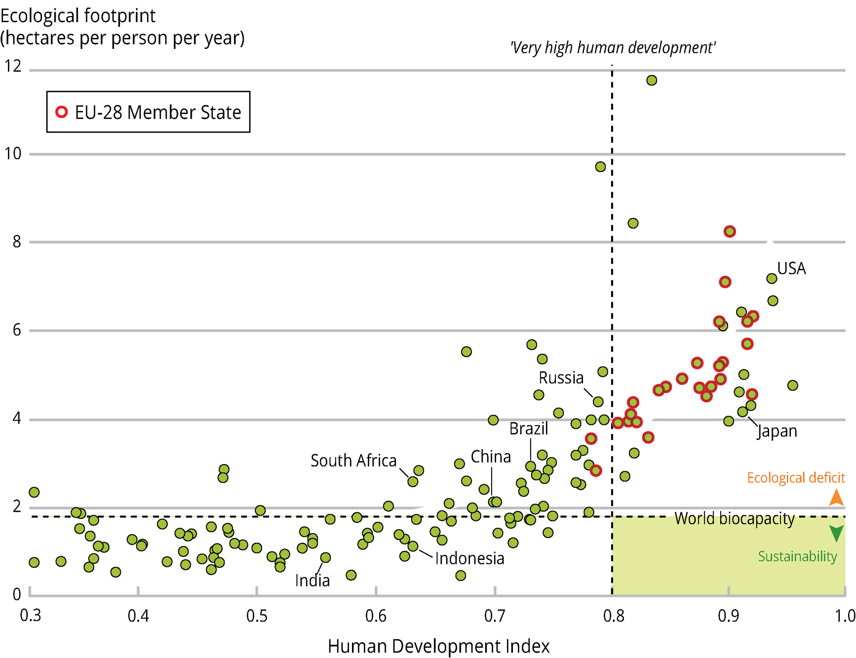
DEVELOPMENT TRAJECTORY …
Source: Global Footprint Network, 2012; UNDP, 2014a
Notes:
it was taken from the UN GEO 5 report. Page 424 of this report indicates the graph was created by plotting UNDP 20009 HDI figures against 2010 Global Footprint Network Figures. The Global Footprint Network site indicates that UK's 2010 footprint is about 5 hectares per person. The 2009 UNDP report indicates that the UK's HDO is at about 0.95. The cluster at the intersection of 5 and 0.9 is thus where the UK is.
This figure plots countries on the basis of two indicators: the Human Development Index (HDI) and the ecological footprint per person.
In order to achieve sustainability, countries must move towards the bottom right hand corner marked in green and as such decouple human development from natural resource use and environmental impacts.
The figure shows that worldwide, no country held that position in 2007.
We should also look to avoid the path the arrows take us: higher human wellbeing yet an increase in the ecological footprint followed by a realisation for the need for change, leading to a decrease in the footprint.

Slide 8
AND …
SOLUTIONS

Slide 9
DECOUPLING IS THE IMPERATIVE
OF MODERN ENVIRONMENTAL AND ECONOMIC POLICY

Slide 10
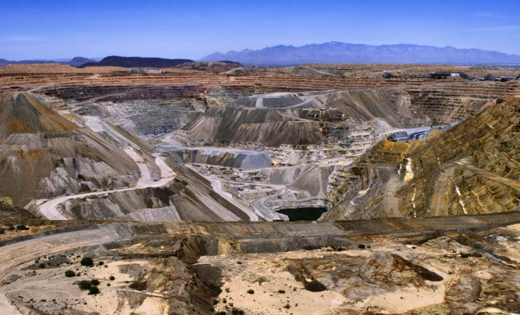
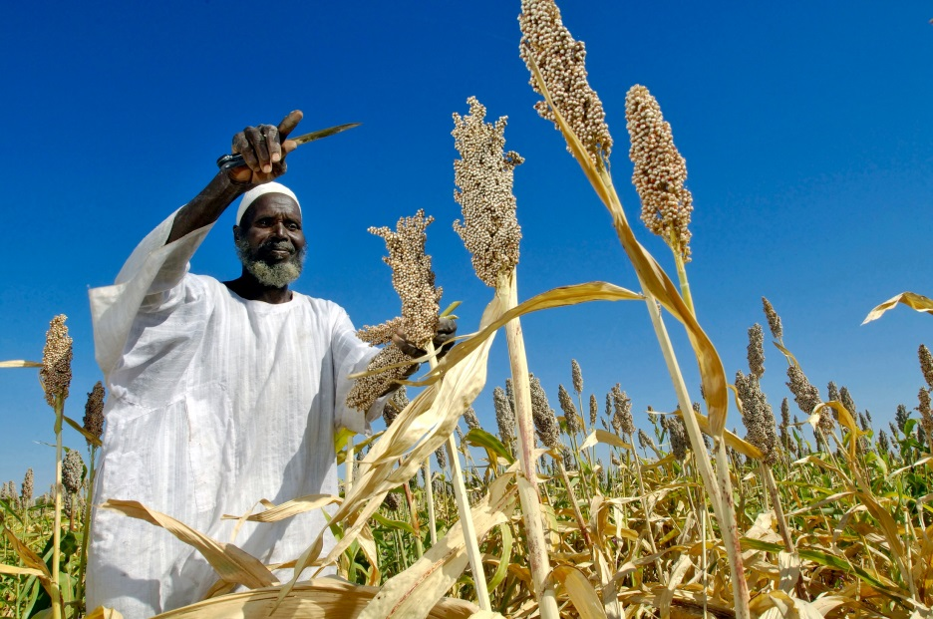
DECOUPLING AND RESOURCE EFFICIENCY POTENTIAL
“With concerted action, there is significant potential for increasing resource efficiency, which will have numerous benefits for the economy and the environment”

Slide 11
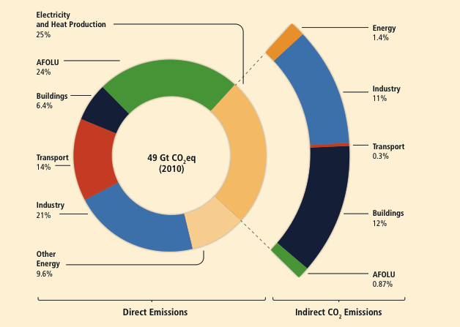
DECOUPLING AND
RESOURCE EFFICIENCY POTENTIAL
“Improving resource efficiency is indispensable for meeting climate change targets cost effectively”
Total anthropogenic GHG emissions (Gt CO2eq per year)
by economic sector

Slide 12
CLIMATE
DECARBONISATION
LAND
WATER
GHG
MATERIALS
DECOUPLING
RESOURCES
LOW CARBON RESOURCE EFFICIENT ECONOMY

Slide 13

DECOUPLING AND
RESOURCE EFFICIENCY POTENTIAL
“Resource efficiency can contribute to
economic growth and job creation”
Modelling results differ in size, but all of them show that increasing resource efficiency can lead to higher economic growth and employment, often even when environmental benefits are not accounted.

Slide 14
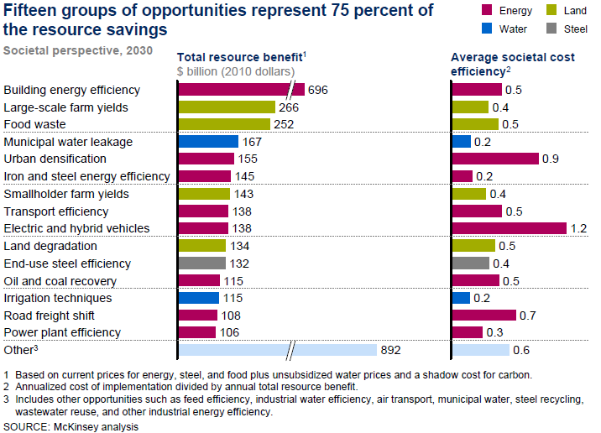
DECOUPLING AND
RESOURCE EFFICIENCY POTENTIAL
“There are substantial areas of opportunity for greater resource efficiency ”
The top 15 categories of resource efficiency potential

Slide 15
DECOUPLING AND
RESOURCE EFFICIENCY POTENTIAL
“Increased resource efficiency is practically attainable”
Energy consumption and saving potential by equipment type in US mining industry

Slide 16
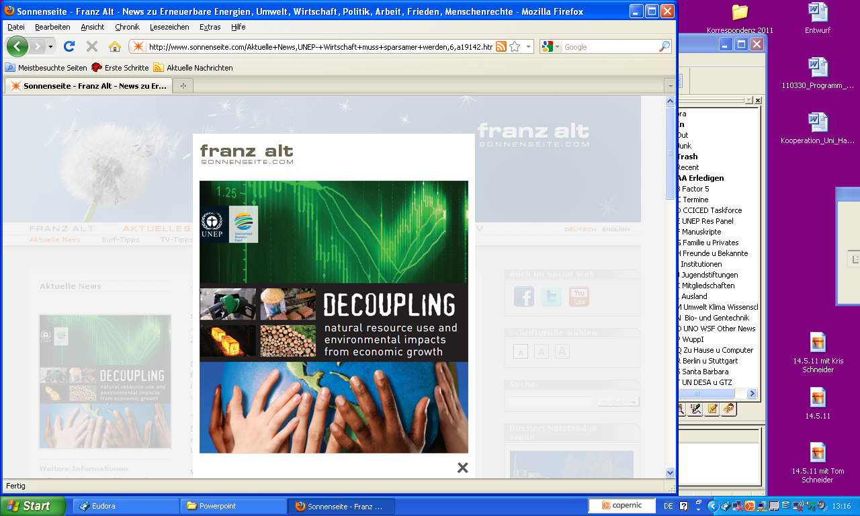
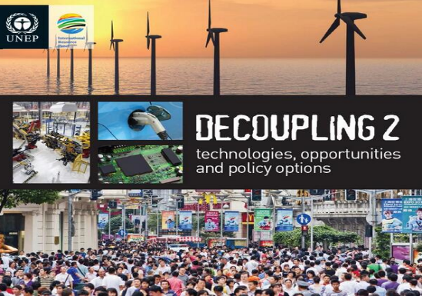
Developed economies will need to adopt strategies that bring their resource consumption down to globally sustainable levels (ABSULUTE DECOUPLING)
Developing nations must strive to improve resource efficiencies and cleaner production processes as their net consumption of natural resources increases for a period until they achieve a societally acceptable quality of life (RELATIVE DECOUPLING)

Slide 17
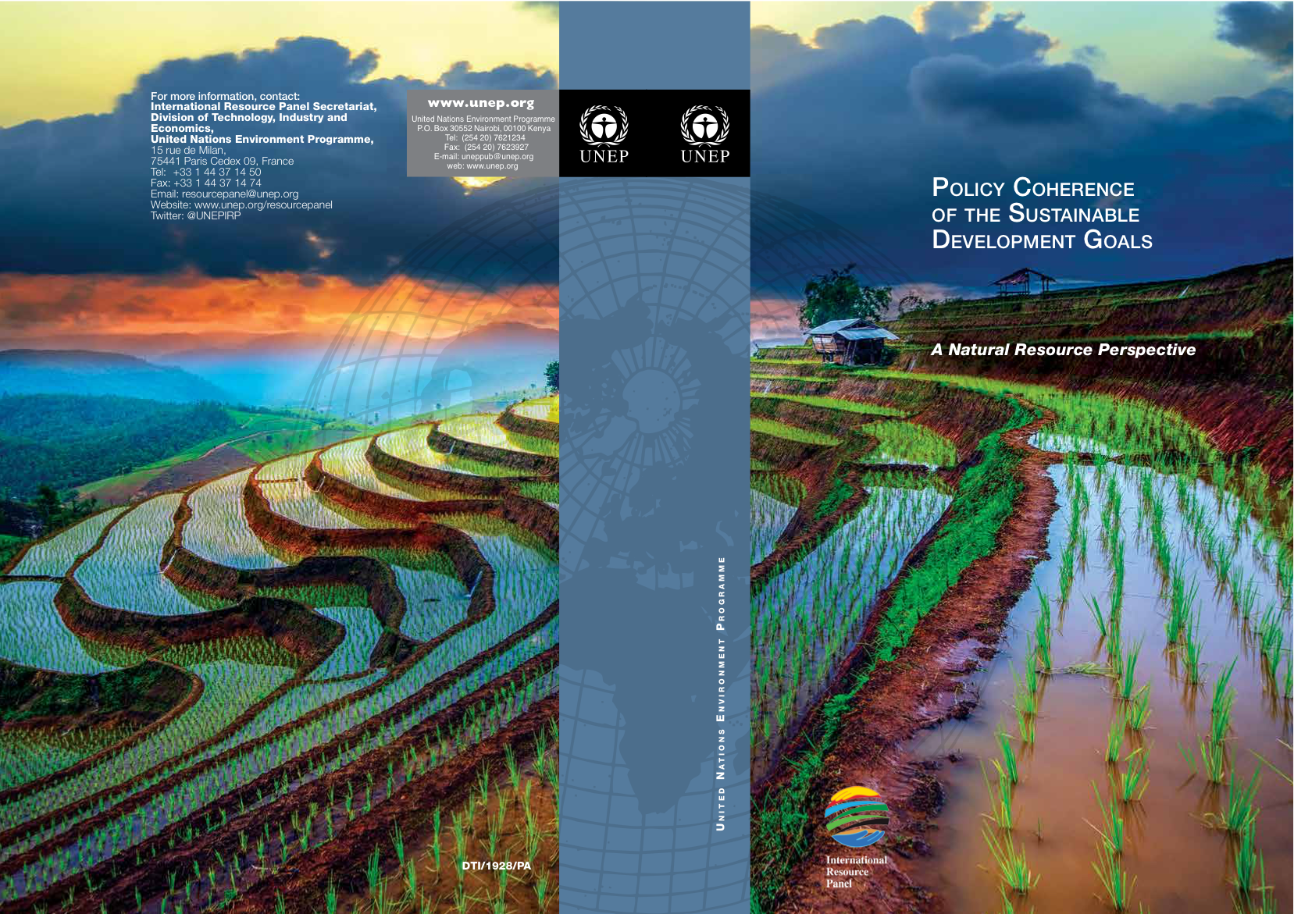
SDGs offer unique opportunity to move to an integrated, universally relevant and potentially transformative Global Development Agenda.

Slide 18

SDGs DIRECTLY DEPENDENT ON NATURAL RESOURCES

Slide 19
Sustainable Consumption and Production is the most efficient strategy to avoid trade-offs and create synergies to resolve the development and environmental challenges articulated in the SDGs.

Slide 20
LINK
TO EU CIRULAR ECONOMY

Slide 21
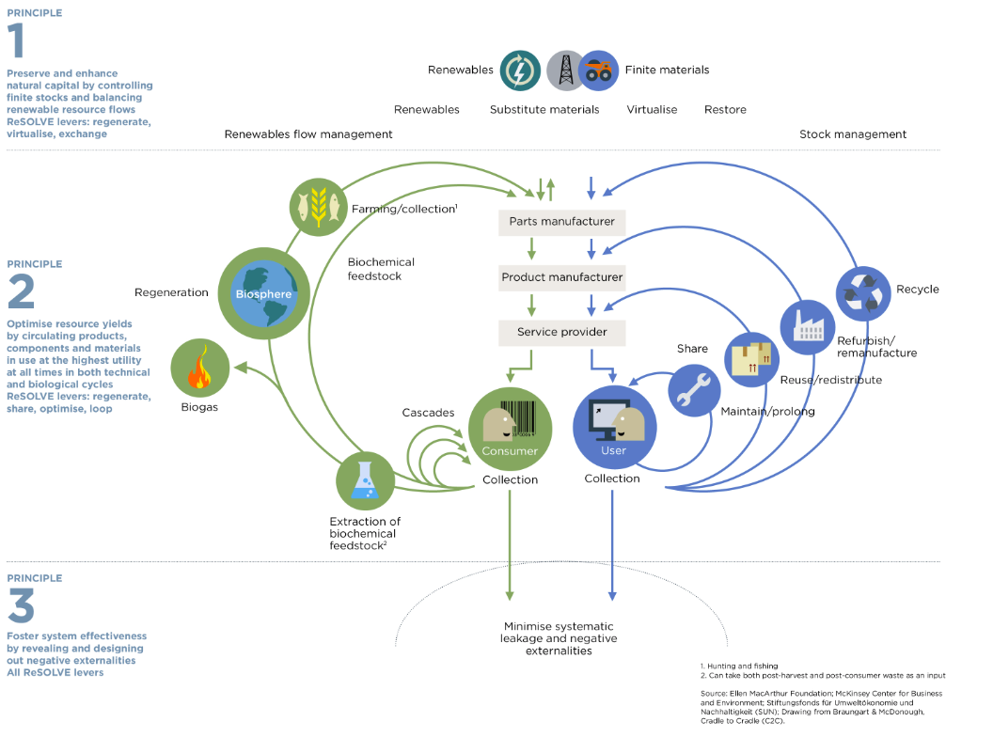

PRINCIPLE
1
Preserve and enhance natural capital by controlling finite stocks and balancing renewable resource flows
PRINCIPLE
2
Optimise resource yields by circulating products, components and materials in use at the highest utility at all times in both technical and biological cycles
PRINCIPLE
1. Hunting and fishing
2. Can take both post-harvest and post-consumer waste as an input
Source: Ellen MacArthur Foundation; McKinsey Center
for Business and Environment; Stiftungsfonds Für Umweltökonomie und Nachhaltigkeit (SUN); Drawing
from Braungart & McDonough Cradle to Cradle (C2C)
3
Foster system effectiveness by revealing and designing out negative externalities
Notes:
Aim to decouple growth and dev from consumption of finite resources
Maximisation of asset utilisation (presupposes design + reverse logistics)
On the left side, notion of regeneration means that nutrient loops need to be addressed (currently fragmentation).

Slide 22

CONCRETE ACTIONS
EU CIRCULAR ECONOMY PACKAGE
ECO-DESIGN to include reparability, durability, recyclability
Legislation on FERTILISERS, Including organic and
waste-based fertilisers
Minimum requirements for the REUSE OF WASTEWATER
Actions on GREEN PUBLIC PROCUREMENT
FUNDING of €650 million for ‘industry 2020
in the circular economy’
Quality standards for SECONDARY RAW MATERIALS
STRATEGY ON PLASTICS, including marine litter
Interface CHEMICALS, PRODUCTS AND WASTE LEGISLATION

Slide 23
CIRCULAR ECONOMY
AND CITIES

Slide 24
WORLD URBANIZATION PROSPECTS 2014 REPORT
3.8 billion people lived in urban areas in 2014 (54% of the global population)
Expectations: 6.3 billion (additional 2.5 billion) people by 2050 (66% of the global population)
If inequalities remain unchanged, one third will be living in slums by 2050
37% of the growth is expected to come from China, India and Nigeria

Slide 25
RESOURCE REQUIREMENTS OF FUTURE URBANISATION
2017 IRP REPORT
What are the resource requirements of future urban growth?
Example: China used more cement in the three years 2011-2013 than the USA used in the whole 20th Century
Two primary determinants of resource consumption in urban settlements: The relatively high or low densities of the urban population within a given area, and The socio-technical infrastructures that are used to conduct key resources into, through or out of given urban area (energy, waste, food, mobility…)
In general, high density urban settlements are more resource efficient

Slide 26
RESOURCE REQUIREMENTS OF FUTURE URBANISATION
2017 IRP REPORT – INITIAL FINDINGS
BAU – DMC is expected to grow from 40 billion tons in 2010 to 85 billion tons by 2050 and land urban cover is expected to grow from an estimated 1 million km² in 2010 to 2,5 million km² by 2050
IRP in SDGs OWG Report recommended that a sustainable level of resource consumption per capita would be 6 tons (North America 25-35, EU 16, developing countries 3-15 tons/cap)
This could be achieved by two sets of interventions: by strategic intensification of a network of urban nodes in each urban settlement and by introducing more resource efficient urban infrastructure

Slide 27
RESOURCE REQUIREMENTS OF FUTURE URBANISATION
2017 IRP REPORT – INTENSIFICATION STRATEGIES
Investment in a network of high density nodes (people, jobs, amenities) interconnected with efficient and affordable mass transit systems
Promotion of energy efficient buildings
Maximum use of renewable energy with integrated demand-supply management
Promotion of more sustainable human behaviours
The cascading multiplicative impact of these four measures can improve resource efficiency by a factor of 10

Slide 28
RESOURCE REQUIREMENTS OF FUTURE URBANISATION
2017 IRP REPORT – INITIAL FINDINGS
Three technological approaches analysed: bus rapid transit system (BRTs), district energy systems (DES) and green buildings (GBs)
Reduction in the life cycle environmental and resource impact by 2050: Resource efficient technologies without densification 24–47 %, Resource efficient technologies with densification 36–54 %
Resource efficiencies could also be achieved by coordinating inter-sectoral infrastructure interventions

Slide 29
RESOURCE REQUIREMENTS OF FUTURE URBANISATION
2017 IRP REPORT – INITIAL FINDINGS
Urban transition will not happen without appropriate urban governance arrangements
Urban experimentation is happening everywhere – the concept of urban experimentation may be emerging as a new mode of urban governance
Far-sighted city governments are needed and they need to become global leaders

Slide 30

TO CONCLUDE …

Slide 31

SUSTAINABLE, LOW-CARBON, CIRCULAR, GREEN, RESOURCE EFFICIENT, ENERGY EFFICIENT, DECOUPLING, 3Rs, ECOLOGICAL CIVILISATION, BIOECONOMY, ECO-ECONOMY, BLUE …
What we actually talk about

Slide 32

NEW ECONOMIC MODEL BASED ON SCP INTEGRATING ALL THREE PILLARS OF SUSTAINABILITY IS
WE HAVE TO FIX A BROKEN COMPASS
(PAVAN SUKHDEV)
NECESSARY
AND UNAVOIDABLE
SCIENCE

Slide 33
POLICY APPROCH
ALL POLICIES SHOULD BE SYSTEMATICALLY ADJUSTED
Beyond GDP, natural capital accounting, corporate sustainability reporting, tax policy, state aid, public procurement, product design, use of banking potential, R and D and innovation, investments in infrastructure, education, consumers awareness, new business models, support to SMS, …
ACTIVE DIALOGUE WITH ALL STAKEHOLDERS IS NECESSARY
Transition is only possible if we actively involve those loosing in the process of transition

Slide 34
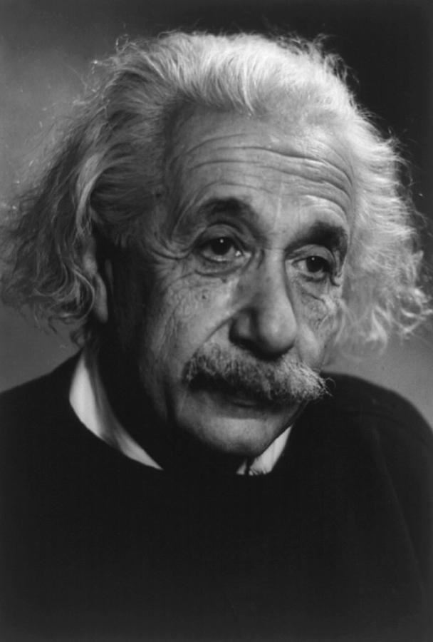
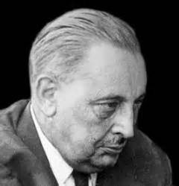
ABOUT OUR TIME ...
ALBERT EINSTEIN
WE CAN NOT SOLVE OUR PROBLEMS WITH THE SAME THINKING WE USED WHEN WE HAVE CREATED THEM
INSANITY – DOING THE SAME THINGS OVER AND OVER AGAIN AND EXPECTING DIFFERENT RESULTS
SOC
ECO
ENV
SCP
GIUSEPPE TOMASI DI LAMPEDUSA
SDGs
EVERYTHING HAS TO CHANGE TO REMAIN THE SAME

Slide 35

THANK YOU
www.unep.org/resourcepanel

