Slide 1
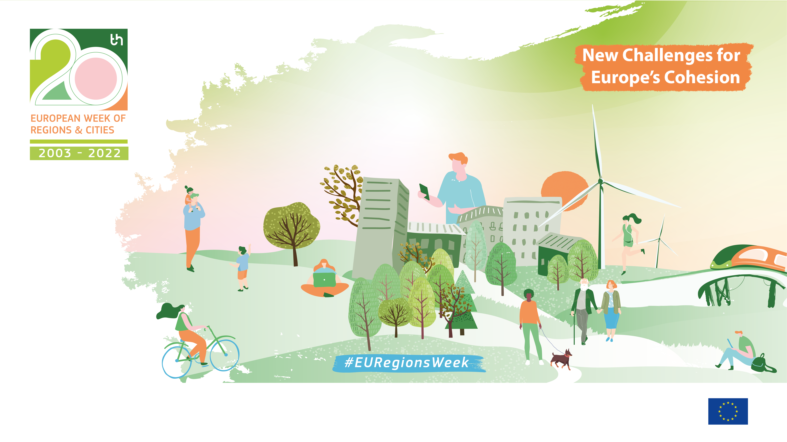
.1
The Covenant of Mayors in practice:
the support of Galicia to local authorities
María Luz Macho-Eiras
Director of the Galician environmental Laboratory
Government of Galicia
Notes:
1

Slide 2

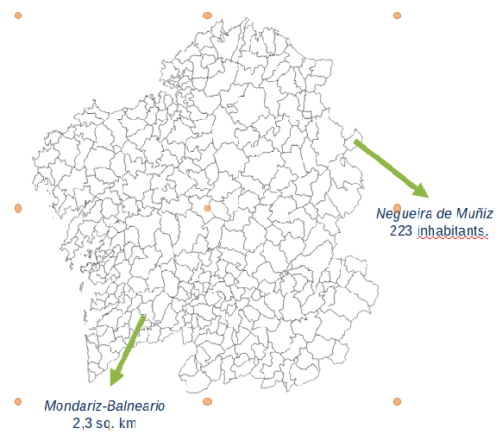
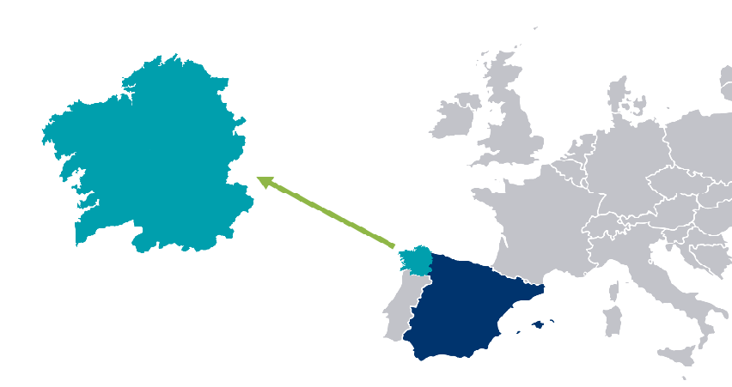
Where is Galicia?
Whats Galicia Like?
2.695.645 inhabitants
29.574,8
sq. km
91,3
people per sq. km
313
municipalities

Slide 3
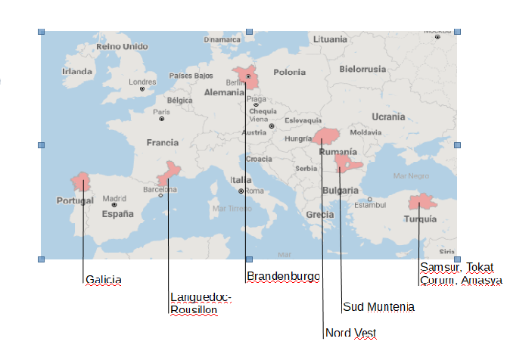
REGIONS LIKE GALICIA
Between
2,5M & 3M inhabitants
Between
20,000 &
40,000 sq. km

Slide 4
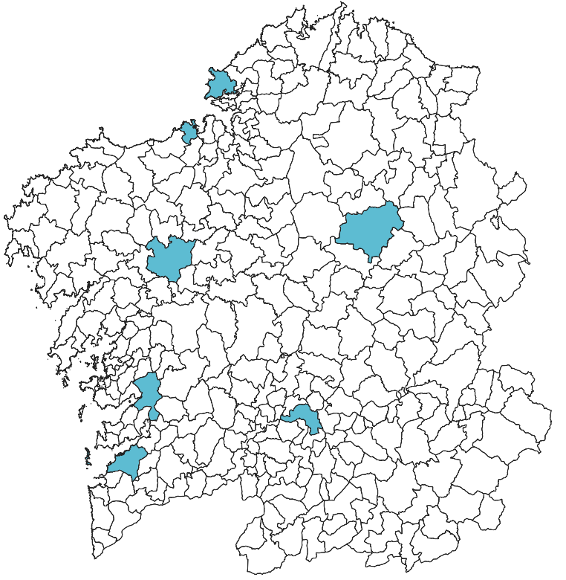
The features of Galician´s Municipalities
Small municipalities
<10.000 inhabitants
257 municipalities
7 Galician Cities
Medium municipalities
Between 10.000 and 20.000 inhabitants
34 municipalities
987.271 inhabitants
Large municipalities
>20.000 inhabitants
22 municipalities

Slide 5
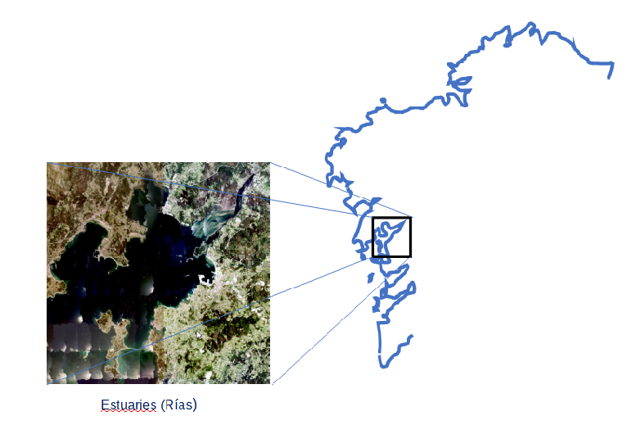
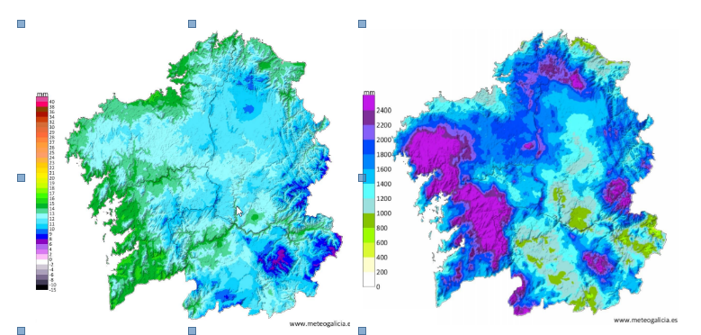
GALICIAN CLIMATE
GALICIAN GEOGRAPHY
1,498 km of coastline
Average temperature of
13.7 ºC
Precipitation over
700mm
Across the entire region

Slide 6
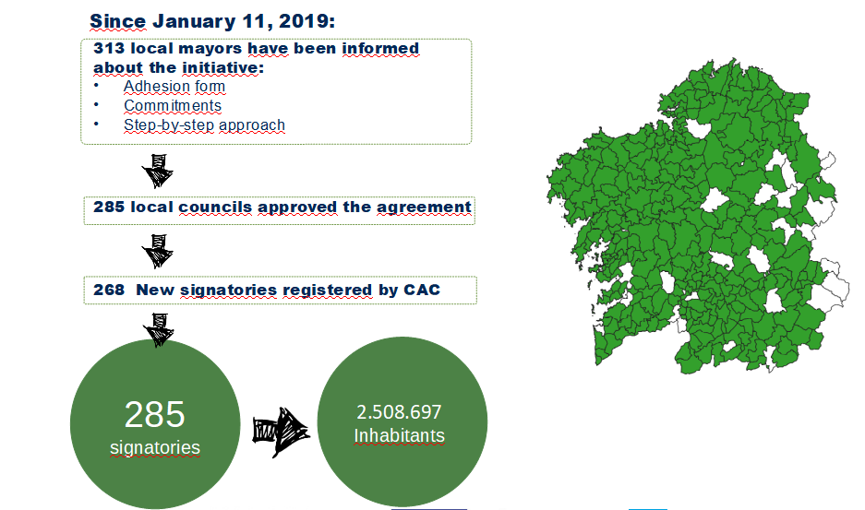
Municipalities Assistance Centre (CAC)
Adhesion support

Slide 7
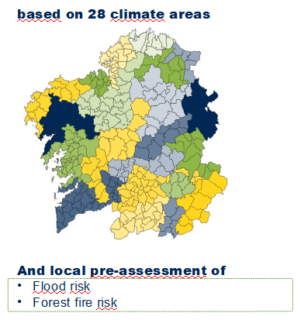
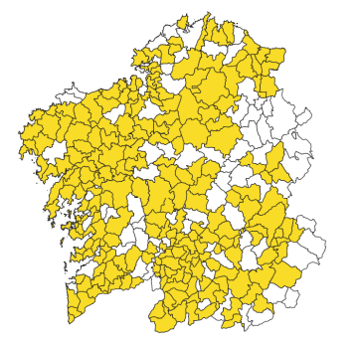
Municipalities Assistance Centre (CAC)
RISK PRE_ASSESMET- METEOGALICIA
251
councils were visited
252 councils have submitted SECAP

Slide 8
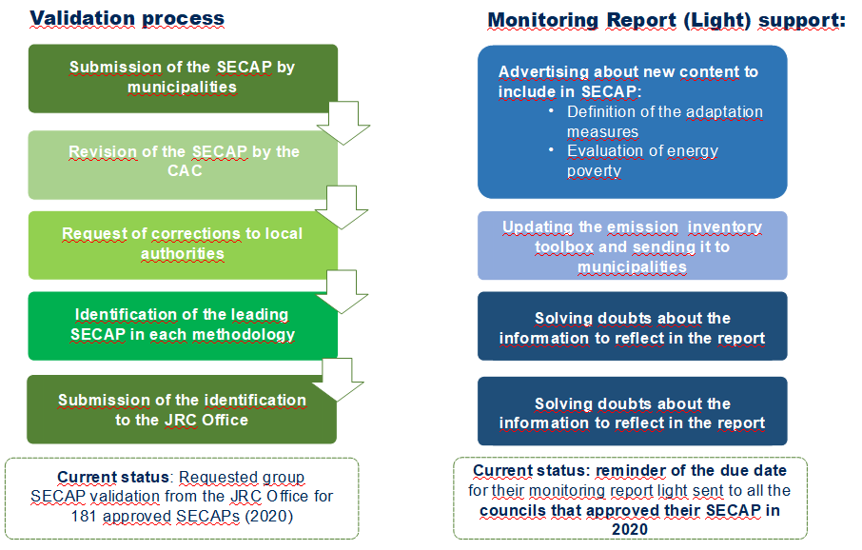
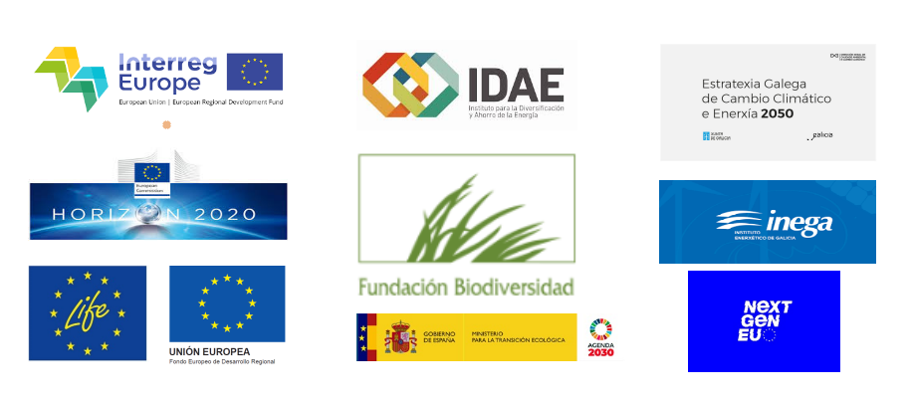
Municipalities Assistance Centre (CAC)
Permanent Observatory of founds and calls
Text color1
Test color 2
Monitoring report support

Slide 9
Thank you!
maria.luz.macho.eiras@xunta.gal https://www.xunta.gal/cmatv

