Slide 1
.1
Integrated Territorial Investments in Slovenia in 2014-2020
Saša Heath-Drugovič

Slide 2
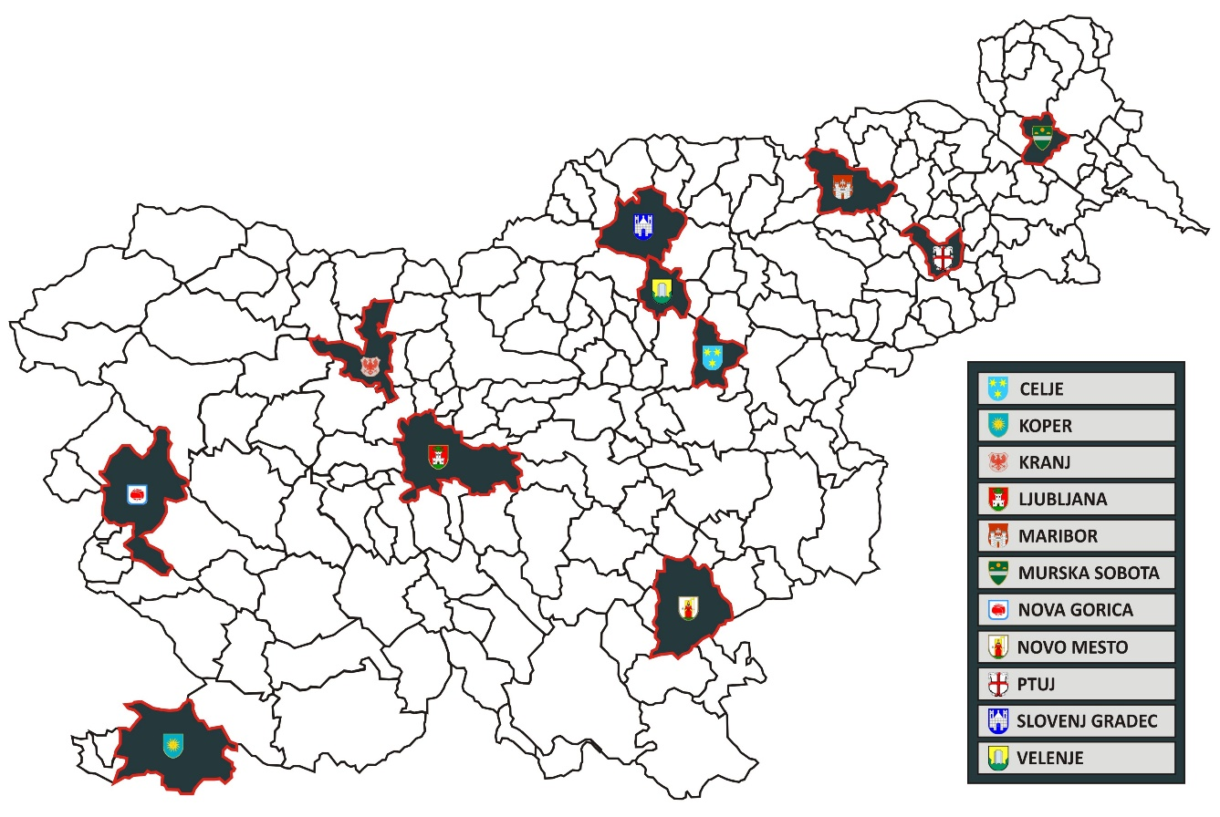
Urban municipalities in ITI 2014-2020
Challenge
Small & medium-sized cities, lack of capacity for each city to be an intermediary body (IB)
212 municipalities → 11* urban municipalities
Solution
ZMOS as IB - existing structure, already operating, uniting and coordinating all urban municipalities
735.000 inhabitants, 35 % of the country

Slide 3
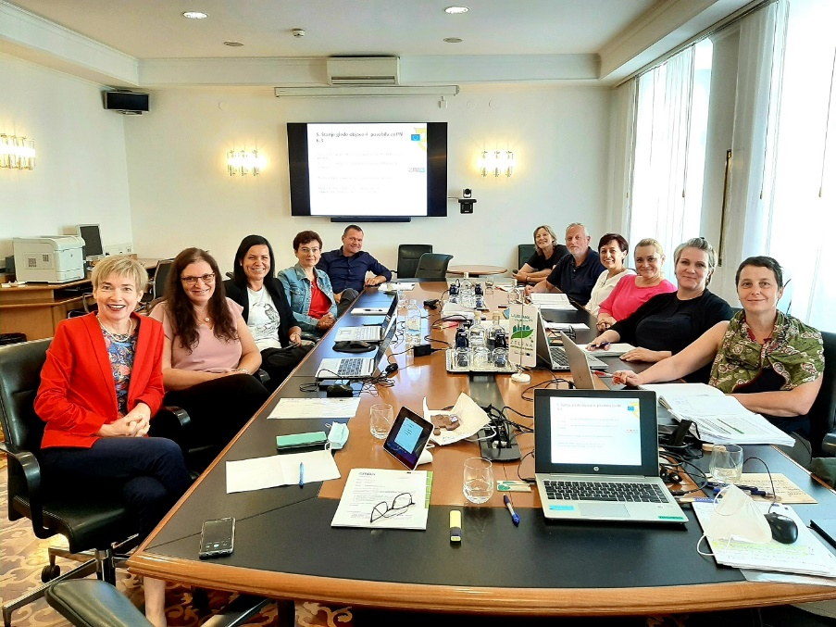
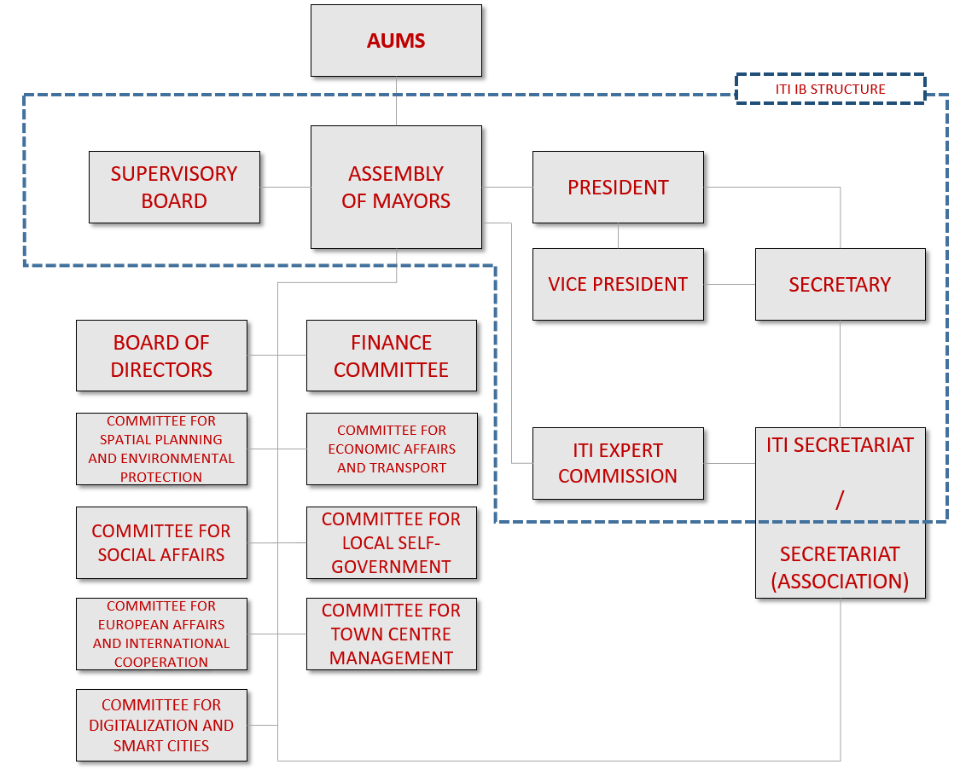
Expert commission for the implementation of ITI
Preparation of calls for projects
Review of applications
Drafting the list of selected projects
Better awareness of municipalities
Overview of SUD strategies
Better ownership of the mechanism
Challenge
New form of cooperation between state and local organs, building trust, mutual understanding
Solution
Intensive dialogue with MA and ministerial IBs, extensive informal coordination, review of obstacles and solutions

Slide 4
Approval of projects
ITI State of play
Managing authority
2017-2022
83
Approved projects
2022-2023
Review of applications
9 projects in the process of approval
PA: 4.1
IB – Ministry for infrastructure
IB – Ministry of the environment and spatial planning
6 mio €
ITI co-financing
PA: 6.3
PA: 4.4
134 mio €
ITI co-financing
122 mio €
Municipal budgets
2nd PHASE
UM
Reporting
UM
1st PHASE
IB - AUMS
Review of applications;
SELECTION OF PROJECTS
96 % of all ITI funds
44 % share of municipal own funds in total investment value
CALLS FOR PROJECTS
11 calls published
256 mio €
Investment value
UM
UM
UM
UM
UM
UM
UM

Slide 5
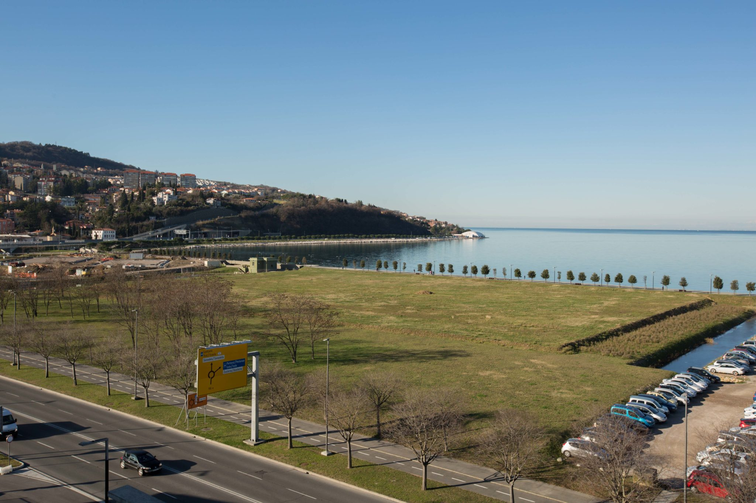
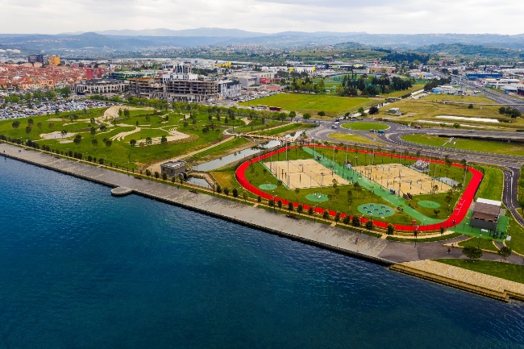
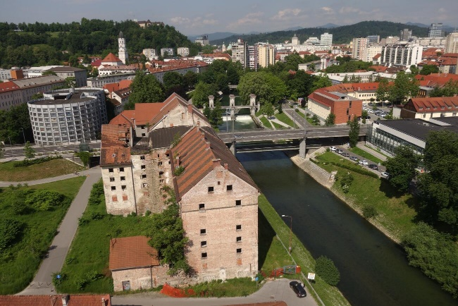
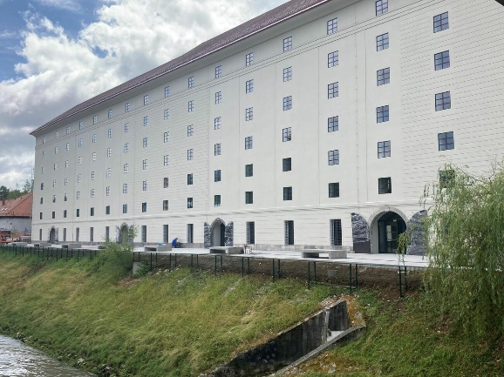
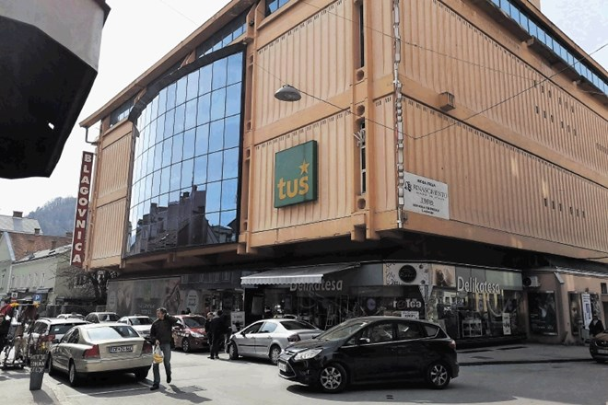
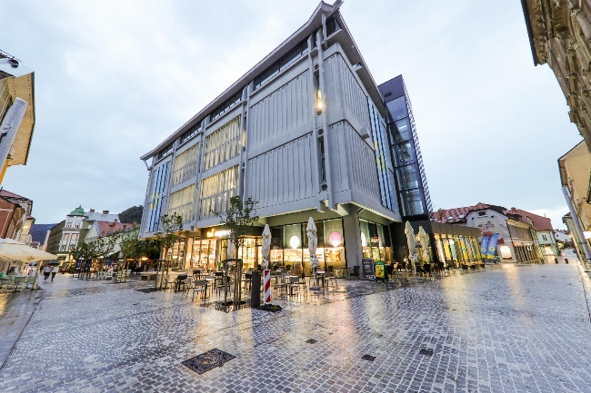
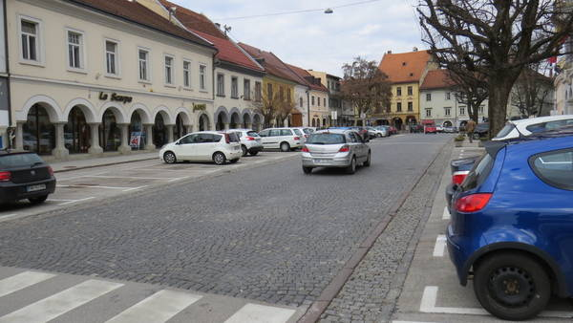
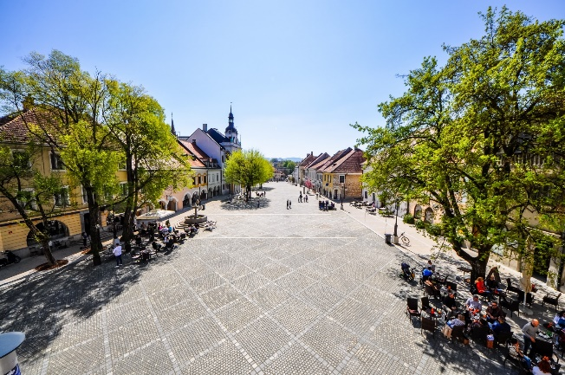
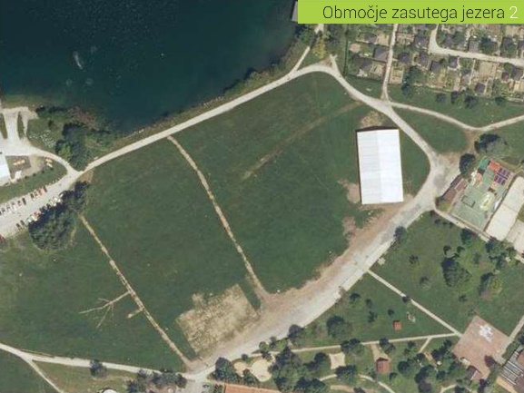
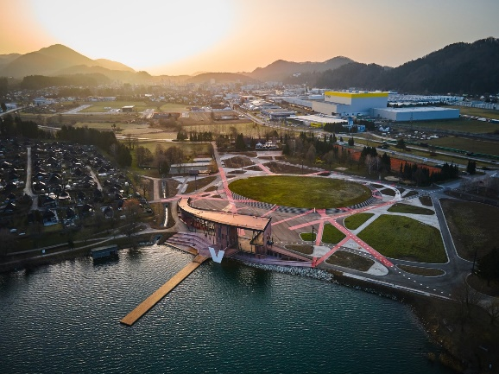
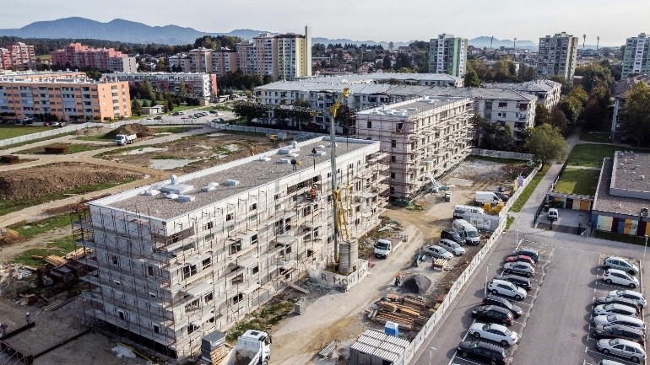
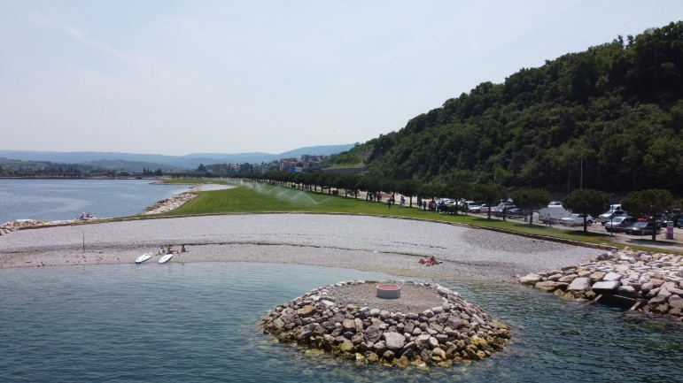
ITI projects
Test color 2
Text color1
Koper – Semedela promenade revitalisation projects (17 mio €, ITI 8,5 mio €)
Ljubljana – Cukrarna Gallery (23 mio €, ITI 13 mio €)
Celje – Generator / Tehnopark (6 mio €, ITI 4 mio €)
Velenje – Vista park (9 mio €, ITI 6 mio €)
Novo mesto – Main Square (7 mio €, ITI 4,5 mio €)
Celje – Public housing Dečkovo naselje 10 (13 mio €, ITI 6 mio €)
Koper – Seafront park (5 mio €, ITI 1 mio €)

Slide 6
Multiplication effects, lessons learned
Building trust between UM and state organs.
Avoid having different rules/procedures for different types of projects in the same mechanism.
Better cooperation between cities, stronger ZMOS.
Important that state organs understand the needs of cities & that cities understand national priorities.
ITI is having a transformational effect on our cities – urban regeneration.
Plan the impleme-
ntation mechanism ahead.
ZMOS ITI governance model as a best practice (EU handbook on SUD strategies)
Good, honest and proactive cooperation among cities is of basic importance.
Multi-level governance and partnership principle indeed lead to better, more efficient mechanisms!
To reach solutions, propose them, don‘t expect that they will be proposed to you.

Slide 7
.1
Thank you!
Further info:
www.zmos.si/ctn/projekti-ctn-v-sloveniji/
www.zmos.si/english
Contacts:
sasa.heath@celje.si
zmos@koper.si

