Slide 1
EU support for the development of the
Trans-European Transport Network (TEN-T)
Stéphane OUAKI
Head Of Unit
Connecting Europe – Infrastructure Investment Strategies
DG MOVE, European Commission
3 March 2016, Brussels

Slide 2
TEN-T framework
Strategic framework
  White Paper for Transport - goals for 2030 and 2050
Policy framework
  TEN-T Guidelines (Regulation No 1315/2013)
Funding framework
  Connecting Europe Facility (Regulation No 1316/2013)
  European Structural and Investment Funds
  European Fund for Strategic Investments (Juncker Plan)
  International Financial Institutions
  Instrument for Pre-accession Assistance

Slide 3
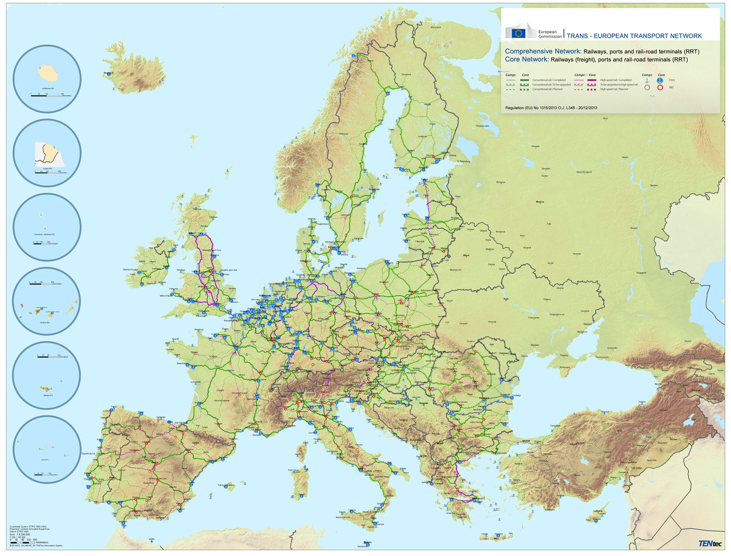
TEN-T Guidelines
Maps
(Rail, road, IWW, ports, airports, RRT)
Standards
Deadlines
  by 2030:
  a single European TEN-T core network
  by 2050:
  accessibility of all regions through a TEN-T comprehensive network

Slide 4
TEN-T Core Network Corridors
An implementation instrument
  facilitate coordinated and resource-efficient realisation of projects of common interest
  European Coordinators
  Corridor platforms (bring together relevant stakeholders)
  Work Plans (submitted by Coordinators in December 2014 and approved by the Member States)
Notes:
4

Slide 5
The Connecting Europe Facility
budget
*
priorities
*
implementation

Slide 6
The Connecting Europe Facility
(transport sector)
Regulation (EU) 1316/2013
Budget: €24.02bn (2014-2020)
  Including €11.3 bn transferred from the Cohesion Fund
  Grants → Priorities (Communication of 7/1/2014):
  TEN-T Corridors and core network:
    cross-border, missing links, bottlenecks
    pre-identified projects
  Horizontal priorities:
    interoperability, innovation, ERTMS…
  Sustainable modes of transport
Innovative financial instruments (10% of total budget)

Slide 7
CEF Transport – Budget allocation
80 – 85 % of available budget (~€20.5bn) for pre-identified projects listed in Annex I
  9 core network corridors and important cross-border sections, bottlenecks and missing links
  Horizontal priorities
15 – 20 % (~€3.5bn) for
  Other projects on the core network
  Projects on the comprehensive network (max 5%)
  Financial instruments (10%)
Notes:
7

Slide 8
CEF Annex I : pre-identified projects in Slovenia
Baltic – Adriatic Corridor
Graz - Maribor – Pragersko | Rail – studies and works for second track
Koper | Port interconnections, (further) development of multimodal platforms
Mediterranean Corridor
Trieste – Divača | Rail – studies and partial upgrading, cross-border section to be realised after 2020
Koper – Divača – Ljubljana -Pragersko | Rail – studies and upgrading/partially new line
Ljubljana – Zagreb | Rail – studies and works
Ljubljana node | Rail node including multi-modal platform; rail airport interconnection
Pragersko – Zalalövö | Rail cross-border – section, studies , works to start before 2020
Lendava – Letenye | Road cross-border – upgrading
Other Core Network Section
SESAR, ERTMS, other telematic application systems (ITS, e-Maritime)
New technologies and innovation: decarbonisation, safe and secure infrastructure, ports and airports

Slide 9
The CEF "Cohesion envelope"
€11.3 bn transferred from the Cohesion Fund to the CEF
  Exclusively for transport projects in Member States eligible for the Cohesion Fund on the core network
  Binding national allocations between 2014 – 2016 (exclusively grants)
      Slovenia allocation: €159.78 million
  CF co-funding rates (up to 85%)
  Technical assistance for capacity building
    Programme Support Actions (direct grants to MS authorities, JASPERS)

Slide 10
Complementarity CEF – ESI Funds
CEF | ESI Funds
High EU added-value, focus on TEN-T Corridors and other sections of the core network (as pre-identified in Annex I of the CEF Regulation) More sustainable modes of transport: rail, IWW | High EU added-value projects to remove bottlenecks in transport networks, by supporting TEN-T infrastructure on both the core and comprehensive networks All modes of transport Regional mobility, through connecting secondary and tertiary nodes to TEN-T infrastructure
Network effect: common project pipeline for Cohesion Fund/ERDF and CEF indicatively included in the Operational Programmes for ESI Funds

Slide 11
CEF grants: direct management
European Commission assisted by Innovation and Networks Executive Agency (INEA)
Competitive evaluation and selection of projects
Work programme (Annual/AP or Multiannual/MAP)
Call for proposals
Evaluation (external and internal)
Grant agreements
AP & MAP 2014
MAP 2015
Framework, priorities and available funding
Oct 2014 – end Feb 2015
Nov 2015 – mid Feb 2016
Mar-Jun 2015
Mar-Jun 2016
Nov/Dec 2015
Nov/Dec 2016

Slide 12
CEF grants: co-funding rates
Types of Projects |  | CEF General Budget (all MS, neighbouring countries) | CEF Cohesion Envelope (Cohesion MS)
(a) Studies (all modes) |  | 50% | 85%
(b) Works on
Rail | Cross border | 40% | 85%
 | Bottleneck | 30% | 85%
 | Other projects of common interest | 20% | 85%
Inland waterways | Cross border | 40% | 85%
 | Bottleneck | 40% | 85%
 | Other projects of common interest | 20% | 85%
Inland transport connections to ports and airports (rail and road) |  | 20% | 85%
Development of ports |  | 20% | 85%
Development of multi-modal platforms |  | 20% | 85%
Reduce rail freight noise by retrofitting of existing rolling stock |  | 20% | 20%
Freight transport services |  | 20% | 20%
Secure parkings on road core network |  | 20% | 20%
Motorways of the sea |  | 30% | 85%
Traffic management systems | SESAR, RIS & VTMIS | 50/20% | 85%
 | ERTMS | 50% | 85%
 | ITS for road | 20% | 85%
Cross border road sections |  | 10% | 85% (core network)
New technologies and innovation for all modes of transport |  | 20% | 85%
Notes:
12

Slide 13
CEF Grants – 2014 Call for proposal
Results

Slide 14
2014 CEF Call (1/3)
€13 bn investment in 276 projects

Slide 15
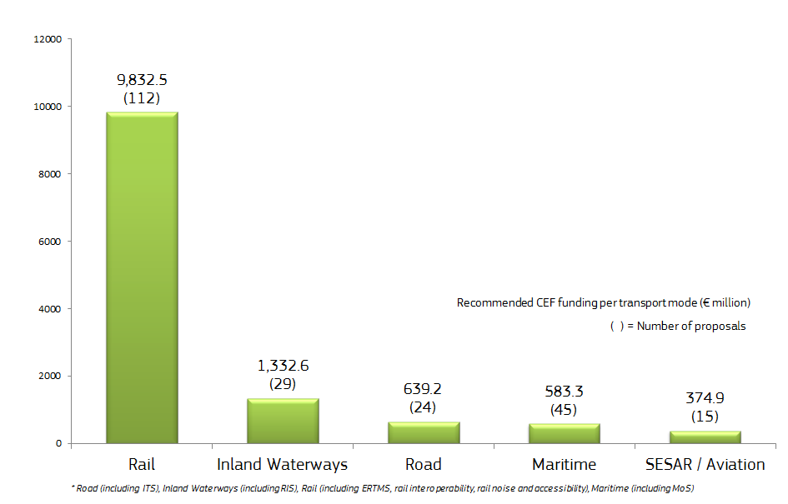
2014 CEF Call (2/3)
EU funding per transport mode

Slide 16
2014 CEF Call (3/3)
Funding per Corridors

Slide 17
Projects in Slovenia
€53.41 million awarded funding (in total)
  €38.97 million cohesion envelope (of total €160 million national allocation)
  €14.44 million general envelope
Proposal Code | Funding Objective | Corridor Name | Proposal Type | Transport Mode
2014-EU-TA-0582-S | (AP/F03) Telematic Application Systems | Comprehensive | Study | ROAD
2014-EU-TM-0032-S | (MAP/F03) Single European Sky - SESAR | Horizontal Priority | Study | CT
2014-EU-TM-0335-S | (MAP/F01) Rail interoperability | Baltic - Adriatic | Study | CRAIL
2014-EU-TM-0343-M | (MAP/F01) Pre-identified projects | Baltic - Adriatic | Study & Work | PORT
2014-EU-TM-0495-S | (MAP/F03) Single European Sky - SESAR | Horizontal Priority | Study | AIRP
2014-EU-TM-0531-S | (MAP/F03) Motorways of the Sea (MoS) | Other Sections on the Core Network* | Study | MOS
2014-EU-TM-0563-W | (MAP/F03) ITS for Road | Baltic - Adriatic | Work | ITS
2014-EU-TM-0698-M | (MAP/F03) Motorways of the Sea (MoS) | Mediterranean | Study & Work | MOS
2014-SI-TA-0357-S | (AP/F01) Projects on Comprehensive Network | Comprehensive | Study | ROAD
2014-SI-TMC-0301-M | (MAPC/F04) Pre-identified projects | Mediterranean | Study & Work | CRAIL
2014-SI-TMC-0537-W | (MAPC/F04) Pre-identified projects | Mediterranean | Work | CRAIL

Slide 18
CEF Grants – 2015 Call for proposal
Application Results

Slide 19
2015 CEF Multi-annual Work Programme
Calls for Proposals: Nov 2015 – Feb 2016
€ 7.6 billion (total budget)
  € 6.5 billion for Cohesion Member States
  € 1.1 billion under the general envelope
Focus (alignment with Juncker priorities):
  Core Network Corridors (Jobs, growth and investment)
  Traffic management systems (Digital single market)
  Innovation and new technologies (Energy Union and climate)
  Rail projects continuing priority

Slide 20
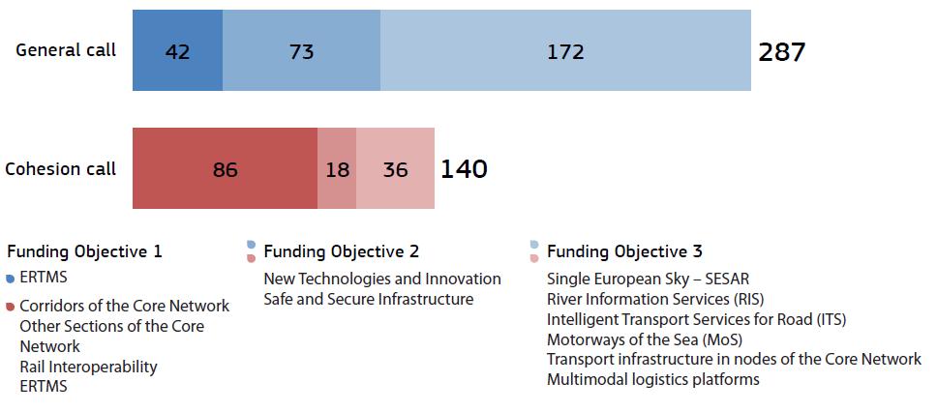
427 proposals submitted by the 16 February 2016 deadline

Slide 21
Submitted proposals per type
The proposals target advanced stages of project implementation

Slide 22
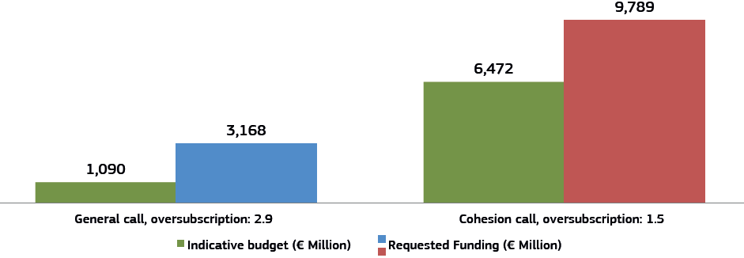
€12.96 billion requested funding
Almost twice the available budget
€9.789 billion requested from the cohesion envelope
€3.168 billion requested from the general envelope

Slide 23
Projects in Slovenia
16 proposals submitted (in total):
  5 national proposals
  11 EU proposals with Slovenian participation
€135.66 million requested EU (in total):
  €126.63 million from the CEF cohesion envelope
    (remaining Slovenian allocation is €120.261 million)
  €9.03 million from the CEF general envelope

Slide 24
Next steps for CEF 2015 calls (indicative)
External and Internal Evaluation | March 2016 – June 2016
Presentation to CEF Committee | July 2016
Adoption of Selection Decision | July/September 2016
Signature of Grant Agreements | October 2016- December 2016

Slide 25
CEF 2016 call under Cohesion envelope
The Commission reserves the possibility to launch a call in 2016 in case the total Cohesion envelope has not been fully used under the 2015 call
Indicative timetable
Publication of Call | 1 October 2016
Call deadline | 31 January 2017
Evaluation | March 2017 – April 2017
Approval Selection decision by CEF Committee | May 2017
EC adoption of Selection Decision | July 2017
Preparation and Signature of Grant Agreements | September 2017- December 2017

Slide 26
The Investment Plan for Europe

Slide 27
A focus on financial instruments….
Private investors looking for investment opportunities
  High levels of liquidity on capital markets
  Very low interest rates on sovereign bonds
  Interest in infrastructure investments
  But risks & uncertainties
European Commission & EIB want to square the circle
  Provide additional support to projects and companies by increasing the use of instruments with more risk bearing capacity

Slide 28
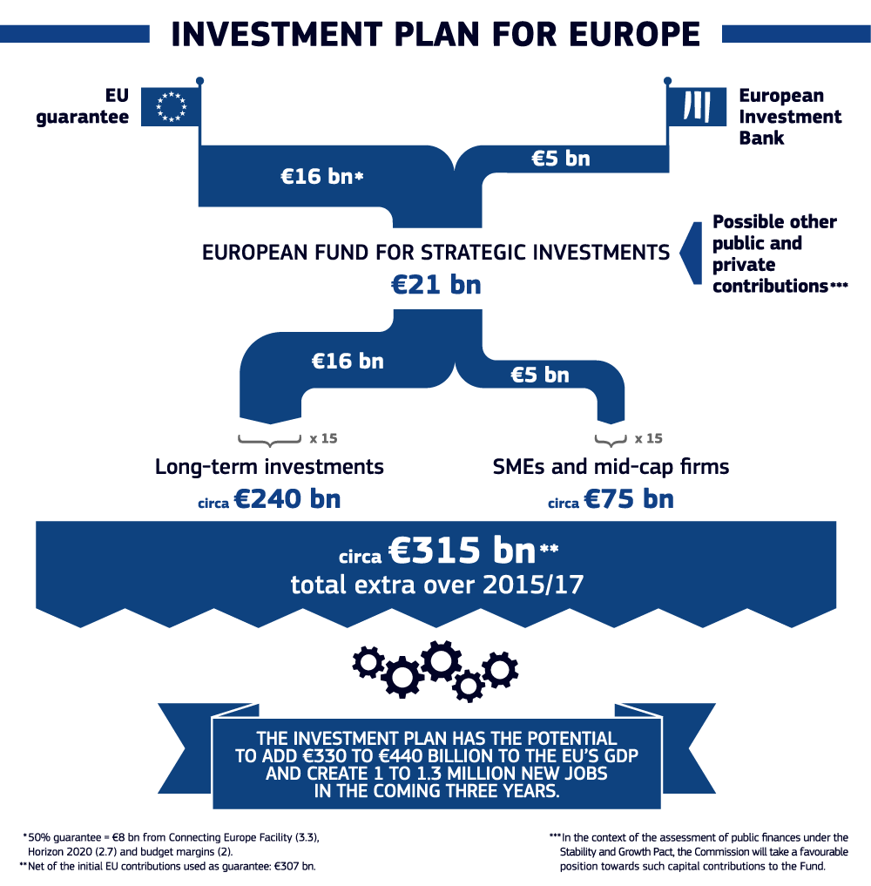
…. to magnify the impact of EU funding

Slide 29
Key features of EFSI
Focus on investments in real economy
  Results on growth and jobs
  Market-driven, no political interference
  No geographic or sector pre-allocation
Consistency with EU policies
Leverage / crowd-in private sector and third parties
Economic and technical viability
Additionality vs existing instruments
  Market failures and sub-optimal investment
  Higher risk-taking than EIB normal activity in EFSI timeframe

Slide 30
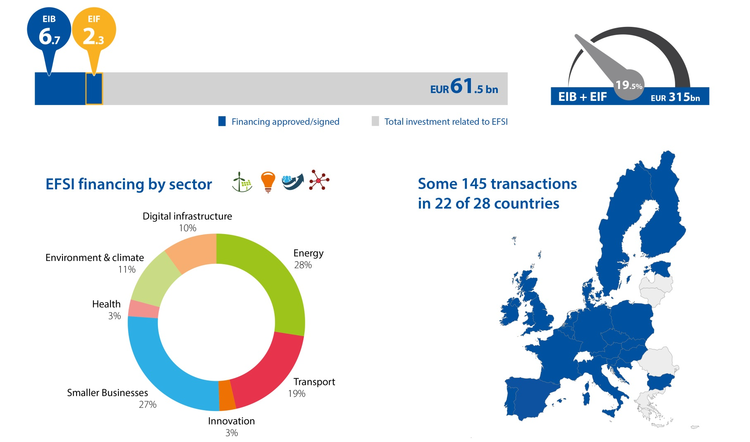
EFSI progress

Slide 31
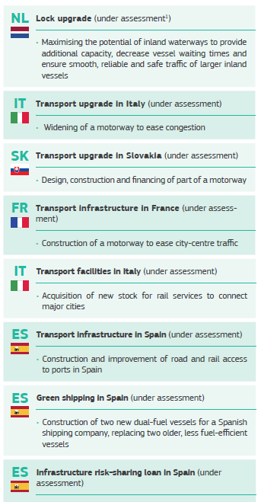
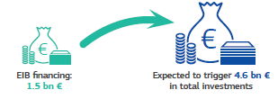
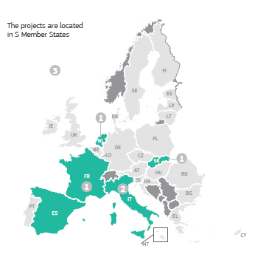
EFSI transport projects

Slide 32
EFSI in combination with other EU funds (CEF)
Blending : Standard EIB lending / ESI Funds / CEF
Connecting Europe Facility: Grants
  Budget of €22.5bn for 2014 -2020, with 11.3bn reserved for Cohesion MS
    1st call in 2014 (€13bn), 2nd call in November 2015 (€7.5bn)
Connecting Europe Facility: Financial instruments
  Up to €1.5bn available for a wide array of instruments
    Project Bonds, LGTT, possibility of other Debt or Equity instruments, dedicated investment funds for specific policies

Slide 33

EFSI in combination with other EU funds (ESIF)
ESI Funds: € 70 billion for transport (2014-2020)
Combination of ESI Funds and EFSI is possible either at individual project or at financial instrument level (e.g. in an investment platform)
New Guidelines on combining European Structural and Investment Funds with the EFSI published on 22.2.2016
http://ec.europa.eu/regional_policy/en/newsroom/news/2016/02/22-02-2016-investment-plan-for-europe-new-guidelines-on-combining-european-structural-and-investment-funds-with-the-efsi

Slide 34
European Investment Advisory Hub
Project promoters
Public authorities
Member States
Private sector
Web content + Web portal + Help Desk team
European Investment Advisory Hub (EIAH)
www.eib.org/eiah/
EIB’s existing advisory programmes and activities
Additional advisory and technical assistance
EIAH’s partner institutions’ expertise
34
Notes:
Managed by EIB in partnership with EC

Slide 35
European Investment Project Portal www.ec.europa.eu/eipp
What can the European Investment Project Portal (EIPP) do for you?
  Registration on the EIPP will boost the visibility of your project
  Opportunity to find investors from all over the world looking for investment opportunities in Europe
  Access to a large network of investors, consultants and advisory services that can help you to structure it and finance it
Is my project eligible for the European Investment Project Portal?
In order to qualify, projects must be:
  Worth at least € 10 million
  Expected to start within three years of their submission to EIPP
  Promoted by a public or private legal entity established in an EU Member State
  Compatible with applicable EU and national laws
  Publication of a project can be denied on legal, reputational or other grounds.

Slide 36
Thank you for your attention!
European Commission – Mobility and Transport http://ec.europa.eu/transport/themes/infrastructure/ten-t-guidelines/index_en.htm
INEA - Calls for proposals http://inea.ec.europa.eu/en/cef/cef_transport/apply_for_funding/cef_transport_call_for_proposals_2014.htm

